Slide 1


Team Details
Team name:
Team leader name:
Problem Statement: Smart Resource Allocation

Slide 2
Brief:
VolunteerMatch is a Next.js application designed to revolutionize volunteer coordination for NGOs. It addresses the challenge of fragmented community needs data by providing a centralized system to gather information and intelligently match volunteers to urgent tasks using Gemini AI. Users input volunteer profiles and task descriptions, receiving a comprehensive match score, detailed reasoning, and actionable recommendations. The platform features a professional, glassmorphism UI with a warm green and earthy orange palette, ensuring an intuitive and engaging user experience.

Slide 3
Opportunities:
• Differentiation
• Real-time, AI-driven volunteer-to-task matching with granular feedback including skill alignment, identified gaps, and onboarding recommendations.
• Centralized data platform for community needs assessment, transforming scattered information into actionable insights for strategic volunteer deployment.
• Distinctive and intuitive Glassmorphism UI, providing a modern, engaging user experience that stands apart from traditional utilitarian NGO tools.
• Problem Solving Approach
• Data Consolidation: Aggregates disparate community needs data from various sources into a unified digital system for clear problem identification.
• AI-Powered Matching: Utilizes Gemini AI to analyze volunteer profiles (skills, availability, location, languages, experience) against detailed community task descriptions to generate precise match scores.
• Actionable Insights: Delivers not only a match score but also a detailed breakdown of compatibility, potential gaps, and clear recommendations to facilitate effective volunteer integration.
• USP
• The only platform that combines intelligent Gemini AI-powered matching of volunteers to urgent community needs with a visually stunning and intuitive Glassmorphism interface, transforming raw data into impactful action.

Slide 4
Features:
• Comprehensive input form for volunteer profiles and community task descriptions.
• AI-generated match score (0-100%) with detailed reasoning and skill alignment breakdown.
• Identification of potential skill or availability gaps and actionable suggestions for bridging them.
• Customized onboarding recommendations for successfully matched volunteers.
• Dynamic loading states and robust error handling for a seamless user experience.
• Fully responsive, professional Glassmorphism UI with a warm green and earthy orange palette.
• Secure, server-side Gemini API integration for intelligent matching operations.

Slide 5
Technologies:
• Next.js 16 (App Router)
• TypeScript
• Tailwind CSS + Custom CSS (Glassmorphism styling)
• lucide-react (Icons)
• Google Fonts (`@import`)
• Gemini API (`gemini-2.5-flash`)

Slide 6
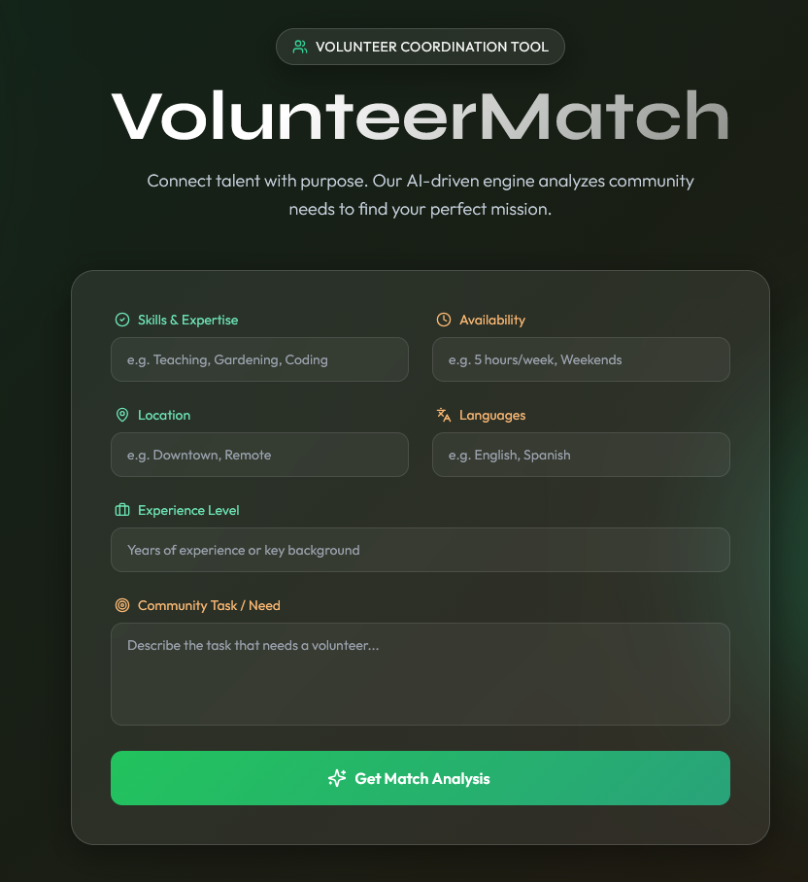
Snapshots of the MVP

Slide 7
Links:
GitHub Public Repository
Working Prototype Link: https://volunteermatch.vercel.app/

Slide 8


