Slide 1


Team Details
Team name:
Team leader name:
Problem Statement: Smart Resource Allocation

Slide 2
Brief:
TaskForge is a Next.js application designed to optimize volunteer coordination for NGOs. It addresses the challenge of scattered community data by using Gemini AI to transform high-level problem descriptions into structured, assignable volunteer task breakdowns. This system ensures efficient resource allocation by clearly defining urgent tasks, matching volunteer skills, and enabling focused social impact.

Slide 3
Opportunities:
• Differentiation
• TaskForge distinguishes itself by leveraging Gemini AI to automatically decompose vague community problems into highly specific, assignable, and detailed volunteer tasks, moving beyond generic volunteer registration to intelligent task orchestration.
• Problem Solving Approach
• The approach combines data centralization for community needs assessment with an AI-first strategy for dynamic task generation. This ensures that volunteer efforts are always directed towards well-defined, impactful actions, maximizing resource utility and social impact.
• USP
• TaskForge's unique selling proposition is its ability to auto-generate a comprehensive, structured volunteer task breakdown—including deliverables, required skills, time estimates, and dependencies—from a simple community problem description.

Slide 4
Features:
• Intuitive input form for community problem details (description, volunteer count, timeframe, location, resources).
• AI-powered decomposition of vague community problems into 6-8 specific, assignable tasks.
• Structured output displaying task name, clear deliverable, required skills, time estimate, volunteer count, dependencies, and success criteria.
• Production-ready Next.js 16 application featuring a distinct flat design UI with strong color contrast.
• Responsive layout with clear loading and error state handling.

Slide 5
Technologies:
• Frontend: Next.js 16 (App Router), TypeScript, Tailwind CSS
• Styling: Custom CSS variables, lucide-react for flat icons
• AI Integration: Google Gemini-2.5-flash API
• Build: next build --no-turbo

Slide 6
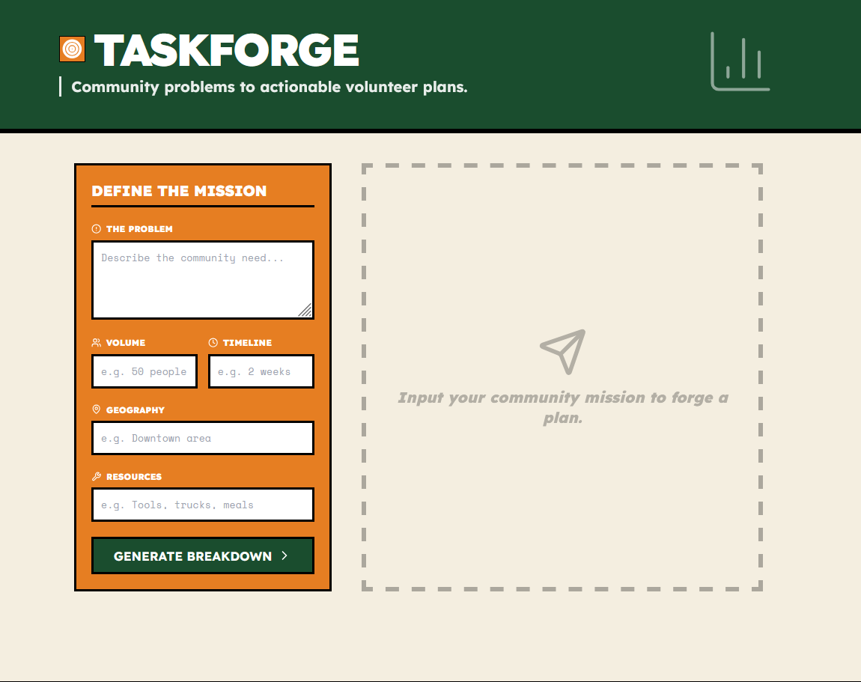
Snapshots of the MVP

Slide 7
Links:
GitHub Public Repository
Working Prototype Link: https://taskforge-sc.vercel.app/

Slide 8


