Slide 1


Team Details
Team name:
Team leader name:
Problem Statement: Smart Resource Allocation

Slide 2
Brief:
ImpactPulse is a Next.js 16 MVP designed to transform scattered volunteer activity data into actionable insights for NGOs. It features a minimalist UI for easy input of volunteer hours, tasks, and served community members, leveraging Gemini AI to generate compelling impact narrative reports. The system visualizes data to highlight urgent community needs and optimize volunteer resource allocation for social impact.

Slide 3
Opportunities:
• Differentiation
• Leverages Gemini AI for sophisticated data transformation into human-centered impact narratives, going beyond simple data aggregation. Offers a strictly minimalist UI focused on clarity and ease of use, reducing user cognitive load.
• Problem Solving Approach
• The solution tackles the problem of scattered social impact data by providing a centralized input mechanism. It then uses AI to synthesize this data into digestible, compelling reports that inform decision-making and donor engagement.
• USP
• Smart Resource Allocation: Converts raw volunteer logs into strategic insights, enabling better understanding of community needs and more efficient volunteer deployment.
• AI-Powered Narrative Generation: Creates human-centered impact stories, making data accessible and persuasive for diverse stakeholders.
• Minimalist UI: Ensures ease of data entry and clear presentation of results, adhering to a strict design philosophy for maximum focus.

Slide 4
Features:
• Intuitive data input form for volunteer activities.
• AI-generated impact summary reports including narratives, key metrics, and efficiency scores.
• Loading state for analysis requests.
• Clean, typographic display of generated reports.
• Responsive, minimalist user interface.
• Error handling for API calls and data processing.

Slide 5
Technologies:
• Next.js 16 (App Router)
• TypeScript
• Tailwind CSS
• Gemini 2.5-flash API
• Lucide-react for icons (minimal usage)

Slide 6
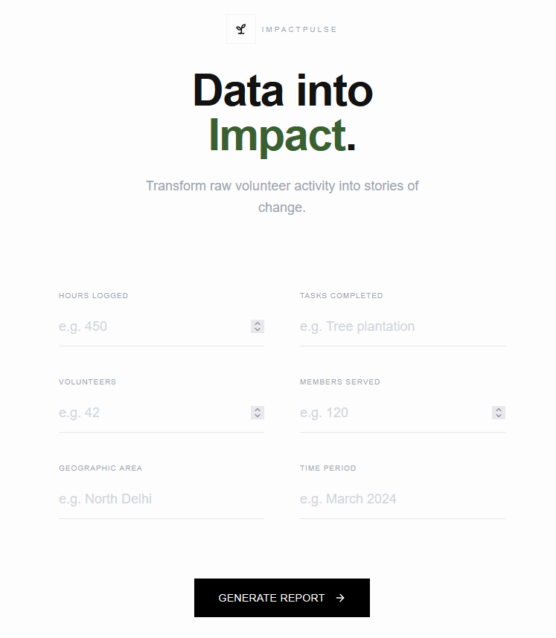
Snapshots of the MVP

Slide 7
Links:
GitHub Public Repository
Working Prototype Link: https://impactpulse.vercel.app/

Slide 8


