Slide 1


Team Details
Team name:
Team leader name:
Problem Statement: Smart Resource Allocation

Slide 2
Brief:
This solution provides "FieldDebrief," a Next.js 16 web application designed for NGOs and social groups. It transforms unstructured, plain-language volunteer field reports into structured, actionable NGO documentation. The system automatically processes these reports, extracting key information like activities, beneficiaries, issues, and follow-up needs, making community needs more visible and enabling smarter volunteer coordination.

Slide 3
Opportunities:
• Differentiation
• AI-powered natural language processing for report structuring.
• Seamless integration of field data into NGO operational workflows.
• Focus on immediate actionable insights for volunteer deployment.
• Problem Solving Approach
• The system addresses the challenge of scattered and unstructured community data by providing a single, automated pipeline for processing field reports. This ensures that valuable insights are captured, organized, and readily available for decision-making.
• USP
• "Submit your field report in plain language — get it structured for NGO records automatically."

Slide 4
Features:
• Plain-language field report submission form.
• AI-driven conversion of unstructured text to structured NGO report format.
• Automatic extraction of key data points: Date/Location, Activities, Beneficiaries, Issues, Follow-up.
• Urgent issue flagging and identification of missing critical information.
• Professional, clean, and responsive web UI for enhanced user experience.
• Loading and error state handling.

Slide 5
Technologies:
• Next.js 16 (App Router)
• TypeScript
• Tailwind CSS
• Gemini API (via serverless route)
• lucide-react for icons
• Google Fonts for professional typography

Slide 6
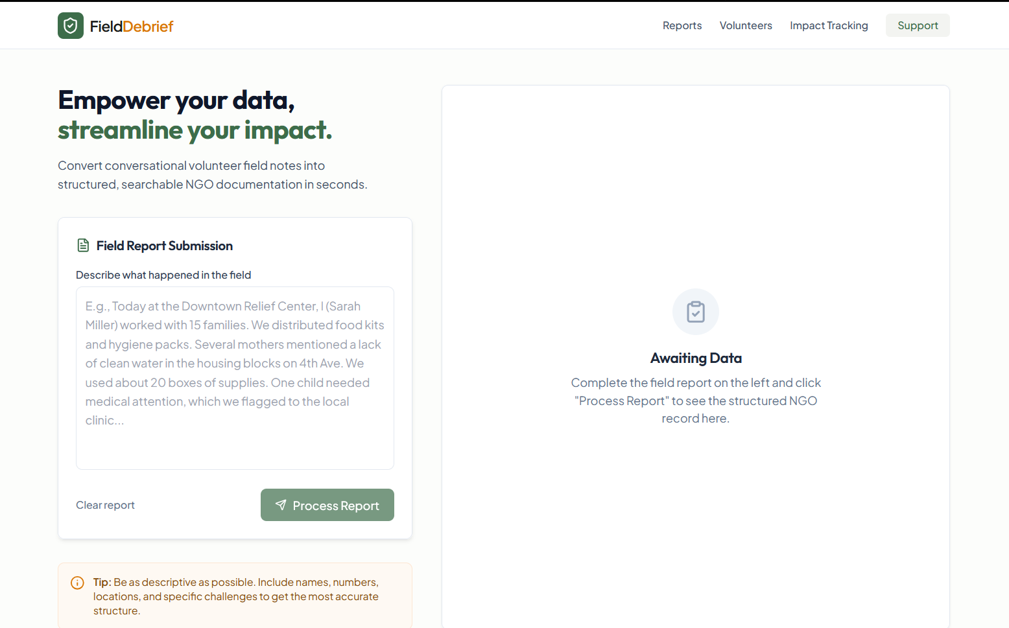
Snapshots of the MVP

Slide 7
Links:
GitHub Public Repository
Working Prototype Link: https://fielddebrief.vercel.app/

Slide 8


