Slide 1


Team Details
Team name:
Team leader name:
Problem Statement: Smart Resource Allocation

Slide 2
Brief:
This solution provides a Next.js 16 web application for UrgencyRank, a tool designed to analyze and prioritize community needs based on user-provided data. It uses Gemini AI to process freeform community needs, available volunteer counts, budget, and timeframes, outputting a ranked list of needs with urgency scores, resource allocation recommendations, and a deployment strategy. The application features a distinctive Glass UI style with dark themes and neon accents, prioritizing a professional and polished user experience.

Slide 3
Opportunities:
• Differentiation
• Unlike traditional methods of manual prioritization, UrgencyRank leverages AI to dynamically assess and rank community needs based on multiple input factors, providing a data-driven, objective prioritization.
• Problem Solving Approach
• The system collects qualitative and quantitative data on community needs and available resources. It then utilizes the Gemini API to reason across these inputs, simulating a strategic planning process to generate a prioritized, actionable deployment strategy.
• USP
• AI-powered, dynamic urgency ranking and resource allocation for maximum social impact, delivered through a premium, intuitive Glass UI.

Slide 4
Features:
• Input multiple community needs with associated resource constraints (volunteer count, budget, timeframe).
• AI-driven prioritization of needs with urgency scores.
• Recommended volunteer and budget allocation per need.
• Comprehensive 1-week deployment strategy.
• Professional, high-fidelity Glass UI with dark theme and vibrant accent colors.
• Real-time loading and error state handling.
• Responsive design for desktop and mobile.

Slide 5
Technologies:
• Framework: Next.js 16 (App Router)
• Language: TypeScript
• Styling: Tailwind CSS, custom CSS variables
• Icons: Lucide React
• AI Integration: Gemini API (`gemini-2.5-flash`)
• Deployment: Serverless functions (Next.js API Routes)

Slide 6
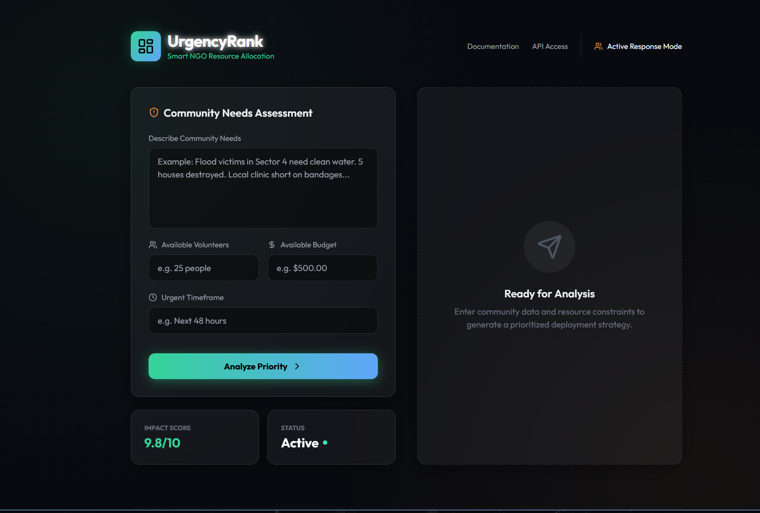
Snapshots of the MVP

Slide 7
Links:
GitHub Public Repository
Working Prototype Link: https://urgencyrank.vercel.app/

Slide 8


