Slide 1


Team Details
Team name:
Team leader name:
Problem Statement: Unbiased AI Decision

Slide 2
Brief:
• PromptBias is a web application that empowers users to identify and rectify bias embedded within AI prompts. It utilizes a distinctive Brutalist UI and the Gemini API to analyze prompts for discriminatory patterns, offering actionable insights and revised, bias-reduced versions.

Slide 3
Opportunities:
• Differentiation: Unique Brutalist UI commands attention and conveys a sense of urgent truth-telling. Focus on prompt-level bias detection as a distinct offering.
• Problem Solving Approach: Directly addresses the amplification of historical biases by AI systems at the point of prompt creation. Provides a tangible, user-friendly tool for proactive bias mitigation.
• USP: Real-time, detailed bias analysis of AI prompts with AI-driven rewritten suggestions, presented through a bold, unforgettable interface.

Slide 4
Features:
• Prominent "PromptBias" title and tagline.
• Brutalist-styled input form for AI prompts.
• Real-time loading state for submit button.
• Gemini-powered bias analysis: types, affected groups, severity.
• Rewritten, bias-reduced prompt suggestions.
• Clear visual hierarchy for displaying analysis results.
• User-friendly error handling.
• Fully responsive design across devices.

Slide 5
Technologies:
• Next.js 16 (App Router)
• TypeScript
• Tailwind CSS (with custom CSS variables)
• Gemini API (gemini-2.5-flash)
• Lucide React for icons

Slide 6
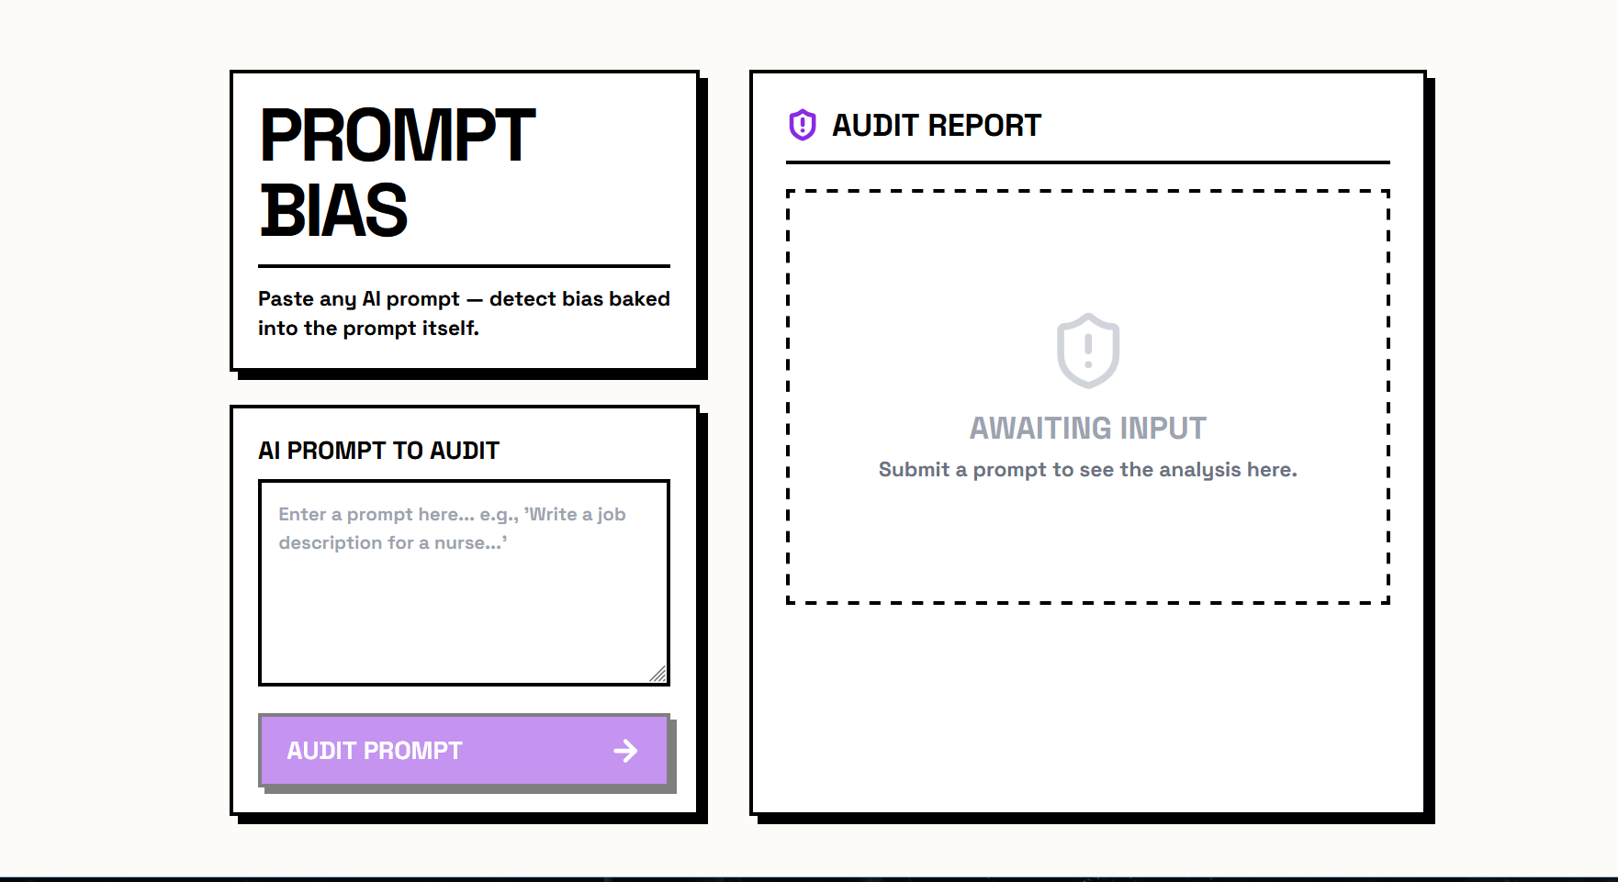
Snapshots of the MVP:

Slide 7
Links:
GitHub Public Repository:
Working Prototype Link: https://promptbias-sc.vercel.app/

Slide 8


