Slide 1


Team Details
Team name:
Team leader name:
Problem Statement: Unbiased AI Decision

Slide 2
Brief:
• A tool to identify and correct discriminatory language in job descriptions, promoting inclusive hiring practices and algorithmic fairness.

Slide 3
Opportunities:
• Differentiation: Focus on proactive bias detection and remediation for hiring.
• Problem Solving Approach: Uses AI to analyze text, explain bias mechanisms, and offer solutions.
• USP: Combines an intuitive neomorphic UI with powerful AI for accessible fairness in recruitment.

Slide 4
Features:
• Job Description Analysis: Identifies and flags discriminatory phrases.
• Bias Explanation: Details disadvantaged groups and the nature of the bias.
• Severity Rating: Assigns HIGH/MEDIUM/LOW severity to flagged phrases.
• Inclusive Rewrite: Generates a fully inclusive job description.
• Neomorphic UI: Soft, extruded design with dual shadows for a modern aesthetic.
• Responsive Design: Optimized for both mobile and desktop viewing.
• Loading & Error States: Clear visual feedback during processing and for any errors.

Slide 5
Technologies:
• Frontend: Next.js 16, React, TypeScript, Tailwind CSS
• Icons: Lucide-react
• AI Integration: Gemini API (`gemini-2.5-flash`)
• Styling: Custom CSS Variables, Google Fonts (Poppins)

Slide 6
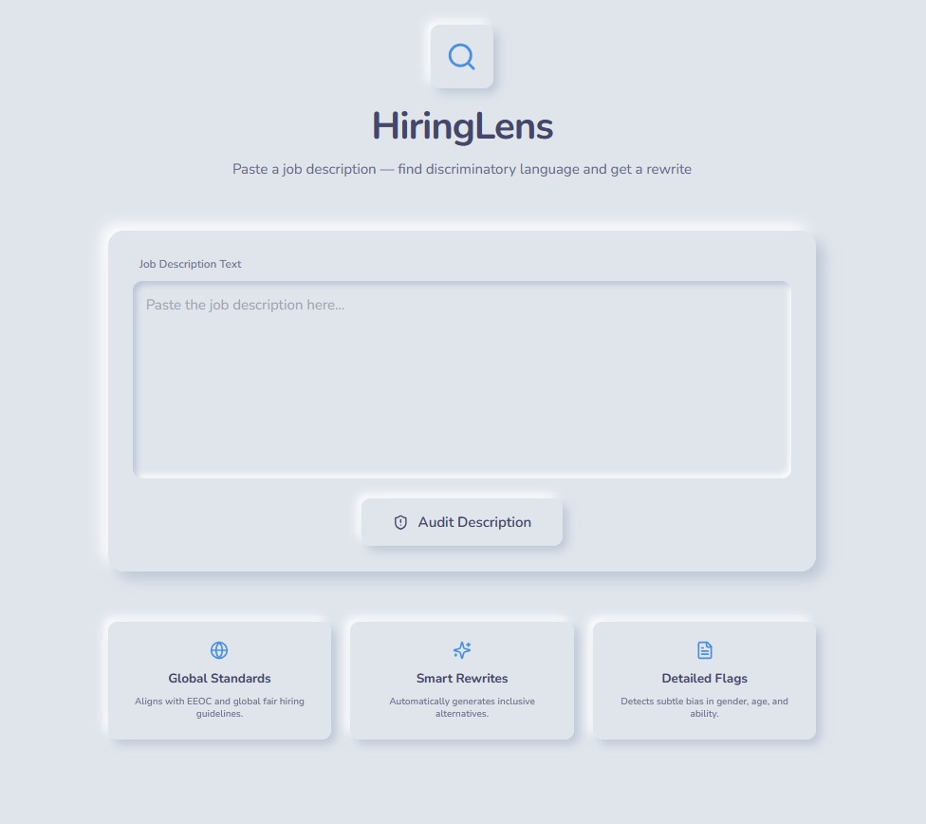
Snapshots of the MVP:

Slide 7
Links:
GitHub Public Repository:
Working Prototype Link: https://hiringlens-sc.vercel.app/

Slide 8


