Slide 1


Team Details
Team name:
Team leader name:
Problem Statement: Unbiased AI Decision

Slide 2
Brief:
• ModelCard is a web application that enables users to automatically generate bias-aware documentation for their AI models. It emphasizes ethical AI by identifying and addressing potential biases within models and their training data, providing a structured and visually engaging user experience.

Slide 3
Opportunities:
• Differentiation: Offers a specialized tool for AI ethics and documentation, combining advanced AI with a premium UI.
• Problem Solving Approach: Addresses the critical need for transparency and fairness in AI by providing a clear framework for identifying and mitigating bias.
• USP: Seamless integration of AI-driven content generation with a sophisticated, visually immersive Aurora UI, focusing on bias detection and ethical model deployment.

Slide 4
Features:
• AI Model Card Generation: Automatically creates detailed model cards using Gemini API.
• Bias-Aware Documentation: Includes dedicated sections for bias risks, recommended mitigations, and fairness checklists.
• Immersive Aurora UI: Features a dark, gradient-rich interface with animated ethereal elements.
• Interactive Input Form: User-friendly form for model purpose, data, and usage details.
• Loading and Error States: Visually distinct loading indicators and user-friendly error handling.
• Responsive Design: Optimized for both desktop and mobile viewing.
• Client-side Data Fetching: Asynchronous API calls for a smooth user experience.

Slide 5
Technologies:
• Frontend: Next.js 16, TypeScript, Tailwind CSS, React
• Backend/API: Next.js API Routes, Gemini API (`gemini-2.5-flash`)
• Icons: Lucide React
• Styling: Custom CSS variables, Google Fonts (e.g., Plus Jakarta Sans)
• Deployment: Next.js build (`next build --no-turbo`)
• Node.js: 24.x
• API Integration: Server-side Gemini API calls, client-side fetching from custom API route.

Slide 6
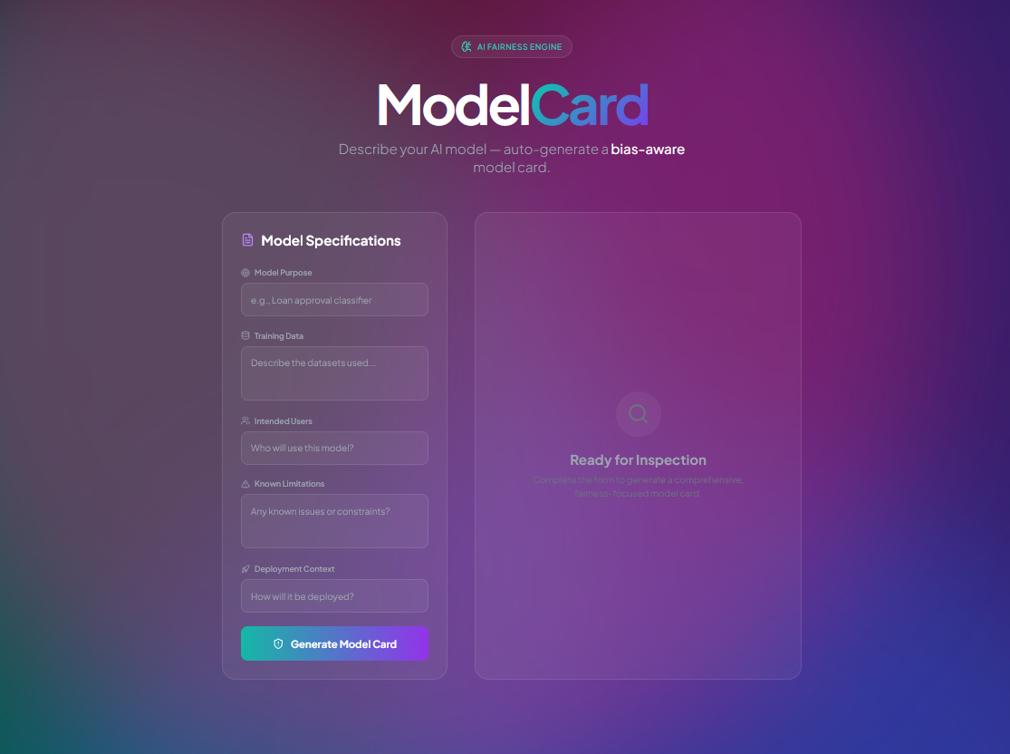
Snapshots of the MVP:

Slide 7
Links:
GitHub Public Repository:
Working Prototype Link: https://modelcard-sc.vercel.app/

Slide 8


