Slide 1


Team Details
Team name:
Team leader name:
Problem Statement: Unbiased AI Decision

Slide 2
Brief:
• CounterfactualAI is a web-based tool that leverages AI to identify and flag discriminatory bias in automated decision-making systems. It provides organizations with actionable counterfactual test cases to ensure fairness and accountability.

Slide 3
Opportunities:
• Differentiation: Unique terminal/hacker UI, specialized focus on counterfactual fairness testing.
• Problem Solving Approach: Systematically isolates demographic variables to reveal hidden biases.
• USP: Generates specific, testable scenarios for algorithmic accountability, promoting ethical AI.

Slide 4
Features:
• Interactive terminal-like UI for inputting decision details.
• AI-powered generation of 5 counterfactual fairness test cases.
• Clear display of expected fair outcomes and potential bias flags.
• Loading and error states for enhanced user experience.
• Fully responsive design for accessibility across devices.

Slide 5
Technologies:
• Next.js 16 (App Router)
• TypeScript
• Tailwind CSS
• Gemini API (gemini-2.5-flash)
• Lucide React for icons
• Constraints:
• Monospace fonts only.
• Restricted color palette (black, greens, white, cyan).
• No external npm packages beyond core dependencies.
• Strict adherence to UI style guide.

Slide 6
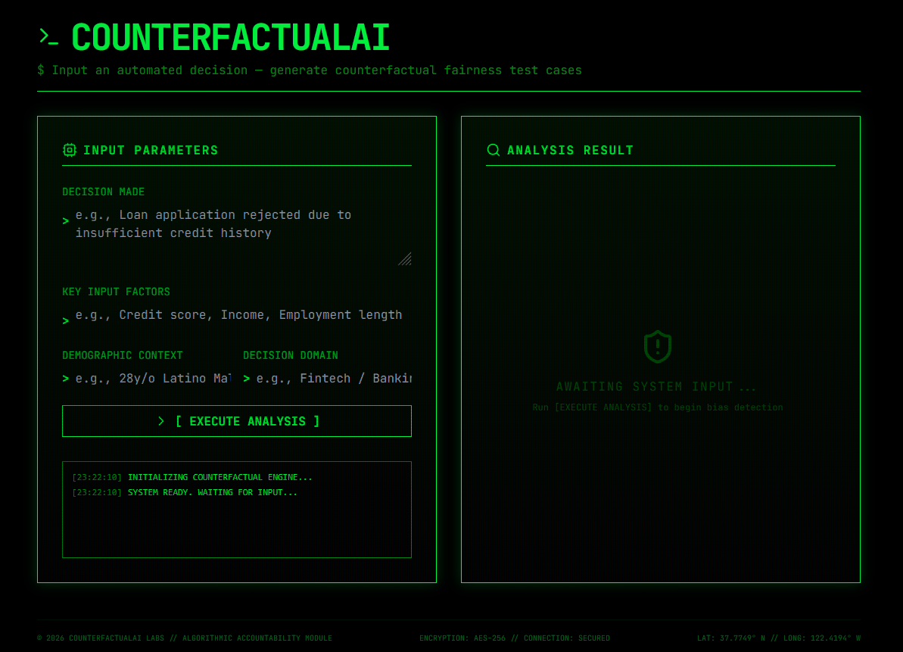
Snapshots of the MVP:

Slide 7
Links:
GitHub Public Repository:
Working Prototype Link: https://counterfactualai-sc.vercel.app/

Slide 8


