Slide 1


Team Details
Team name:
Team leader name:
Problem Statement: Unbiased AI Decision

Slide 2
Brief:
• RedTeamAI is a web application that helps identify and mitigate bias in AI systems. It generates adversarial attack scenarios based on user-provided AI system details, making bias detection accessible and actionable for organizations.

Slide 3
Opportunities:
• Differentiation: Offers a unique blend of a playful, claymorphic UI with serious AI fairness capabilities, making bias detection approachable.
• Problem Solving Approach: Proactively identifies AI vulnerabilities through structured red-teaming scenarios, preventing real-world discriminatory outcomes.
• USP: Combines advanced AI for scenario generation with an intuitive, engaging user interface for easy adoption and effective bias mitigation.

Slide 4
Features:
• AI System Input: Form to describe AI purpose, inputs, decisions, and user population.
• Adversarial Scenario Generation: Creates 10 detailed bias attack scenarios using Gemini AI.
• Scenario Breakdown: Each scenario includes attack method, target vulnerability, expected biased output, and detection strategy.
• Claymorphism UI: Soft, inflated, 3D-like shapes with pastel colors and rounded elements for an approachable aesthetic.
• Loading & Error Handling: Visual feedback for submission processing and user-friendly error messages.
• Responsive Design: Fully functional and visually appealing across mobile and desktop devices.
• AI Fairness Focus: Dedicated to identifying and flagging unfair discrimination in AI models.

Slide 5
Technologies:
• Frontend: Next.js 16, React, TypeScript, Tailwind CSS
• Icons: Lucide React
• AI Integration: Gemini API (gemini-2.5-flash) via server-side route
• Styling: Claymorphism UI principles, custom CSS variables
• Constraints:
• No markdown like bold or headers
• No code
• Clean bullet points only
• Keep concise

Slide 6
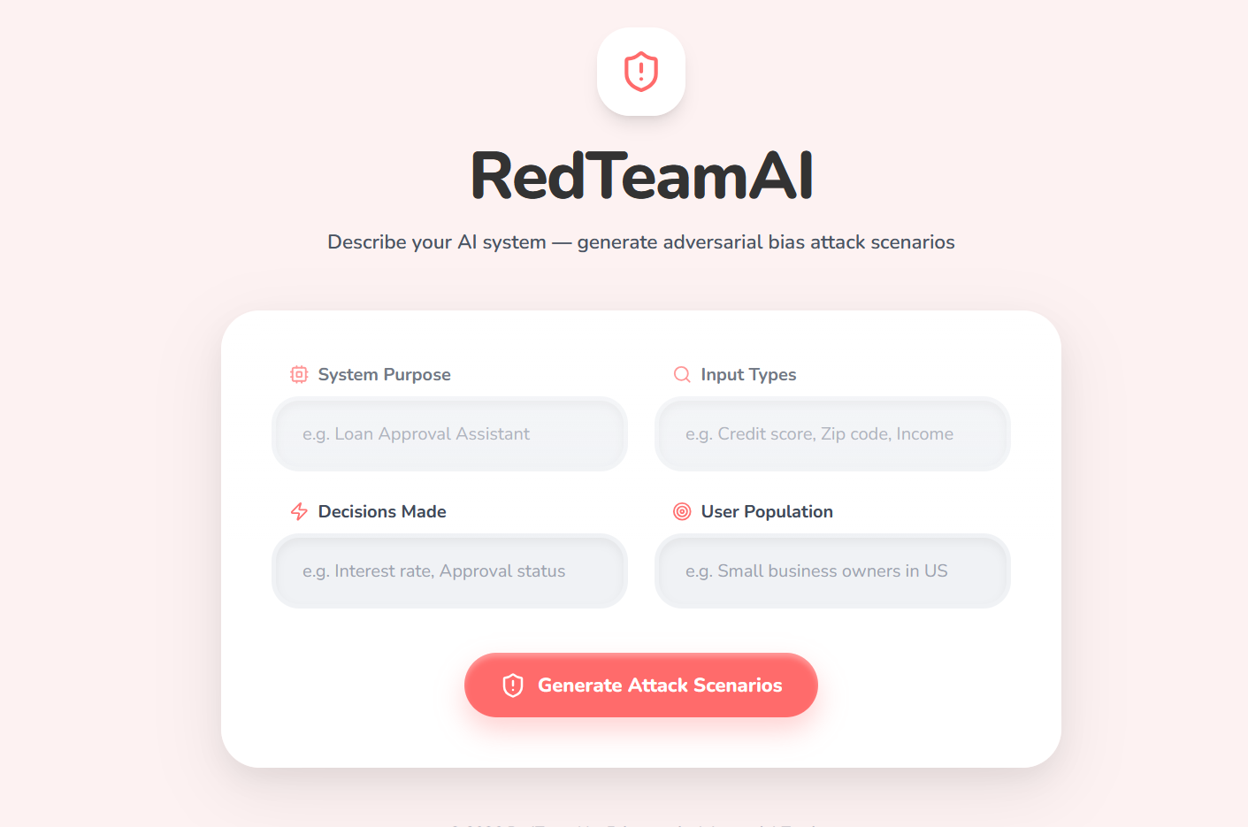
Snapshots of the MVP:

Slide 7
Links:
GitHub Public Repository:
Working Prototype Link: https://redteamai-sc.vercel.app/

Slide 8


