Slide 1


Team Details
Team name:
Team leader name:
Problem Statement: Rapid Crisis Response

Slide 2
Brief:
• PanicTranslate provides an immediate, structured response to guest emergencies by converting panicked messages into calm, actionable reports for responders, ensuring critical information is conveyed rapidly and clearly.

Slide 3
Opportunities:
• Differentiation: Provides a specialized, AI-driven solution for a critical hospitality need.
• Problem Solving Approach: Leverages AI for rapid information extraction and communication streamlining during high-stress events.
• USP: Instantaneous conversion of chaotic guest distress into organized, life-saving intelligence with a striking, unignorable UI.

Slide 4
Features:
• AI-powered message triage
• Structured emergency fact extraction (incident type, location, people affected, severity, needs)
• Calm responder briefing generation
• Brutalist UI for maximum impact and clarity
• Responsive design for all devices
• Client-side API interaction with server-side Gemini processing
• Loading and error state handling

Slide 5
Technologies:
• Next.js 16 (App Router, TypeScript)
• Tailwind CSS
• Lucide React for icons
• Gemini API (gemini-2.5-flash)
• Constraints:
• No markdown like or ##
• No code
• Clean bullet points only
• Keep concise

Slide 6
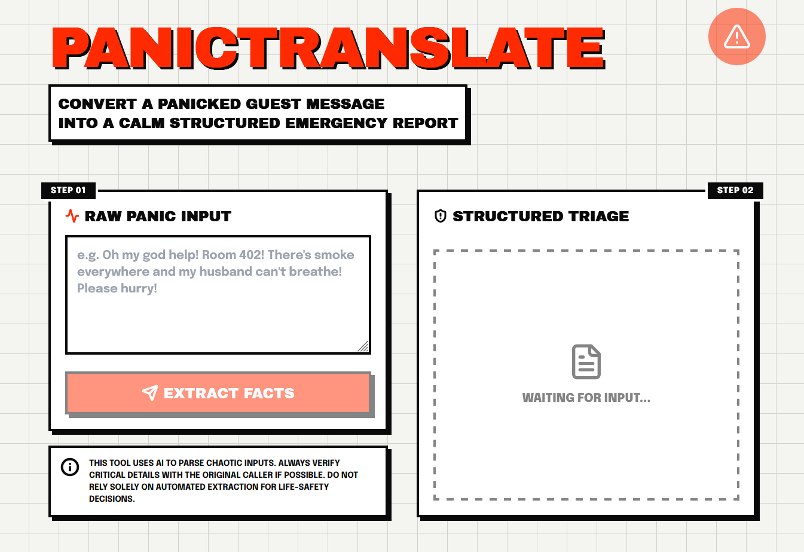
Snapshots of the MVP:

Slide 7
Links:
GitHub Public Repository:
Working Prototype Link: https://panictranslate-sc.vercel.app/

Slide 8


