Slide 1


Team Details
Team name:
Team leader name:
Problem Statement: Rapid Crisis Response

Slide 2
Brief:
• StaffPulse provides instant, synthesized crisis response coordination for hospitality venues, bridging communication gaps between staff and emergency services.

Slide 3
Opportunities:
• Differentiation: Real-time, AI-powered synthesis of fragmented crisis communications.
• Problem Solving Approach: Centralizes critical incident information, enabling rapid, informed decision-making.
• USP: Live team status synthesis and AI-driven redeployment recommendations for optimized crisis management.

Slide 4
Features:
• Real-time Staff Check-in Forms
• AI-powered Crisis Situation Synthesis
• Visual Team Status Map
• Zone Coverage Assessment
• Identification of Coverage Gaps
• Redeployment Recommendations
• Loading and Error State Handling
• Responsive Neomorphism UI

Slide 5
Technologies:
• Next.js 16
• React
• TypeScript
• Tailwind CSS
• Gemini API
• Lucide React Icons

Slide 6
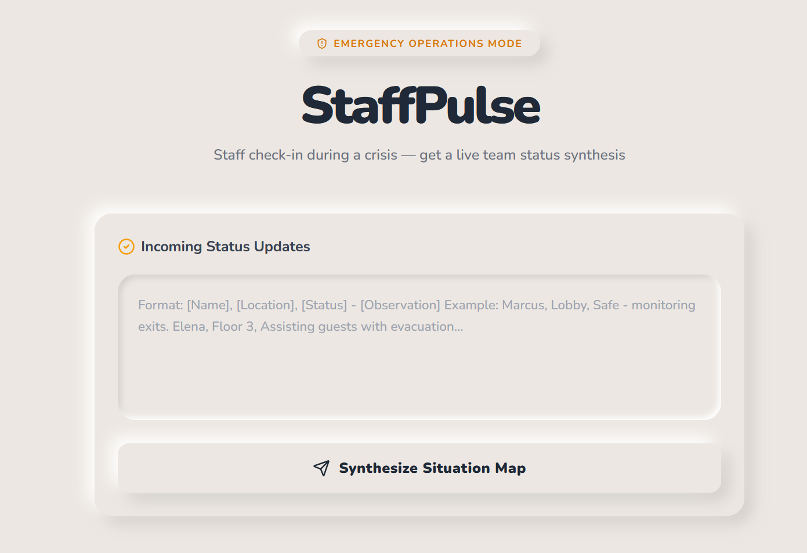
Snapshots of the MVP:

Slide 7
Links:
GitHub Public Repository:
Working Prototype Link: https://staffpulse-sc.vercel.app/

Slide 8


