Slide 1


Team Details
Team name:
Team leader name:
Problem Statement: Rapid Crisis Response

Slide 2
Brief:
• GuestSOS offers instant, clear, and calming emergency guidance for guests in hospitality venues, directly addressing safety concerns during crises with plain language instructions generated by AI.

Slide 3
Opportunities:
• Differentiation: Real-time AI-powered safety instructions in a crisis, delivered with a calming, premium UI.
• Problem Solving Approach: Centralizes critical information, reduces panic through clear directives, and facilitates rapid response.
• USP: Panic-reducing, simple, actionable safety advice tailored to emergencies, integrated into a visually striking and user-friendly interface.

Slide 4
Features:
• Crisis Reporting Form: Intuitive input for emergency type, location, people affected, and immediate dangers.
• AI-Generated Safety Instructions: Clear, numbered steps and "don'ts" provided by Gemini.
• Reassuring Closures: Ends AI responses with calming affirmations.
• Loading States: Visually distinct loading indicators during AI response generation.
• Error Handling: User-friendly messages for failed requests.
• Responsive Design: Optimized for all devices.
• Aurora UI Style: Dark immersive theme with gradient orbs and glassmorphism.

Slide 5
Technologies:
• Next.js 16 (App Router)
• TypeScript
• Tailwind CSS
• Gemini API (gemini-2.5-flash)
• Lucide-react for icons

Slide 6
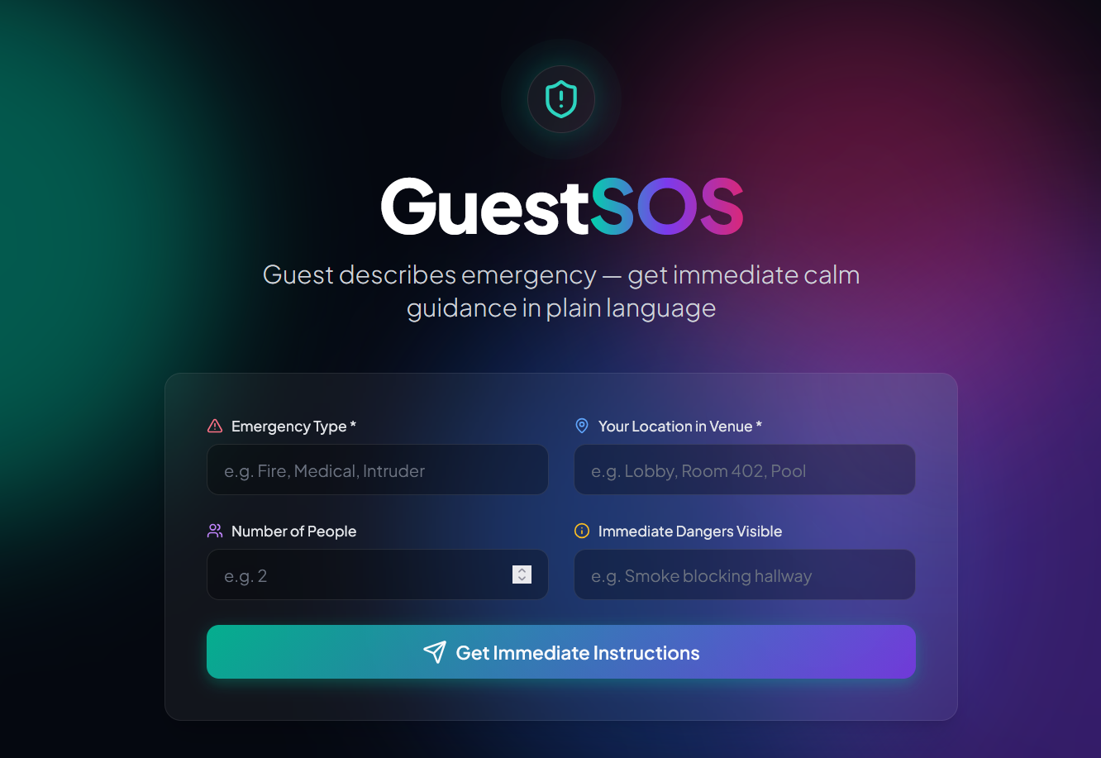
Snapshots of the MVP:

Slide 7
Links:
GitHub Public Repository:
Working Prototype Link: https://guestsos-sc.vercel.app/

Slide 8


