Slide 1


Team Details
Team name:
Team leader name:
Problem Statement: Rapid Crisis Response

Slide 2
Brief:
• CrisisScript offers an instant, AI-powered solution for hospitality venues to generate essential crisis communication scripts. It bridges the gap between emergency detection and coordinated response by providing clear, channel-specific messaging for guests, staff, and public announcements, all within a retro-hacker terminal aesthetic.

Slide 3
Opportunities:
• Differentiation: Unique retro terminal UI combined with critical AI-driven communication tools.
• Problem Solving Approach: Addresses fragmented communication during emergencies by centralizing script generation.
• USP: Instantaneous, tailored crisis script generation (PA, Staff, Social Media) with a distinct, memorable user interface.

Slide 4
Features:
• Intuitive Terminal-Style Input Form
• AI-Powered Script Generation (PA, Staff Briefing, Social Media)
• Loading & Error State Handling
• Responsive Design for all Devices
• Prominent Branding & Tagline Display

Slide 5
Technologies:
• Next.js 16 (App Router)
• TypeScript
• Tailwind CSS
• Gemini API (Gemini-2.5-Flash)
• Lucide-React Icons
• Google Fonts (Monospace)

Slide 6
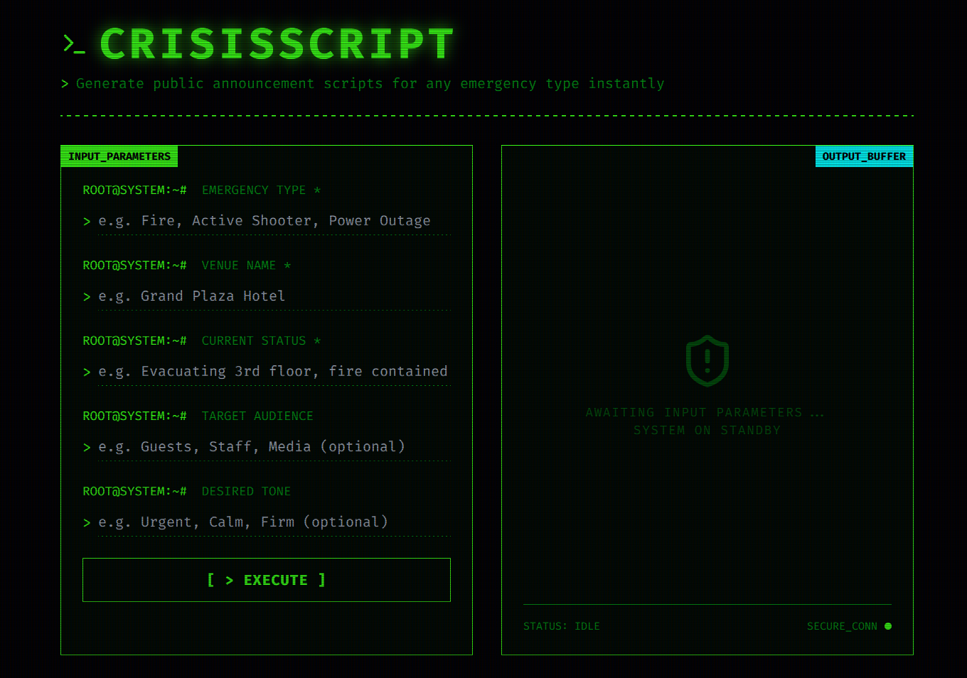
Snapshots of the MVP:

Slide 7
Links:
GitHub Public Repository:
Working Prototype Link: https://crisisscript-sc.vercel.app/

Slide 8


