Slide 1


Team Details
Team name:
Team leader name:
Problem Statement: Rapid Crisis Response

Slide 2
Brief:
• PostMortemPro is a web application that streamlines hospitality crisis response by automatically generating detailed incident post-mortem reports. It acts as a central hub for incident information, transforming raw input into actionable insights for future prevention.

Slide 3
Opportunities:
• Differentiation: Specializes in the hospitality sector's unique emergency needs.
• Problem Solving Approach: Automates the complex and time-consuming post-mortem report generation process.
• USP: Provides a structured, actionable post-mortem report using AI, ensuring consistent quality and detail.

Slide 4
Features:
• Crisis Incident Reporting: User-friendly form to capture incident details.
• AI-Powered Report Generation: Automatically creates structured post-mortem reports using Gemini API.
• Structured Output: Reports include Executive Summary, Timeline, Root Cause Analysis, What Worked, What Failed, and Prevention Plan.
• Paper/Editorial UI Style: Clean, readable, and trustworthy interface with serif fonts and a muted color scheme.
• Loading and Error Handling: Provides clear user feedback during report generation and for errors.
• Responsive Design: Ensures usability across all devices.

Slide 5
Technologies:
• Next.js 16 (App Router)
• TypeScript
• Tailwind CSS
• Gemini API (gemini-2.5-flash)
• Lucide React (Icons)

Slide 6
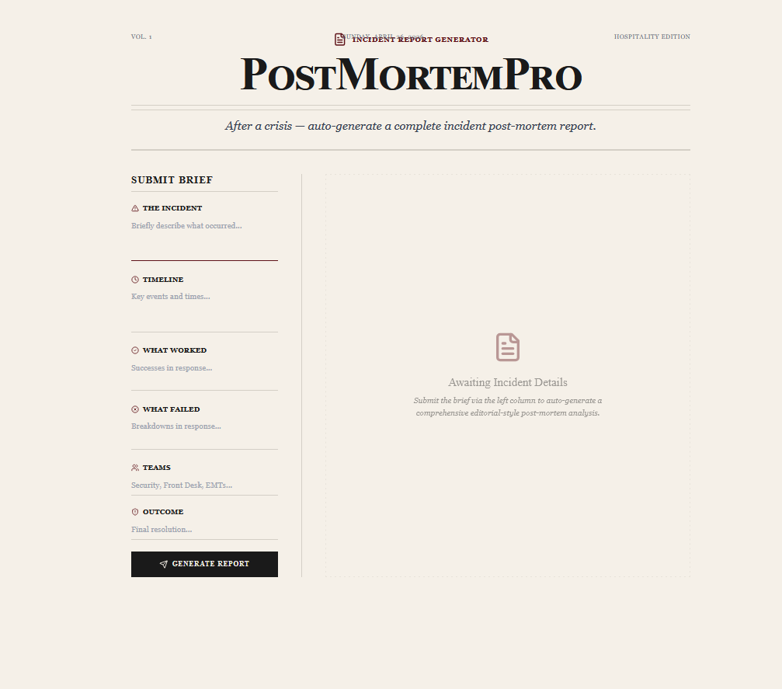
Snapshots of the MVP:

Slide 7
Links:
GitHub Public Repository:
Working Prototype Link: https://postmortempro-sc.vercel.app/

Slide 8


