Slide 1


Team Details
Team name:
Team leader name:
Problem Statement: Rapid Crisis Response

Slide 2
Brief:
• HazardMap provides an AI-powered solution for hospitality venues to proactively identify and manage safety hazards. By analyzing venue descriptions, it generates detailed hazard zone reports, risk assessments, and actionable mitigation strategies, enhancing emergency preparedness and response coordination.

Slide 3
Opportunities:
• Differentiation: Offers a unique, AI-driven approach to venue-specific hazard analysis in the hospitality sector.
• Problem Solving Approach: Addresses critical communication gaps and fragmented information during emergencies by centralizing hazard data and recommendations.
• USP: Instantaneous, AI-generated hazard zone mapping and tailored mitigation plans with a user-friendly, engaging interface.

Slide 4
Features:
• AI-Powered Hazard Analysis: Automatically detects and risk-ranks hazard zones based on venue descriptions.
• Detailed Hazard Reporting: Specifies hazard types, risk levels, and rationale for each zone.
• Actionable Mitigation: Provides targeted recommendations for hazard mitigation and emergency access.
• Claymorphism UI: Engaging, modern, and intuitive user interface with a playful 3D aesthetic.
• Responsive Design: Optimized for both mobile and desktop experiences.
• Client-Side Data Fetching: Efficiently retrieves AI analysis results.
• Integrated Loading & Error States: Provides clear feedback during processing and handles errors gracefully.

Slide 5
Technologies:
• Next.js 16 (App Router)
• TypeScript
• Tailwind CSS (with custom variables)
• Gemini API (gemini-2.5-flash)
• Lucide React for icons
• Google Fonts (Nunito, Fredoka One)

Slide 6
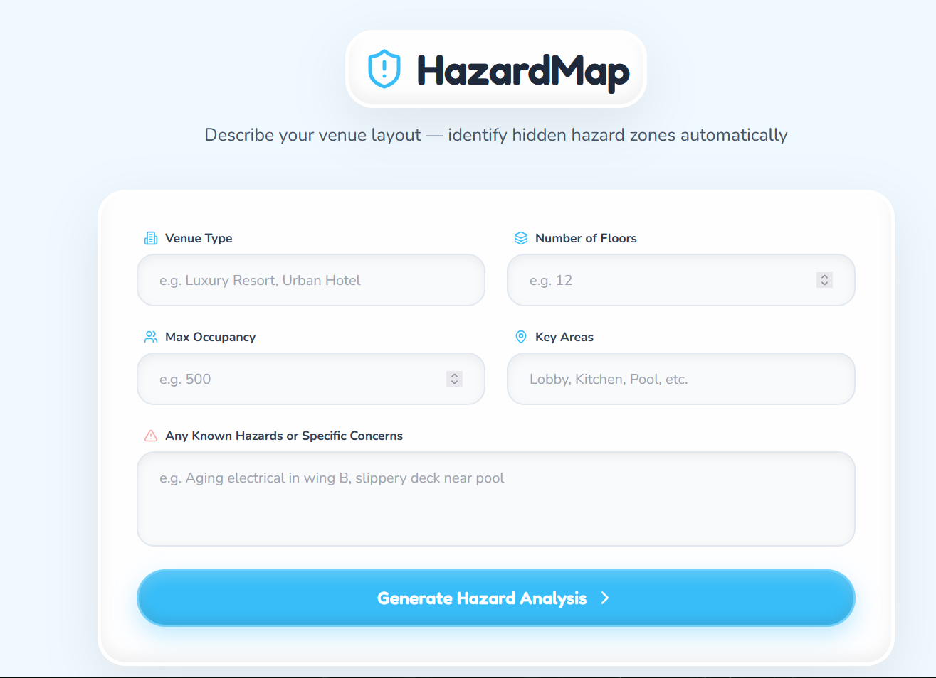
Snapshots of the MVP:

Slide 7
Links:
GitHub Public Repository:
Working Prototype Link: https://hazardmap-sc.vercel.app/

Slide 8


