Slide 1


Team Details
Team name:
Team leader name:
Problem Statement: Digital Asset Protection

Slide 2
Brief:
• WatermarkIQ is a digital asset protection platform designed for sports organizations. It generates invisible steganographic watermarks and cryptographic ownership signatures for digital media, helping to identify, track, and flag unauthorized use across the internet.

Slide 3
Opportunities:
• Differentiation: Offers advanced IP protection for the high-volume digital media market in sports.
• Problem Solving Approach: Leverages AI for robust, scalable, and near real-time digital asset authentication.
• USP: Provides unique, invisible watermarking and traceable ownership signatures to combat digital misappropriation and IP violations.

Slide 4
Features:
• User-friendly input form for asset details.
• AI-powered generation of invisible watermarks and ownership signatures.
• Clear display of generated signatures and embedding instructions.
• Loading and error handling with user-friendly feedback.
• Responsive design for all devices.
• Brutalist UI for a bold, attention-grabbing aesthetic.

Slide 5
Technologies:
• Next.js 16 (App Router)
• TypeScript
• Tailwind CSS
• Gemini API (gemini-2.5-flash)
• Lucide-React for icons

Slide 6
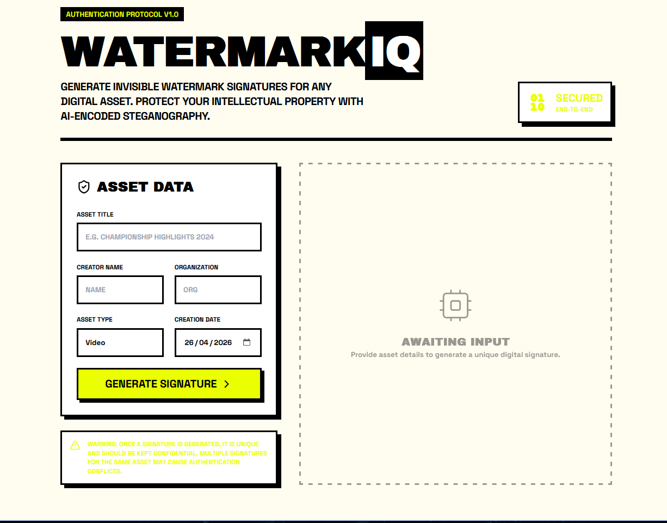
Snapshots of the MVP:

Slide 7
Links:
GitHub Public Repository:
Working Prototype Link: https://watermarkiq-sc.vercel.app/

Slide 8


