Slide 1


Team Details
Team name:
Team leader name:
Problem Statement: Digital Asset Protection

Slide 2
Brief:
• CloneCourt automates the creation of legal case summaries for sports media copyright infringement. It provides a clear, evidence-based framework to address unauthorized content use swiftly and efficiently.

Slide 3
Opportunities:
• Differentiation: Offers a specialized, AI-driven solution for the unique challenges of digital sports media IP protection.
• Problem Solving Approach: Addresses the critical visibility gap in tracking scattered digital assets, turning a complex problem into a manageable legal process.
• USP: Near real-time detection and AI-generated, actionable legal summaries for rapid response to IP violations.

Slide 4
Features:
• Intuitive Neomorphism UI for a clean, professional user experience.
• AI-powered legal case summary generation via Gemini API.
• Structured output with case title, legal basis, evidence chain, estimated damages, and recommended actions.
• Input form for asset description, publish date, infringing URL, infringement type, and evidence.
• Loading states for a smooth user interaction during AI processing.
• Responsive design for accessibility across devices.

Slide 5
Technologies:
• Next.js 16 with App Router
• TypeScript
• Tailwind CSS
• Gemini 2.5 Flash API
• Lucide React icons

Slide 6
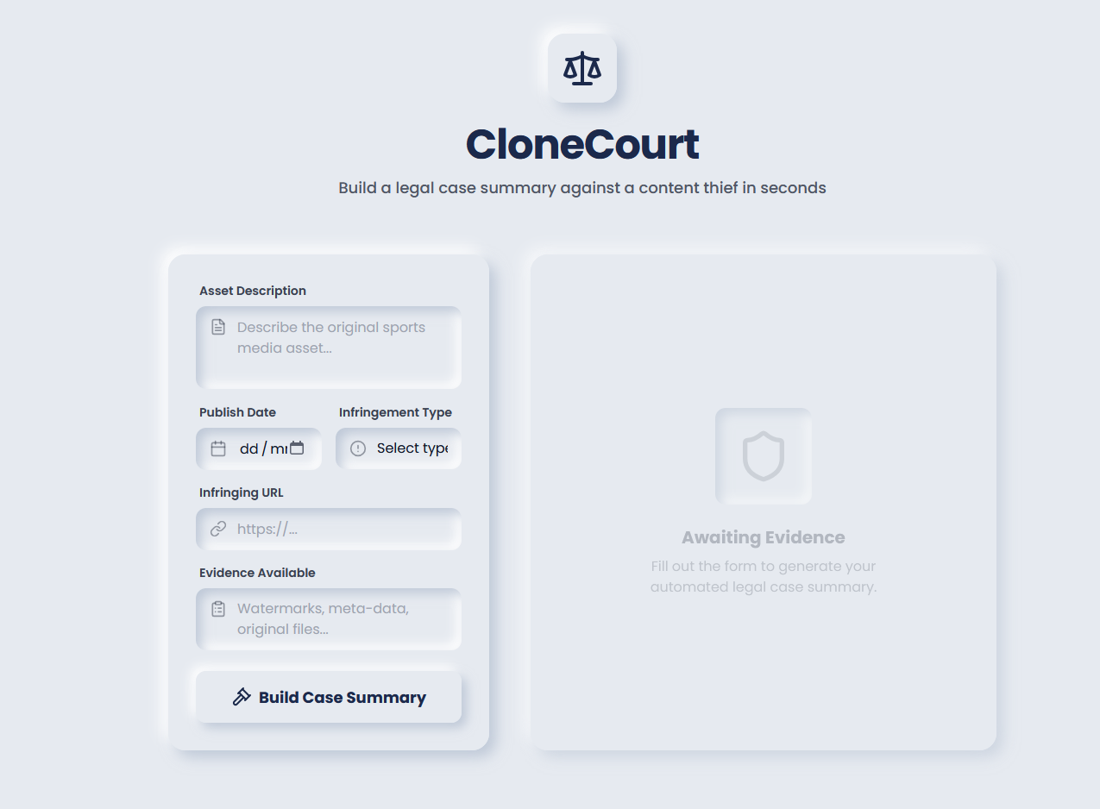
Snapshots of the MVP:

Slide 7
Links:
GitHub Public Repository:
Working Prototype Link: https://clonecourt-sc.vercel.app/

Slide 8


