Slide 1


Team Details
Team name:
Team leader name:
Problem Statement: Digital Asset Protection

Slide 2
Brief:
• A sophisticated platform for sports organizations to identify, track, and flag unauthorized use of their digital media assets, providing a clear vulnerability ranking and actionable protection strategies.

Slide 3
Opportunities:
• Differentiation: Specializes in high-value digital sports media, a niche with significant IP risk.
• Problem Solving Approach: Leverages AI for automated risk assessment and provides tailored security recommendations.
• USP: Real-time threat identification and proactive IP protection for sports media.

Slide 4
Features:
• Interactive Input Form: Intuitive interface for describing media assets, platforms, access levels, and commercial value.
• AI-Powered Vulnerability Ranking: Gemini analyzes input to score and rank asset types by theft risk.
• Detailed Risk Analysis: Explains why assets are at risk, identifies exposure platforms, and suggests specific protection actions.
• Aurora UI Style: Immersive dark theme with ethereal gradient overlays for a premium, secure feel.
• Responsive Design: Fully functional and visually appealing on all devices.
• Loading & Error States: Clear visual feedback during processing and user-friendly error messaging.

Slide 5
Technologies:
• Frontend: Next.js 16, TypeScript, Tailwind CSS
• Icons: Lucide React
• AI Integration: Gemini API (gemini-2.5-flash)

Slide 6
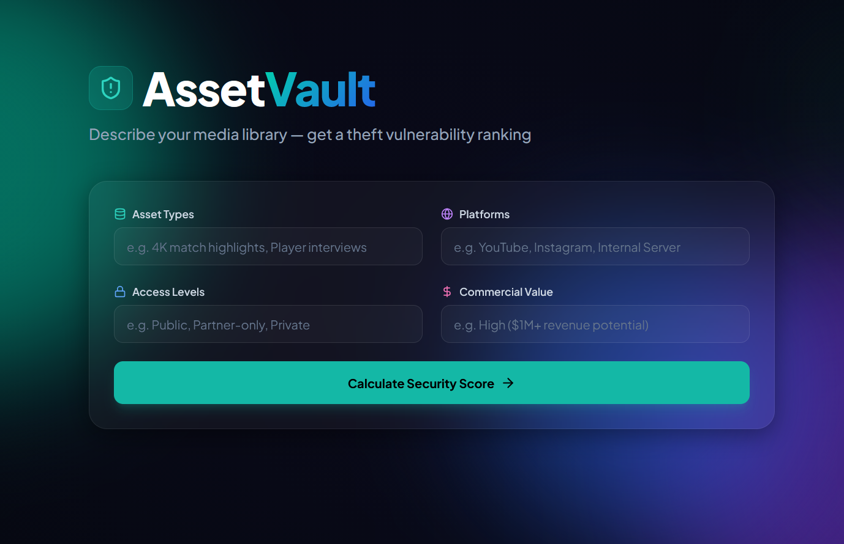
Snapshots of the MVP:

Slide 7
Links:
GitHub Public Repository:
Working Prototype Link: https://assetvault-sc.vercel.app/

Slide 8


