Slide 1


Team Details
Team name:
Team leader name:
Problem Statement: Digital Asset Protection

Slide 2
Brief:
• PlatformSpy identifies and mitigates digital content misappropriation risks for sports organizations by analyzing platform-specific IP theft vulnerabilities and offering actionable defensive strategies.

Slide 3
Opportunities:
• Differentiation: Unique hacker terminal UI and specialized focus on digital sports media IP.
• Problem Solving Approach: Proactive risk assessment and tailored defense recommendations for content creators.
• USP: Near real-time content authentication and anomaly detection for digital assets across various platforms.

Slide 4
Features:
• Platform Risk Profiling: Generates detailed IP theft risk assessments for user-specified platforms.
• IP Enforcement Ratings: Provides an A-F grade for platform IP enforcement with detailed reasoning.
• Common Theft Vectors: Identifies the top 3 methods of content theft specific to each platform.
• Personal Exposure Level: Assesses the user's individual risk based on account size and content type.
• Defensive Tactics: Offers 4 actionable, platform-specific strategies to protect digital assets.
• Interactive Terminal UI: Immersive, retro-futuristic hacker aesthetic with green-on-black theme.
• Dynamic Loading States: Visual feedback during analysis and data fetching.
• Responsive Design: Optimized for both desktop and mobile viewing.

Slide 5
Technologies:
• Frontend: Next.js 16, React, TypeScript, Tailwind CSS
• Icons: Lucide React
• Backend API: Next.js API Routes (app/api/generate/route.ts)
• AI Integration: Gemini API (gemini-2.5-flash)
• Styling: Custom CSS variables, Monospace fonts (Google Fonts)

Slide 6
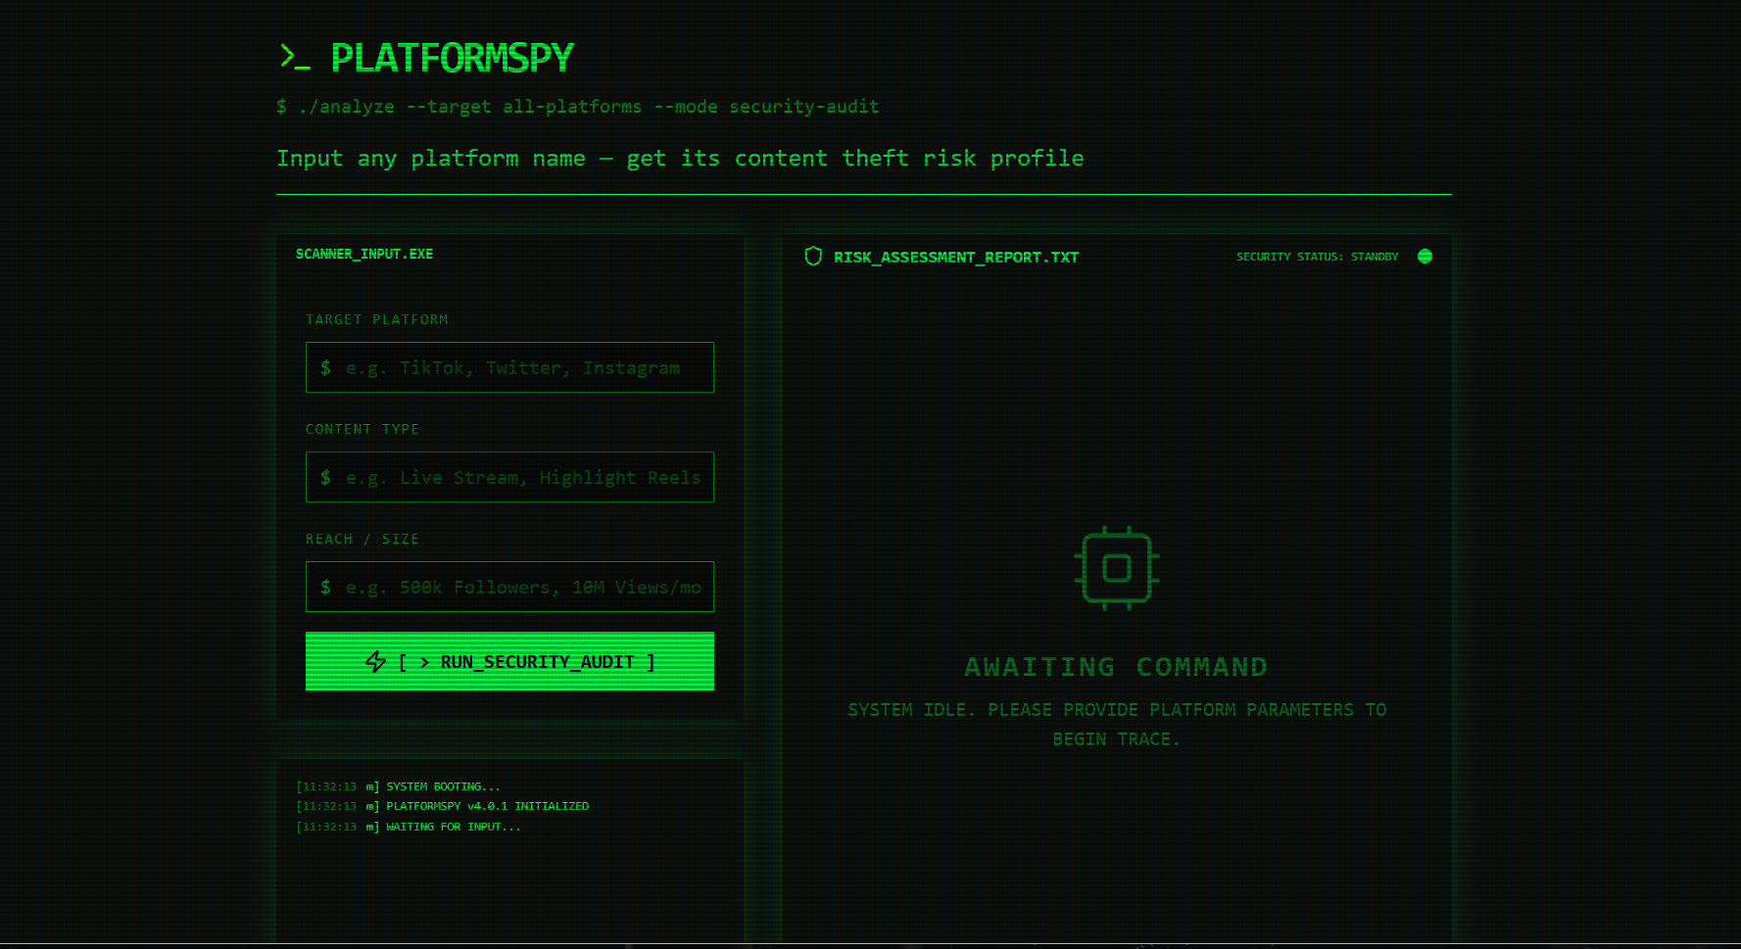
Snapshots of the MVP:

Slide 7
Links:
GitHub Public Repository:
Working Prototype Link: https://platformspy-sc.vercel.app/

Slide 8


