Slide 1


Team Details
Team name:
Team leader name:
Problem Statement: Digital Asset Protection

Slide 2
Brief:
• ReverseTrace provides a robust solution for sports organizations to identify, track, and flag unauthorized use of their digital media assets. By analyzing user-provided content descriptions, the platform generates a detailed forensic report, helping to ascertain the origin and propagation of proprietary content across the internet.

Slide 3
Opportunities:
• Differentiation: Offers specialized IP protection for the high-value, rapidly disseminated digital media of sports organizations.
• Problem Solving Approach: Utilizes advanced AI analysis for forensic tracing of digital content, addressing a critical visibility gap.
• USP: Near real-time detection and authentication of digital assets through AI-driven origin analysis, presented in a credible editorial format.

Slide 4
Features:
• Content Description Input: A structured form for users to detail suspicious media.
• AI-Powered Origin Analysis: Forensic reasoning by Gemini to determine likely source and distribution.
• Authenticity Signals: Identification of content genuineness indicators or lack thereof.
• Verification Steps: Actionable guidance for users to confirm content origin.
• Editorial UI: Clean, newspaper-inspired design for enhanced readability and trust.
• Loading & Error States: Clear visual feedback during processing and for any issues.
• Responsive Design: Optimized for all devices.

Slide 5
Technologies:
• Frontend: Next.js 16, React, TypeScript, Tailwind CSS
• Icons: Lucide React
• AI Integration: Gemini API (via server-side route)

Slide 6
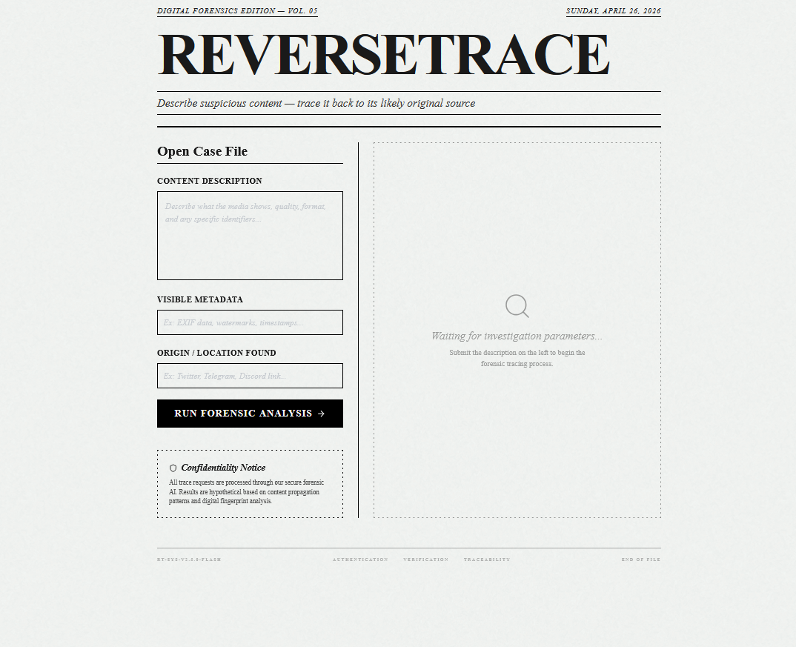
Snapshots of the MVP:

Slide 7
Links:
GitHub Public Repository:
Working Prototype Link: https://reversetrace-sc.vercel.app/

Slide 8


