Slide 1


Team Details
Team name:
Team leader name:
Problem Statement: Digital Asset Protection

Slide 2
Brief:
• LicenseGen automates the generation of bespoke digital media license agreements, addressing the critical need for IP protection in the sports industry. It simplifies the process for organizations to define and enforce terms for their valuable content, safeguarding against unauthorized use and misappropriation.

Slide 3
Opportunities:
• Differentiation: Offers a specialized, AI-driven solution for a niche but high-value market (sports digital media IP).
• Problem Solving Approach: Directly tackles the visibility gap and IP vulnerability of scattered digital assets.
• USP: Instant generation of legally structured, customizable license agreements with a user-friendly, engaging interface.

Slide 4
Features:
• Intuitive input form for defining license parameters (asset type, usage rights, territory, etc.).
• AI-powered license generation via Gemini API.
• Dynamic display of generated license agreements with clear section hierarchy.
• Real-time loading and error handling states for a seamless user experience.
• Responsive Claymorphism UI design for a modern, approachable feel.
• Browser tab and page title set to "LicenseGen".

Slide 5
Technologies:
• Next.js 16 (App Router)
• TypeScript
• Tailwind CSS
• Gemini API (gemini-2.5-flash)
• Lucide React for icons
• Google Fonts (Nunito, Fredoka One)
• Constraints:
• No markdown like or ##
• No code
• Clean bullet points only
• Keep concise

Slide 6
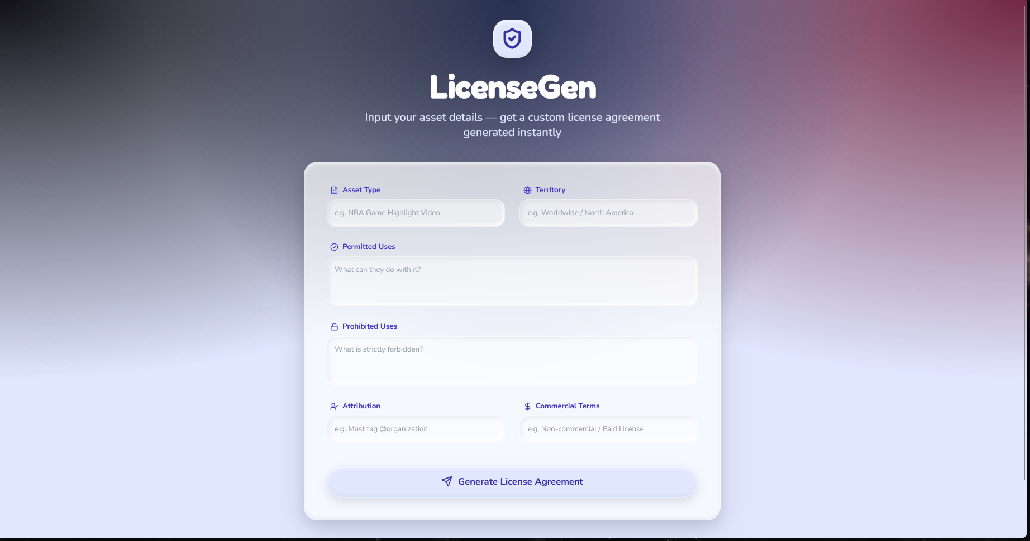
Snapshots of the MVP:

Slide 7
Links:
GitHub Public Repository:
Working Prototype Link: https://licensegen-sc.vercel.app/

Slide 8


