Slide 1


Team Details
Team name:
Team leader name:
Problem Statement: Smart Supply Chains

Slide 2
Brief:
• A Next.js 16 MVP application for predicting and mitigating weather-based supply chain disruptions. Features a Brutalist UI and Gemini API integration to provide users with real-time route risk analysis and actionable recommendations.

Slide 3
Opportunities:
• Differentiation: Unique Brutalist UI style that stands out in the logistics tech space.
• Problem Solving Approach: Proactive identification and mitigation of weather-related transit delays through data analysis.
• USP: Real-time, AI-powered weather risk assessment for supply chain routes with actionable insights.

Slide 4
Features:
• Intuitive input form for route details (origin, destination, transport mode, departure).
• Dynamic weather risk score and detailed threat analysis per route segment.
• Estimated impact on Estimated Time of Arrival (ETA).
• Practical weather-proofing recommendations.
• Loading state for AI processing.
• Error handling for graceful failure.
• Responsive design for all devices.
• Striking Brutalist UI with high contrast and bold typography.

Slide 5
Technologies:
• Frontend: Next.js 16 (App Router), TypeScript, Tailwind CSS
• Icons: Lucide React
• AI Integration: Gemini API (`gemini-2.5-flash`)

Slide 6
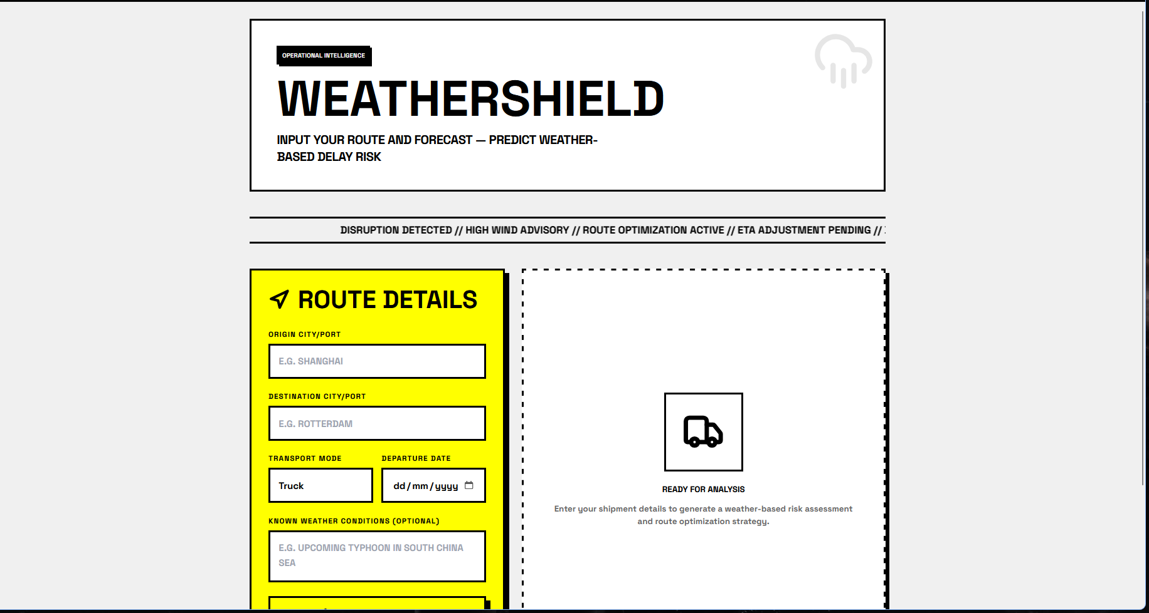
Snapshots of the MVP:

Slide 7
Links:
GitHub Public Repository:
Working Prototype Link: https://weathershield-sc.vercel.app/

Slide 8


