Slide 1


Team Details
Team name:
Team leader name:
Problem Statement: Smart Supply Chains

Slide 2
Brief:
• A web application that provides a vendor reliability scorecard by analyzing user-provided relationship details through an AI model.

Slide 3
Opportunities:
• Differentiation: Unique AI-powered vendor assessment and proactive disruption detection for supply chains.
• Problem Solving Approach: Continuously analyzes transit data to preemptively flag and mitigate supply chain disruptions.
• USP: Dynamic route adjustment recommendations to prevent cascading delays.

Slide 4
Features:
• Vendor relationship input form
• AI-powered reliability scorecard generation (scores, grade, risk flags, recommendations)
• Neumorphism UI with a soft, extruded 3D aesthetic
• Responsive design for all devices
• Loading and error state handling
• Prominent display of vendor name and tagline
• Seamless integration with Gemini API for backend processing

Slide 5
Technologies:
• Next.js 16 (App Router)
• TypeScript
• Tailwind CSS
• Lucide React for icons
• Gemini API (gemini-2.5-flash)

Slide 6
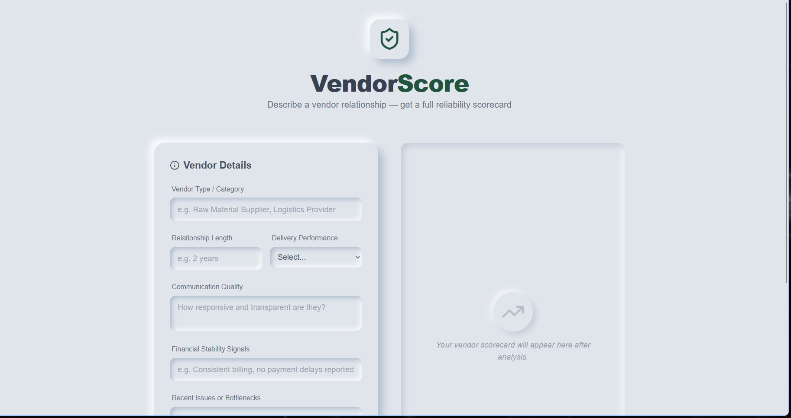
Snapshots of the MVP:

Slide 7
Links:
GitHub Public Repository:
Working Prototype Link: https://vendorscore-sc.vercel.app/

Slide 8


