Slide 1


Team Details
Team name:
Team leader name:
Problem Statement: Smart Supply Chains

Slide 2
Brief:
• The ShipmentNarrator is a Next.js 16 application designed to combat critical transit disruptions in global supply chains. It ingests raw shipment tracking data and leverages Gemini AI to generate a clear, chronological narrative. This narrative highlights shipment progress, pinpoints the causes and locations of delays, and provides insights into expected next steps, enabling proactive management of supply chain volatility.

Slide 3
Opportunities:
• Differentiation
• The ShipmentNarrator differentiates itself through its specialized focus on translating complex, raw logistics data into accessible, actionable plain-language insights. Its Aurora UI provides a premium, immersive user experience, while the AI-driven narrative offers immediate clarity and predictive value, unlike traditional, often fragmented tracking systems.
• Problem Solving Approach
• The solution addresses the problem of delayed disruption identification by employing a two-pronged approach:
• 1. Data Translation: A user-friendly interface allows for easy submission of raw tracking data.
• 2. AI-Powered Narrative: Gemini 2.5 Flash translates this data into a coherent, easy-to-understand story, identifying delays, their root causes, and future implications. This empowers stakeholders to react quickly and optimize routes before issues escalate.
• USP
• Translate raw tracking data into an instantly understandable, AI-generated shipment story with predictive insights and a premium, immersive Aurora UI.

Slide 4
Features:
• AI-Powered Shipment Narrative: Converts raw logistics logs into chronological, plain-language stories.
• Delay Analysis: Identifies and explains the reasons and locations of transit delays.
• Predictive Insights: Offers simple explanations of what to expect next for a shipment.
• Immersive Aurora UI: Features a dark, gradient-filled interface with dynamic elements for a premium user experience.
• Responsive Design: Fully functional and visually appealing on both desktop and mobile devices.
• Loading & Error Handling: Provides clear visual feedback during data processing and displays user-friendly error messages.
• Client-Side API Fetching: Efficiently retrieves AI-generated content from a dedicated API route.

Slide 5
Technologies:
• Frontend Framework: Next.js 16 (App Router)
• Language: TypeScript
• Styling: Tailwind CSS + Custom CSS Variables
• Icons: Lucide React
• AI Integration: Gemini API (gemini-2.5-flash)

Slide 6
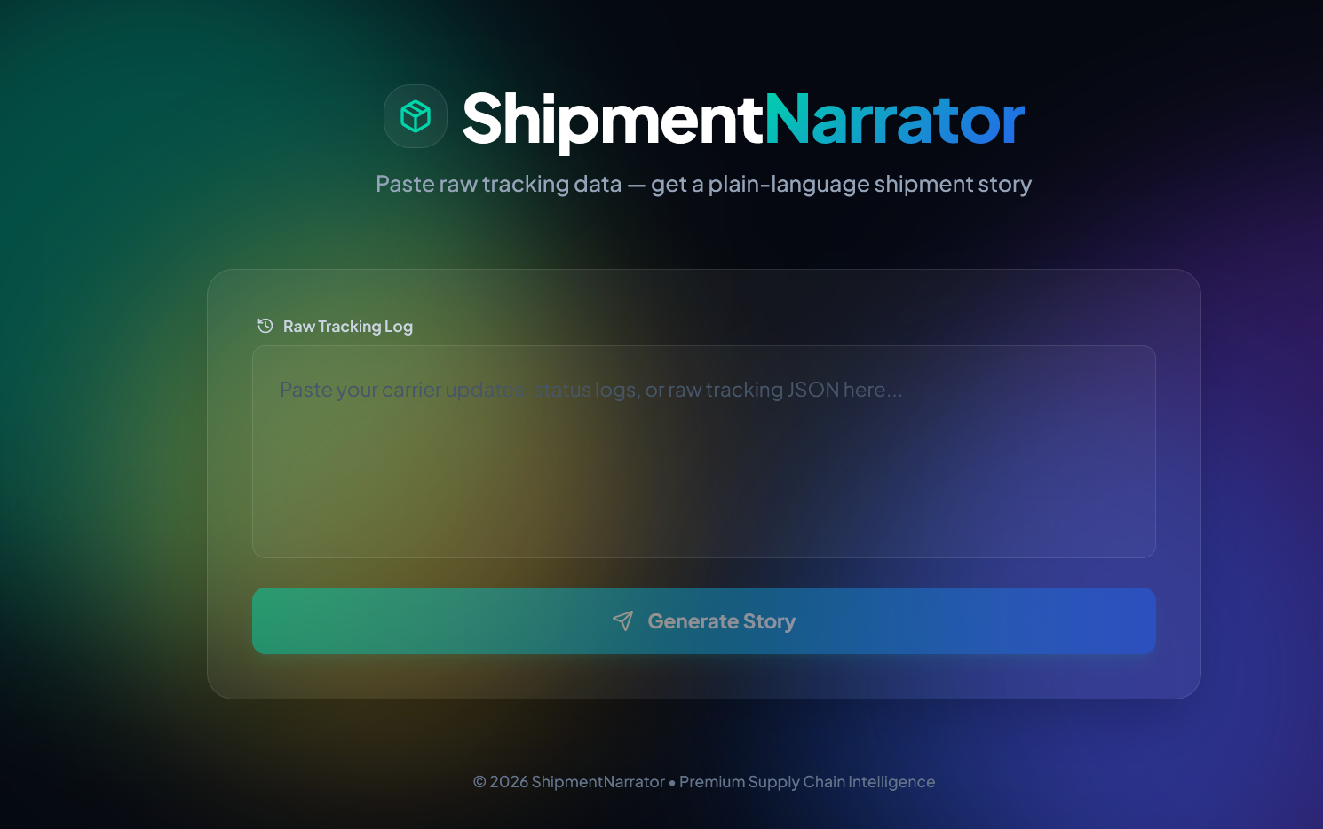
Snapshots of the MVP:

Slide 7
Links:
GitHub Public Repository:
Working Prototype Link: https://shipmentnarrator-sc.vercel.app/

Slide 8


