Slide 1


Team Details
Team name:
Team leader name:
Problem Statement: Smart Supply Chains

Slide 2
Brief:
• CostLeakFinder is a web application designed to preemptively detect and flag potential supply chain disruptions and hidden cost inefficiencies. It analyzes user-provided supply chain descriptions to identify waste points, estimate financial impact, and prescribe targeted cost-saving interventions, all within a stylized terminal interface.

Slide 3
Opportunities:
• Differentiation
• The core differentiator is the unique "hacker terminal" UI, which provides a novel and engaging user experience for a typically complex business problem. This retro-futuristic aesthetic appeals to a niche audience and makes the analytics feel more immediate and direct.
• Problem Solving Approach
• The application utilizes a prompt-engineered Gemini API integration to perform sophisticated analysis of supply chain data. It focuses on uncovering non-obvious inefficiencies beyond user-stated pain points, offering data-driven insights and actionable recommendations for cost optimization and route adjustment.
• USP
• "Describe your supply chain — find hidden cost inefficiencies instantly." The USP lies in the combination of advanced AI-powered supply chain analysis delivered through a distinct, immersive terminal UI, making complex optimization accessible and visually compelling.

Slide 4
Features:
• Supply Chain Input Form: User-friendly terminal-style input for describing supply chain stages, vendors, transport modes, and pain points.
• AI-Powered Analysis: Gemini API integration for identifying and prioritizing supply chain cost leaks.
• Cost Leak Reporting: Clear presentation of identified inefficiencies, estimated waste magnitude (low/medium/high $), and ranked savings potential.
• Actionable Interventions: Specific, prescribed fixes for each identified cost leak.
• Hacker Terminal UI: Immersive green-on-black, monospace font, terminal-like interface.
• Loading & Error States: Visually distinct loading animations and user-friendly error handling.
• Responsive Design: Optimized for both desktop and mobile viewing.

Slide 5
Technologies:
• Frontend: Next.js 16 (App Router), TypeScript, Tailwind CSS, Lucide React
• Backend: Next.js API Routes (`app/api/generate/route.ts`)
• AI Integration: Gemini API (`gemini-2.5-flash`)
• Styling: Custom CSS variables, Google Fonts (imported)

Slide 6
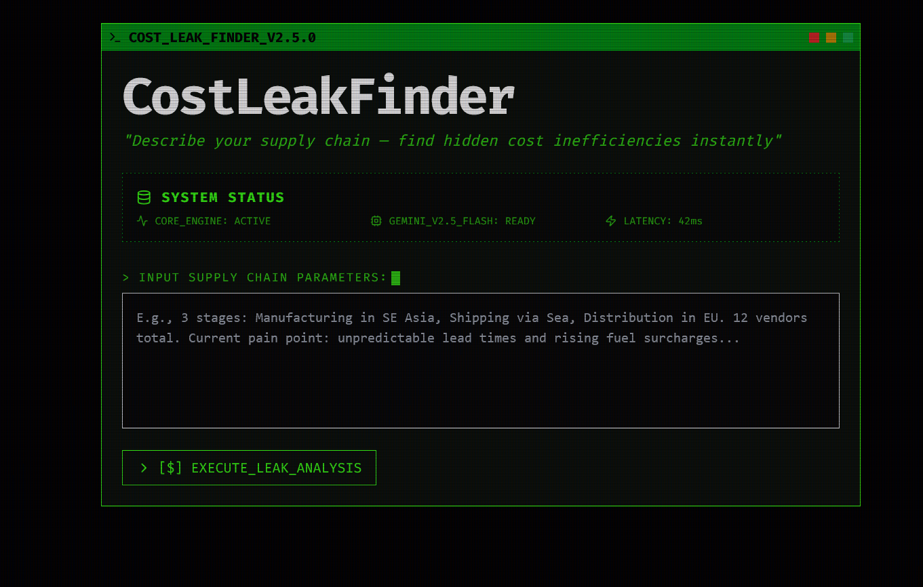
Snapshots of the MVP:

Slide 7
Links:
GitHub Public Repository:
Working Prototype Link: https://costleakfinder-sc.vercel.app/

Slide 8


