Slide 1


Team Details
Team name:
Team leader name:
Problem Statement: Smart Supply Chains

Slide 2
Brief:
• ContractClause is a Next.js 16 MVP application that empowers users to generate custom contract clauses to mitigate supply chain disruption risks. Leveraging a Gemini AI backend, it offers pre-drafted, legally-structured clauses tailored to specific scenarios, roles, jurisdictions, and risk tolerances, ensuring business continuity and legal protection.

Slide 3
Opportunities:
• Differentiation
• The application differentiates itself by combining a highly refined, editorial UI aesthetic with precise, AI-generated legal drafting for supply chain disruptions, a niche but critical area. Its focus on pre-emptive clause generation offers a significant advantage over reactive legal solutions.
• Problem Solving Approach
• The solution addresses the problem of supply chain volatility by providing a tool that generates proactive contractual safeguards. It translates complex disruption scenarios into clear, actionable contract language, enabling businesses to define protections before disruptions occur.
• USP
• AI-powered generation of bespoke, legally structured contract clauses for supply chain disruptions, presented within a professional, trustworthy editorial UI, offering immediate risk mitigation.

Slide 4
Features:
• AI-Driven Clause Generation: Dynamically drafts Force Majeure, SLA, Penalty, and Dispute Resolution clauses based on user input.
• Paper/Editorial UI: Implements a sophisticated newspaper/magazine layout with serif fonts, clear hierarchy, and a cream/near-black color scheme for a trustworthy feel.
• User-Friendly Input Form: Collects essential details like contract type, disruption scenario, role, jurisdiction, and risk tolerance.
• Loading & Error Handling: Provides distinct visual states for submission loading and displays user-friendly error messages.
• Responsive Design: Ensures full functionality and aesthetic integrity across mobile and desktop devices.
• Next.js 16 App Router: Built with modern Next.js features for performance and maintainability.

Slide 5
Technologies:
• Frontend: Next.js 16, React, TypeScript, Tailwind CSS
• Icons: Lucide React
• Backend Integration: Gemini API (via Next.js API Route)

Slide 6
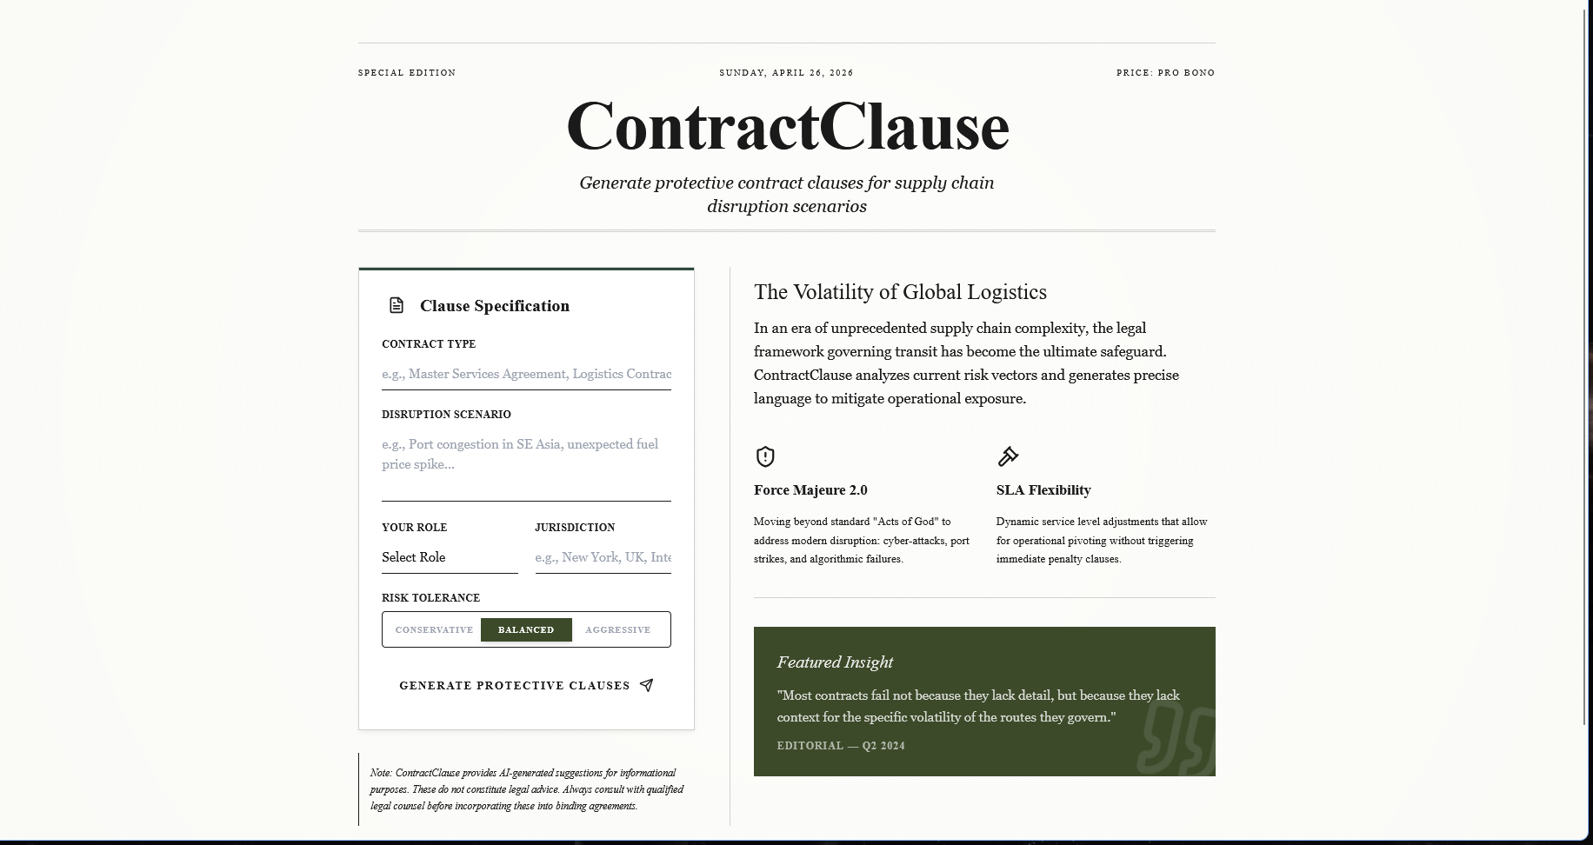
Snapshots of the MVP:

Slide 7
Links:
GitHub Public Repository:
Working Prototype Link: https://contractclause-sc.vercel.app/

Slide 8


