Slide 1


Team Details
Team name:
Team leader name:
Problem Statement: Smart Supply Chains

Slide 2
Brief:
• DemandSignal is a web application that uses AI to predict near-term demand shifts in supply chains. It analyzes market signals provided by users to offer demand direction, magnitude, confidence levels, leading indicators, and inventory recommendations, helping businesses preemptively manage potential disruptions.

Slide 3
Opportunities:
• Differentiation:
• Proactive demand forecasting powered by advanced AI.
• Unique Claymorphism UI for an engaging and modern user experience.
• Focus on actionable insights for inventory and route optimization.
• Problem Solving Approach:
• Leverages AI to analyze qualitative market data into quantifiable demand predictions.
• Provides early warning system for supply chain volatility.
• Offers concrete inventory management advice based on predictions.
• USP:
• Near real-time demand shift prediction with confidence scoring.
• Explanations of AI logic and identification of key influencing factors.
• Seamless integration of AI analysis into an intuitive user interface.

Slide 4
Features:
• User input form for industry, market signals, and inventory levels.
• Dynamic loading state for AI processing.
• Structured display of AI-generated demand prediction:
• Prediction Direction (Up/Down/Stable)
• Magnitude Estimate
• Confidence Level
• Leading Indicators to Watch
• Inventory Recommendation
• Error handling with user-friendly messages.
• Responsive design for optimal viewing on all devices.
• Prominent display of Tool Name and Tagline.
• Claymorphism UI style for a playful and modern aesthetic.

Slide 5
Technologies:
• Frontend: Next.js 16, React, TypeScript, Tailwind CSS, Lucide React Icons.
• Backend: Next.js API Routes.
• AI Integration: Gemini API (`gemini-2.5-flash`).

Slide 6
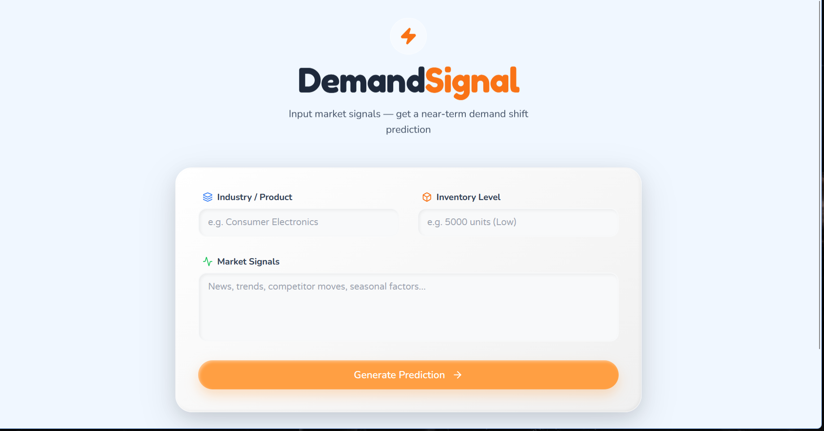
Snapshots of the MVP:

Slide 7
Links:
GitHub Public Repository:
Working Prototype Link: https://demandsignal-sc.vercel.app/

Slide 8


