Slide 1


Team Details
Team name:
Team leader name:
Problem Statement: Smart Resource Allocation

Slide 2
Brief:
• GrantWriter is a web-based tool that leverages AI to generate persuasive grant application paragraphs for NGOs. It simplifies the fundraising process by converting user-provided details into a structured, funder-ready narrative.

Slide 3
Opportunities:
• Differentiation
• Provides an AI-powered solution specifically for grant writing, directly addressing a critical operational need for NGOs. Its Brutalist UI ensures immediate attention and memorability.
• Problem Solving Approach
• Collects key organizational data through a structured form. Utilizes the Gemini API with a specialized prompt to craft a comprehensive grant paragraph following established grant writing principles. Presents the output in a clear, organized manner.
• USP
• Automated generation of compelling grant application paragraphs powered by Gemini AI, combined with a distinctive and attention-grabbing Brutalist user interface.

Slide 4
Features:
• AI-Powered Grant Paragraph Generation: Auto-drafts problem statements, solutions, impact projections, and budget justifications.
• Brutalist UI: Bold typography, thick borders, high contrast, and intentional asymmetry for a unique user experience.
• Responsive Design: Fully functional and visually consistent across desktop and mobile devices.
• Loading & Error States: Clear visual indicators for submission progress and user-friendly error messaging.
• Structured Output: Parses and displays AI-generated text with visual hierarchy for readability.

Slide 5
Technologies:
• Frontend: Next.js 16 (App Router), React, TypeScript, Tailwind CSS
• Backend/API: Next.js API Route (`app/api/generate/route.ts`)
• AI Integration: Gemini API (`gemini-2.5-flash`)
• Icons: Lucide React
• Styling: Custom CSS variables, Brutalism design principles

Slide 6
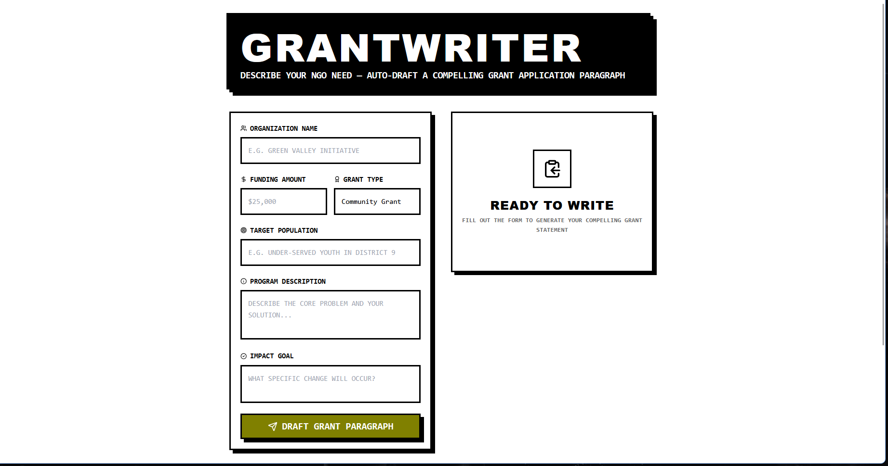
Snapshots of the MVP:

Slide 7
Links:
GitHub Public Repository:
Working Prototype Link: https://grantwriter-sc.vercel.app/

Slide 8


