Slide 1


Team Details
Team name:
Team leader name:
Problem Statement: Smart Resource Allocation

Slide 2
Brief:
• VolunteerBio is a Next.js 16 web application that generates personalized impact biographies for volunteers. It streamlines the process of showcasing volunteer contributions for NGOs, donor reports, and recruitment efforts by transforming raw volunteer data into compelling, human-centered narratives.

Slide 3
Opportunities:
• Differentiation
• The VolunteerBio application differentiates itself through its unique Neumorphism UI, creating a distinct and modern aesthetic. Its core value proposition lies in the AI-powered generation of high-quality, inspiring volunteer bios, moving beyond simple data aggregation to narrative storytelling.
• Problem Solving Approach
• The application tackles the challenge of scattered community data and volunteer engagement by:
• 1. Providing a centralized input mechanism for volunteer details.
• 2. Leveraging Gemini AI to craft engaging impact narratives.
• 3. Presenting these narratives in a format suitable for multiple NGO needs (reporting, recognition, recruitment).
• USP
• AI-generated, inspiring volunteer impact biographies with a distinctive Neumorphism UI, designed to enhance NGO storytelling and volunteer engagement.

Slide 4
Features:
• Neumorphism-styled input form for volunteer details (name, skills, hours, tasks, motivation).
• Real-time loading indicator upon submission.
• AI-powered generation of personalized volunteer impact biographies using Gemini.
• Display of generated biographies with clear visual hierarchy.
• Graceful error handling for user-friendly feedback.
• Fully responsive design for desktop and mobile.
• Prominent display of the VolunteerBio title and tagline.

Slide 5
Technologies:
• Next.js 16 (App Router)
• TypeScript
• Tailwind CSS (with custom variables and Google Fonts)
• Lucide-React for icons
• Gemini API (`gemini-2.5-flash`)

Slide 6
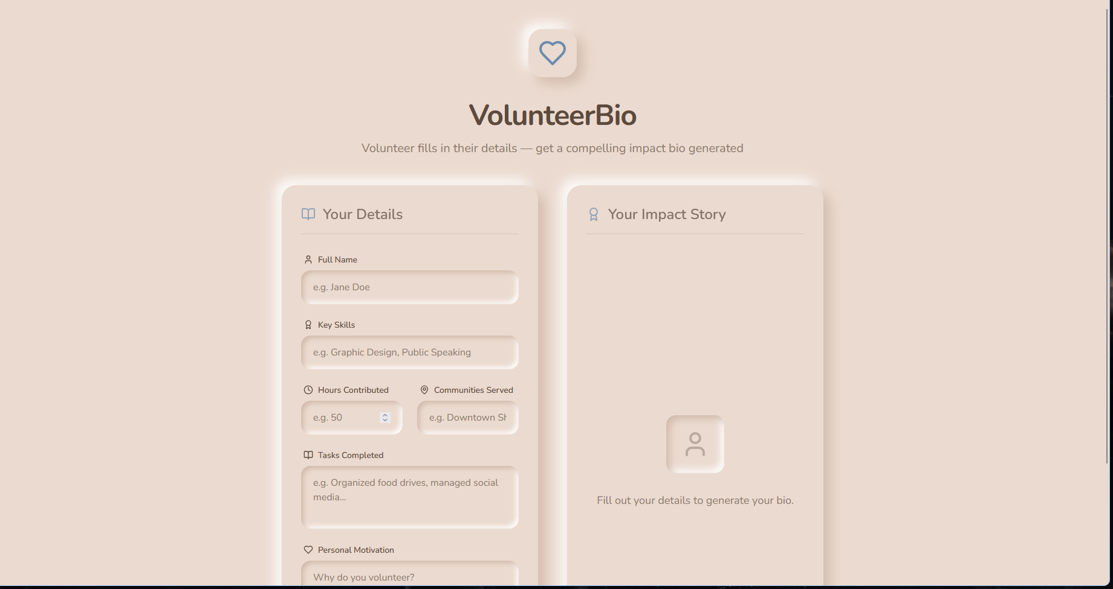
Snapshots of the MVP:

Slide 7
Links:
GitHub Public Repository:
Working Prototype Link: https://volunteerbio-sc.vercel.app/

Slide 8


