Slide 1


Team Details
Team name:
Team leader name:
Problem Statement: Smart Resource Allocation

Slide 2
Brief:
• CommunityPulse addresses the challenge of scattered community data by providing a centralized platform for NGOs. It transforms raw social media posts into actionable insights, highlighting urgent needs and suggesting targeted interventions. This empowers NGOs to efficiently allocate resources and connect volunteers with critical tasks, ultimately amplifying social impact.

Slide 3
Opportunities:
• Differentiation
• AI-powered Social Listening: Directly extracts insights from unstructured text data, going beyond manual analysis.
• Actionable Intelligence: Provides ranked needs, sentiment, affected demographics, and specific NGO interventions, not just raw data.
• Aurora UI Style: Offers a unique, premium, and immersive dark-themed interface, enhancing user engagement.
• Seamless Volunteer Matching: Facilitates targeted resource allocation by clearly defining needs and areas of impact.
• Problem Solving Approach
• The solution employs a robust AI-driven approach combined with a user-centric design.
• 1. Data Ingestion: Users paste community social media posts into a structured input form.
• 2. AI Analysis: The Gemini API processes the input using a specialized system prompt to extract key community needs, urgency, sentiment, affected segments, and intervention recommendations.
• 3. Insight Visualization: Results are presented in a clear, hierarchical, and visually appealing format, adhering to the Aurora UI style.
• 4. User Feedback: The application handles loading states and errors gracefully, ensuring a smooth user experience.
• USP
• CommunityPulse's Unique Selling Proposition lies in its AI-driven ability to distill complex social media chatter into prioritized, actionable intelligence for NGOs, wrapped in a distinct and immersive Aurora UI. This empowers immediate, informed decision-making for social impact initiatives.

Slide 4
Features:
• AI-Powered Needs Extraction: Analyzes social media posts to identify and rank unmet community needs.
• Urgency Scoring & Sentiment Analysis: Quantifies the urgency of needs and assesses the emotional tone within community feedback.
• Affected Population Identification: Pinpoints demographic segments most impacted by identified issues.
• Actionable Intervention Recommendations: Suggests specific steps NGOs can take based on the analysis.
• Evidence Quoting: Provides direct quotes from posts to support the extracted insights.
• Engaging Aurora UI: Features a dark, gradient-infused, and ethereal interface for a premium feel.
• Real-time Loading & Error States: Provides clear visual feedback during processing and for handling errors.
• Fully Responsive Design: Ensures optimal viewing and interaction across all devices.
• Prominent Branding: "CommunityPulse" title and tagline are clearly displayed.

Slide 5
Technologies:
• Frontend Framework: Next.js 16 (App Router)
• Language: TypeScript
• Styling: Tailwind CSS, Custom CSS variables, Google Fonts
• Icons: lucide-react
• AI Integration: Gemini API (`gemini-2.5-flash`)

Slide 6
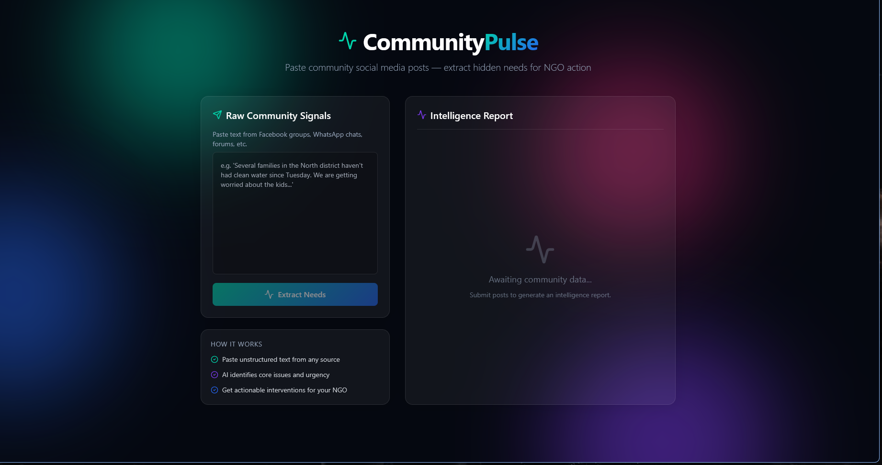
Snapshots of the MVP:

Slide 7
Links:
GitHub Public Repository:
Working Prototype Link: https://communitypulse-sc.vercel.app/

Slide 8


