Slide 1


Team Details
Team name:
Team leader name:
Problem Statement: Smart Resource Allocation

Slide 2
Brief:
• TaskNarrator is a functional MVP web application built with Next.js 16, TypeScript, and Tailwind CSS. It provides a unique terminal-inspired user interface for non-profit organizations to generate emotionally resonant impact stories from completed task data, enhancing donor engagement and support.

Slide 3
Opportunities:
• Differentiation
• Unique UI/UX: Adopts a nostalgic 90s hacker terminal aesthetic, setting it apart from conventional web applications.
• AI-Powered Storytelling: Leverages Gemini AI to craft compelling narratives, not just present data.
• Focused Utility: Specifically targets the need for clear, motivational communication in the non-profit sector.
• Problem Solving Approach
• The system addresses the challenge of fragmented community data by:
• 1. Data Aggregation: Providing a single interface to input detailed task completion information.
• 2. AI Transformation: Using Gemini to convert this data into engaging donor narratives.
• 3. Impact Communication: Presenting results in a structured, visually hierarchical format that emphasizes emotional impact and calls to action.
• USP
• Generates humanized, donor-motivating impact stories from raw task data, using a distinctive terminal UI and advanced AI to clearly demonstrate the tangible social good achieved by non-profit efforts.

Slide 4
Features:
• Terminal UI: Full command-line interface aesthetic (green-on-black, monospace fonts, styled inputs/buttons).
• AI-Driven Story Generation: Input task details (volunteer, beneficiaries, resources, outcomes, location) to generate a donor-facing story.
• Dynamic Form: User-friendly input fields styled to match the terminal theme.
• Loading States: Visually engaging loading animations while waiting for AI response.
• Hierarchical Results Display: Parsed AI output presented with clear sections, headlines, metrics, and calls to action.
• Error Handling: Graceful display of user-friendly error messages.
• Responsive Design: Fully functional and styled across mobile and desktop devices.
• Page Title & Heading: Prominently displays "TaskNarrator" as required.

Slide 5
Technologies:
• Frontend Framework: Next.js 16 (App Router)
• Language: TypeScript
• Styling: Tailwind CSS, Custom CSS Variables (`globals.css`)
• Icons: `lucide-react`
• AI Integration: Gemini API (`gemini-2.5-flash`)

Slide 6
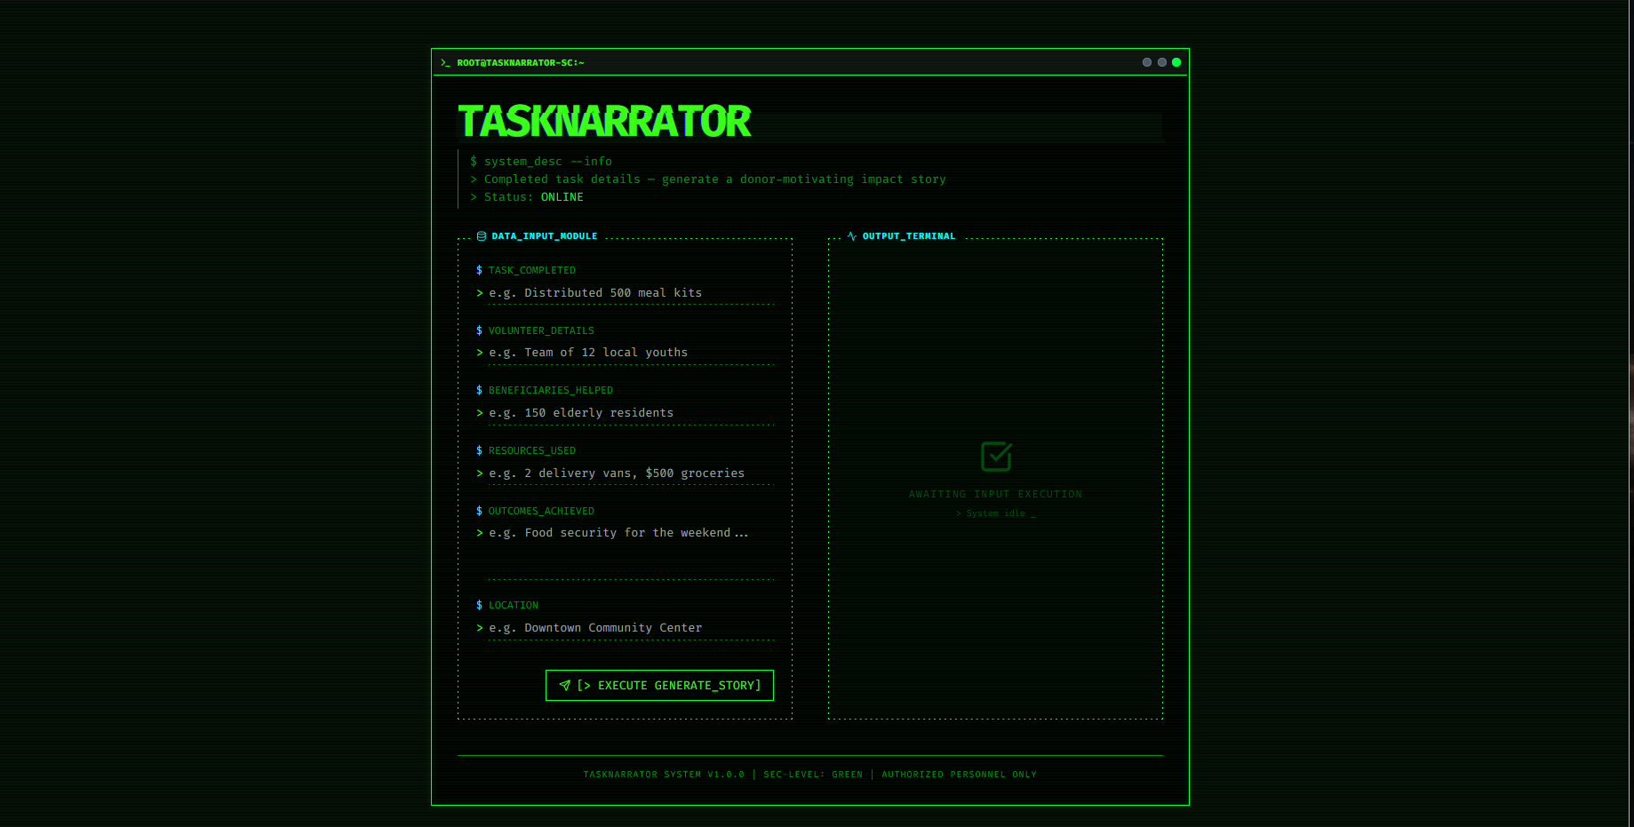
Snapshots of the MVP:

Slide 7
Links:
GitHub Public Repository:
Working Prototype Link: https://tasknarrator-sc.vercel.app/

Slide 8


