Slide 1


Team Details
Team name:
Team leader name:
Problem Statement: Smart Resource Allocation

Slide 2
Brief:
• SkillGapFinder is a Next.js 16 application designed to empower local social groups and NGOs. It addresses the challenge of understanding community needs from scattered data and efficiently matching volunteers to critical tasks. By analyzing project requirements against available volunteer skills, it pinpoints crucial skill gaps, quantifies their impact, and provides actionable recruitment briefs and interim solutions.

Slide 3
Opportunities:
• Differentiation
• The application differentiates itself through its unique "Paper/Editorial" UI style, fostering a sense of trust and readability akin to professional publications. Its focused AI-driven analysis of NGO skill gaps provides a clear, actionable roadmap for volunteer recruitment and project success.
• Problem Solving Approach
• The solution tackles the problem by centralizing NGO project and volunteer data, then employing AI to identify critical skill deficiencies. It prioritizes these gaps, articulates their impact, and generates tailored resources (recruitment briefs, workarounds) to bridge them, thereby enhancing operational efficiency and social impact.
• USP
• The core Unique Selling Proposition (USP) lies in its sophisticated AI-powered skill gap analysis presented through a sophisticated, editorial-style interface, offering NGOs precise insights into their talent needs and actionable strategies for volunteer recruitment and project completion.

Slide 4
Features:
• Skill Gap Analysis: Identifies and ranks missing skills based on criticality.
• Impact Quantification: Assesses the effect of each skill gap on project outcomes.
• Targeted Recruitment Briefs: Generates compelling 3-sentence briefs for each missing skill.
• Interim Workarounds: Provides practical solutions for gaps while recruiting.
• Intuitive Input Form: Collects NGO project details and volunteer skill information.
• Loading State: Visually indicates when the AI is processing.
• Error Handling: Displays user-friendly messages for issues.
• Responsive Design: Adapts seamlessly to various screen sizes.

Slide 5
Technologies:
• Frontend Framework: Next.js 16 (App Router)
• Language: TypeScript
• Styling: Tailwind CSS with custom CSS variables
• Icons: lucide-react
• AI Integration: Gemini API (`gemini-2.5-flash`)

Slide 6
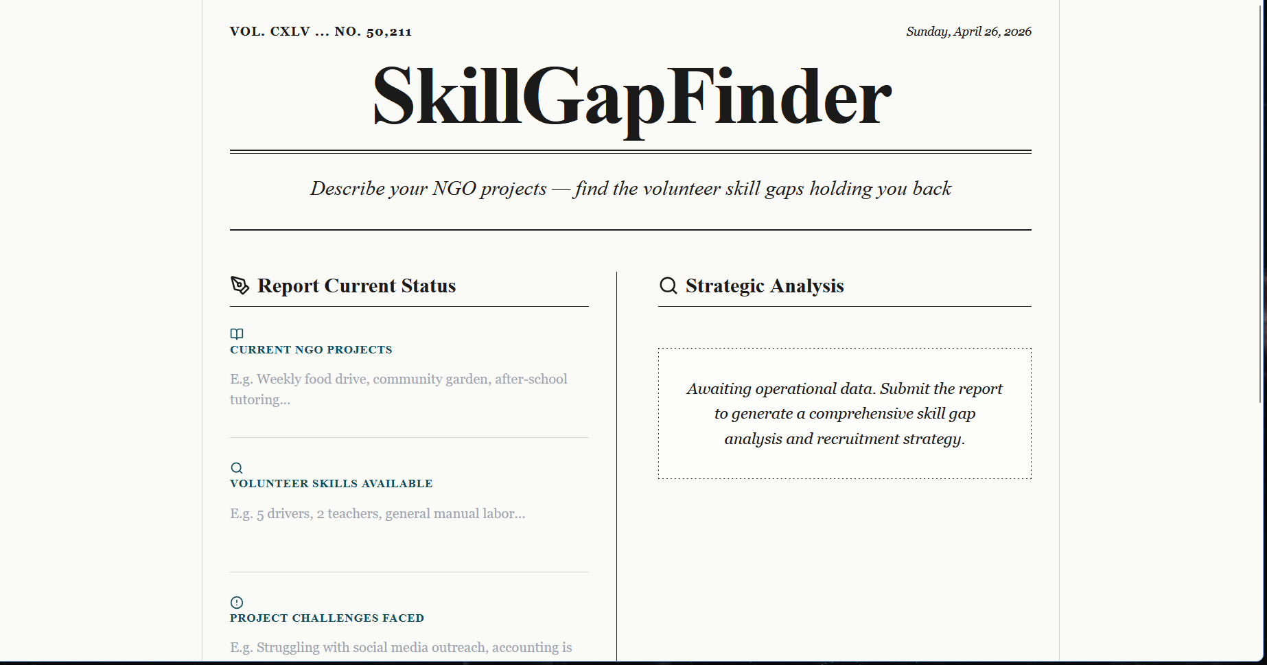
Snapshots of the MVP:

Slide 7
Links:
GitHub Public Repository:
Working Prototype Link: https://skillgapfinder-sc.vercel.app/

Slide 8


