Slide 1


Team Details
Team name:
Team leader name:
Problem Statement: Smart Resource Allocation

Slide 2
Brief:
• EventPlanner is a Next.js 16 application that acts as a central hub for community needs assessment and volunteer coordination. It empowers local social groups and NGOs to transform scattered community data into actionable insights by generating detailed volunteer event plans. The application utilizes a visually engaging claymorphism UI and integrates with the Gemini API to provide comprehensive event strategies, from concept to success metrics.

Slide 3
Opportunities:
• Differentiation
• The application differentiates itself through its specialized focus on volunteer event planning for community needs, its unique claymorphism UI that creates an inviting and playful user experience, and its seamless integration with a powerful AI model for generating detailed, ready-to-execute plans.
• Problem Solving Approach
• The approach addresses the problem of scattered community data and inefficient volunteer matching by providing a single platform that:
• 1. Gathers Inputs: Collects community needs, volunteer availability, budget, location, and timeframe.
• 2. Generates Plans: Uses AI to create a structured event plan including concept, schedule, roles, materials, communication, and metrics.
• 3. Visualizes Data: Presents the generated plan in a clear, hierarchical, and aesthetically pleasing claymorphism UI.
• 4. Facilitates Action: Equips organizers with a complete blueprint to address community needs effectively.
• USP
• The Unique Selling Proposition of EventPlanner is its ability to provide an AI-generated, comprehensive, and visually appealing volunteer event plan tailored to specific community needs, all within an intuitive and delightful claymorphism user interface.

Slide 4
Features:
• Community Need Input: A user-friendly form to describe the community's specific needs.
• Resource Specification: Fields for detailing available volunteers, budget, location, and timeframe.
• AI-Powered Plan Generation: Integration with Gemini API to create detailed event plans.
• Claymorphism UI: A visually distinct, playful, and modern interface with pastel colors, rounded elements, and soft shadows.
• Loading & Error States: Clear visual feedback during AI generation and graceful handling of errors.
• Responsive Design: Optimized for both mobile and desktop viewing.
• Organized Output Display: The generated event plan is parsed and presented with clear visual hierarchy.

Slide 5
Technologies:
• Frontend Framework: Next.js 16 (App Router)
• Language: TypeScript
• Styling: Tailwind CSS with custom CSS variables
• Icons: lucide-react
• AI Integration: Gemini API (`gemini-2.5-flash`)

Slide 6
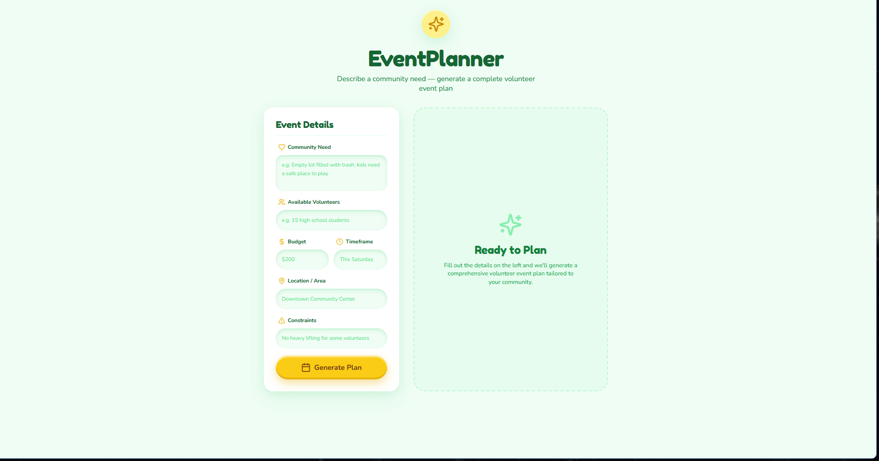
Snapshots of the MVP:

Slide 7
Links:
GitHub Public Repository:
Working Prototype Link: https://eventplanner-sc.vercel.app/

Slide 8


