Slide 1
Q3 Review (synthetic sample)
Field Services team

Slide 2
Results

Slide 3
Results
Signups grew in every month
  Strongest in September
    Driven by the referral pilot
Support tickets fell 12%
Notes:
Caveat: September includes 400 test accounts. Exclude them before quoting growth.

Slide 4
Quarterly signups

Slide 5
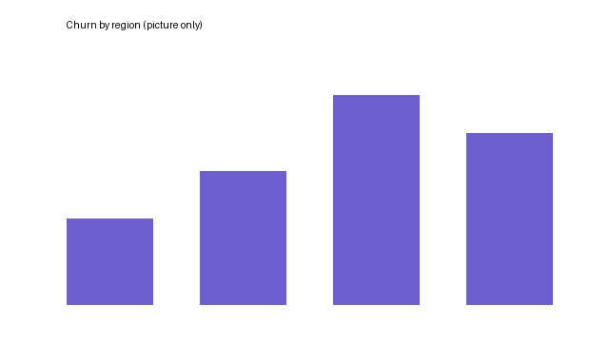

Slide 6
Support costs
Region | Tickets | Cost
North | 1,240 | 18.6
South | 980 | 14.7
Cost in USD thousands.

Slide 7
Before and after
Before: 5-day response
After: 2-day response

Slide 8
Draft numbers (old)
Signups 3.1k in September

