Slide 1


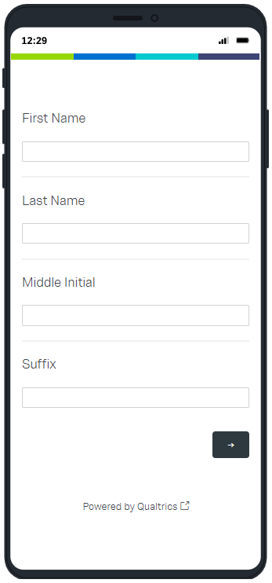
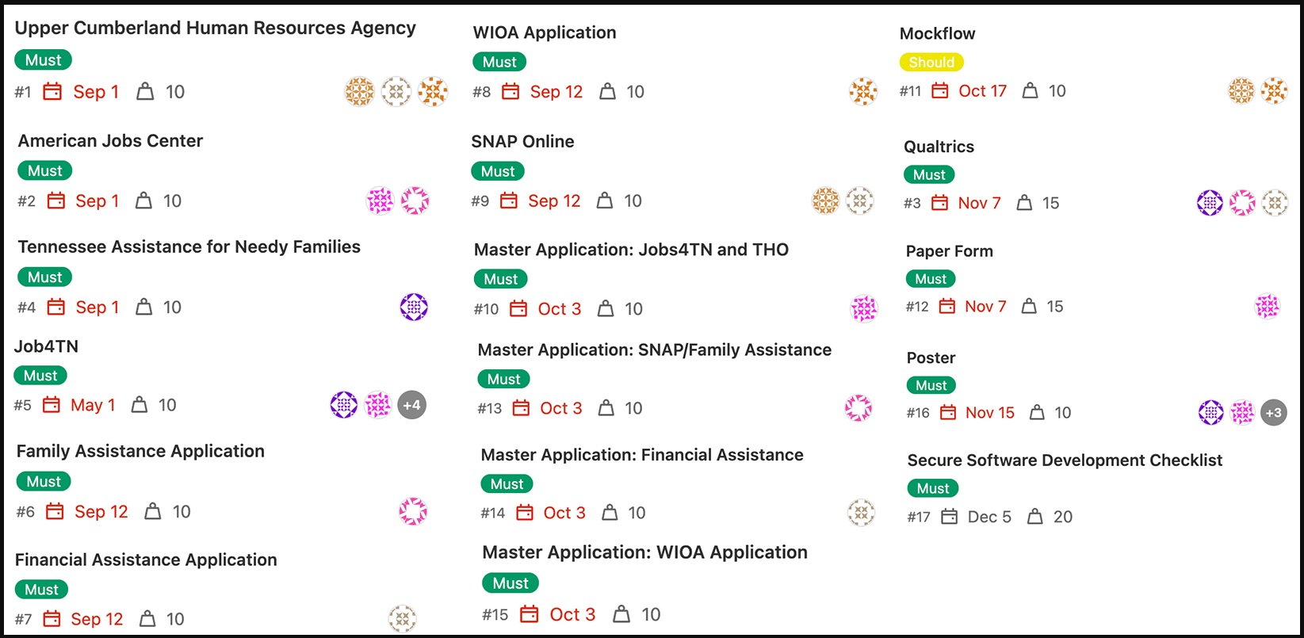
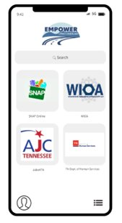
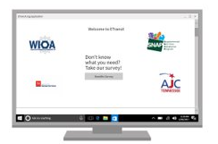
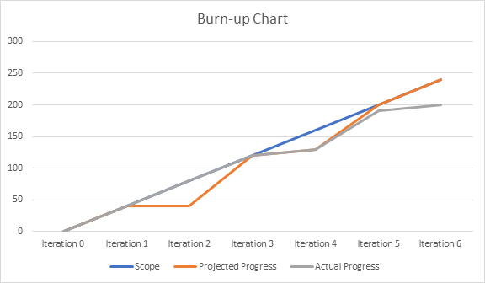



TANF Applications
TANF Opportunity Act
Eric Brown
Michael Aikens & Megan Spurgeon
Department of Computer Science, Tennessee Technological University
This project will focus on Tennessee Tech’s participation in the TANF Opportunity Act. The goal of this project is to bring 800 families out of poverty through the application of financial and training resources made available via the grant. To accomplish this task, there are multiple agencies and their related workflows that must be traversed. Analyze the workflows seeking optimizations as well as the development of software to assist the process.
This computer science applied research project addresses the disparities between rural Upper Cumberland residents in poverty and the agencies which seek to help them. This project will create efficiencies to fix a broken and outdated system. These agencies include the Upper Cumberland Human Resources Agency, the American Jobs Center, and Tennessee Assistance for Needy Families. Currently, each agency utilizes ten or more systems that do not integrate. Consequently, those in poverty are left at a distinct disadvantage and hardship when attempting to navigate the agencies' services. Accordingly, this project will develop the foundation and framework to unify these systems and to create a brighter future for those in poverty.
Outcome
Brief concept and Elevator statement
Project Progress Overview
Team was divided in subgroups to research and create accounts with agencies to measure time, information and other data needed to fill out application.
Master Application was developed to integrate all the data points from different agencies and create one application to eliminate redundancies.​
Goal was to create one Master Application that will work as one for all the agencies' applications to make it easier for user rather than filling out application for each different agency.​
From collected data through all different agency portals and applications we presented this detailed documentation to the contractors of this project (eTransX) who will design the system.
As a team we developed a prototype application using Qualtrics software to show a Minimum Viable Product (MVP) for the eTransX.
Timeline:
March 2022
Iteration 1: Begin researching all agencies portal
Sept. 2022
Iteration 2: Organized data points from agency portals
Oct. 2022
Iteration 3: Eliminated redundant data points from collected documentation.
Oct. 2022
Iteration 4: Begin working on the Qualtrics software to create demo for showcase.
Agile Sprint Board Overview
Each sprint cycle in this project had a scope of 40 points.
All the stories were prioritized according to the planned features for MVP.
We also hosted team scrum meetings weekly to check progress on stories started in sprint.
We use GitLab to visualize our sprint board and used board to organize projects, breaking them down into defined time.
Team Temperature was also considered to measure team workload and happiness for definite results.
Figure 5: Final Product
Nov. 2022
Iteration 5: Completed Qualtrics software.
Discussions
Team designed a Qualtrics survey which showcased how the redundant data can be combined to one to eliminate unnecessary storage of data in the backend of the system. ​
Master Application was designed by taking similar data points from all agency's application set and integrating it into one functional application.
TANF Opportunity
Gitlab Manager: Devraj Chauhan.
Quality Assurance: Zoey Bolduc, Alexandra Lee, and Alex Omran.
Business Analyst: Aidan Hurst.
Developers/Testers: Jacob Harris and Jonathan Spradlin.
Iteration Manager: (Rotating through team members each Iteration).
The progress throughout the project was well-paced for each iteration and allowed each teammate proper time to complete the user stories. What could have been better was have clearer goals presented at the beginning from our clients to know that the team's focus was creating a master application rather than a database. This also would've allowed the team more research time with the clients from each agency to aid in the project.
Conclusion
Primarily Flowcharts and MS Excel were used to collect the data points from all the agencies applications.
MS Excel was for documentation of each agency’s application and their specific roles in rural communities.
Qualtrics was used to visualize all the agencies applications through a survey tool to analyze responses from one convenient online location
Project Overview
Websites: https://thosolutions.com/time/login.aspx & https://www.tn.gov/humanservices/for-families/supplemental-nutrition-assistance-program-snap/applying-for-services.html
Technology resources used: GitLab, MockFlow, Qualtrics, Draw.io, MS Excel. ​
Documents: WIOA Application, Family Assistance Application, Cookeville Regional Medical Application for Financial Assistance, THO.
Reference
Figure 3: Agile Story Board
Burn up Chart
Acknowledgement
Figure 1: Representation for the Desktop UI
Figure 2: Representation for the Smartphone UI
Figure 4: Project Burn-Up Chart.

