Slide 1
Poison-resilient continual intrusion detection on CICDDoS2019
Can a gate plus a frozen teacher keep a replay-based NIDS safe AND still learning when its stored labels are poisoned?
Main result (four labels, CII, seeds 42-44)
With ALL 2,000 stored Syn labels flipped to BENIGN, teacher relabelling learns all four classes in 3/3 seeds on held-out test:
Syn 0.9952 · LDAP 0.9825 · UDP 0.9983 · benign FAR 0.0011 (gate only and soft repair: LDAP = UDP = 0)
HELD-OUT TEST
POST HOC
the relabel method was chosen after the pre-registered sweep's diagnostic
• Scope: four labels defended (BENIGN, Syn, LDAP, UDP); one attacked class (Syn); CII; 3 seeds; no significance claim
• Not claimed: a 12- or 14-label defence (unsolved), or training on all 70.4M raw rows (we trained on capped, deduplicated subsets)
• Known limitation: a recall-based gate does not see confidence loss (RF study, slide 10)
Source: github.com/DevChi1l/cicddos2019-continual-nids (committed files; tables: docs/RESULT_TABLES.md)
1 / 10
Notes:
Thirty seconds. One sentence on the problem, one on the result, one on the scope. Say 'four-label' and 'post hoc' out loud now so nobody hears a 12-label claim later.

Slide 2
Problem, threat model and what is new here
• Continual NIDS: a detector keeps learning new attack types; replay mixes stored old rows into each update so it does not forget
• Attack surface: whoever can edit stored labels can make it forget an old attack or block new learning
• Threat model: flip a share f of the stored labels of ONE old class (Syn -> BENIGN). The attacker cannot touch new data, validation, test, the teacher or gradients
• Inherited: CI/CII scenarios, replay + buffer label-flipping threat, joint oracle (reference paper); feature-token Transformer (FT-Transformer, Gorishniy et al. 2021); CICDDoS2019 (Sharafaldin et al. 2019)
Our contribution (implemented and measured)
• Leakage-controlled pipeline over all 70.4M raw rows (audit, global dedupe, conflict drop, E0-only scaler, transformed-duplicate exclusion)
• Validation gate + frozen E0 teacher + one repair attempt; rejected update -> keep last accepted model
• Pre-registered poison sweep; post-hoc teacher relabelling (FU2) as the defence at 100% flips
• Honest limits: 12-label protocol fails; two pilots stopped; confidence loss invisible to the gate
Source: github.com/DevChi1l/cicddos2019-continual-nids (committed files; tables: docs/RESULT_TABLES.md)
2 / 10
Notes:
Replay buffers stop forgetting but are an attack surface. The reference paper (Ariffin et al., arXiv 2608.04602, CICIDS2017) showed label flipping on the buffer collapses accuracy and proposed no defence. Our contribution is not a new architecture: it is a gated update protocol with a frozen teacher and one repair, tested with pre-registered experiments on an audited CICDDoS2019 pipeline. We do not claim the gate idea is new in the literature; we did not survey that systematically.

Slide 3
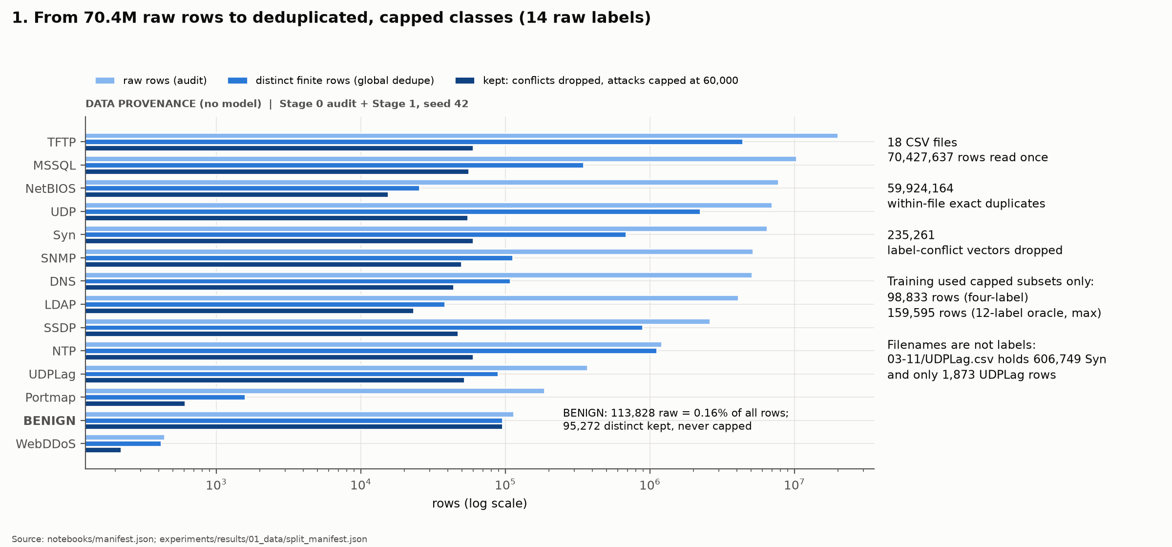
Audited dataset and preprocessing
DATA
• Audit: 18 CSV files, 70,427,637 rows, 14 raw labels, 59,924,164 within-file duplicates
• Order: label column (not filename) -> drop ids, IPs, ports, timestamp, Inbound -> drop non-finite -> global dedupe on a feature hash -> drop 235,261 label-conflict vectors -> cap 60,000 distinct per attack -> split 60/10/10/20
• BENIGN: 113,828 raw (0.16%) -> 95,272 distinct kept, never capped
• Inputs: 77 numeric features + protocol
• Trained on: capped subsets only (98,833 rows four-label; at most 159,595)
Source: github.com/DevChi1l/cicddos2019-continual-nids (committed files; tables: docs/RESULT_TABLES.md)
3 / 10
Notes:
We read all 70,427,637 rows once, but the data is mostly copies: 59,924,164 within-file duplicates. Filenames are not labels: 03-11/UDPLag.csv is mostly Syn, so the label column decides. Benign is 0.16%; we keep every distinct benign row. Training used capped subsets only: 98,833 rows for the four-label experiments. Never say we trained on 70 million rows.

Slide 4
How E0 / E1 / E2 are formed (four-label, CII)
experience | new class | attack rows | fresh BENIGN rows | model after it
E0 | Syn | 13,890 | 19,055 | T (frozen) and A0
E1 | LDAP | 13,890 | 19,054 | A1 (if accepted)
E2 | UDP | 13,890 | 19,054 | A2 (if accepted)
Attack cap = 13,890
= LDAP's whole cleaned training count, so every attack class contributes equally
Same Stage 1 splits feed every experiment (sha256 bb1f5acb…)
12-label runs: 9,312 per class, two classes per update; RF: fixed 3 classes
• Splits fixed first: validation 23,263 rows, held-out test 46,527 rows (19,028 benign); never used for training
• Scaler: signed log1p -> standardise -> clip ±5, fitted on E0 training rows only, then frozen
• Leakage guard: 166 protected rows excluded because their scaled input equals a training input (residual 0)
• Replay buffer: 2,000 rows per class per ACCEPTED experience, true label stored; a rejected experience adds nothing
Source: github.com/DevChi1l/cicddos2019-continual-nids (committed files; tables: docs/RESULT_TABLES.md)
4 / 10
Notes:
E0 trains the first model on benign plus Syn. Each update brings one new attack class and a fresh, disjoint benign portion (that is CII). The scaler is fitted on E0 only and frozen. 166 validation/test rows whose scaled input equals a training input were excluded, so evaluation never sees a training input. The buffer keeps 2,000 rows per class from each accepted experience.

Slide 5
Model: FT-Transformer-style feature-token Transformer
Feature tokenizer
z_j = x_j·W_j + b_j (77 tokens)
protocol embedding (1)
[CLS] first (1)
-> (N, 79, 32)
3 × PreNorm encoder layer
self-attention: 4 heads × 8 dims
softmax(QKᵀ/√8)·V over 79 tokens
FFN 32 -> 128 -> 32, GELU
one flow
77 scaled numbers
+ protocol (0/6/17)
[CLS] -> LayerNorm -> Linear(32, K)
logits for the classes seen so far
• Size: d = 32; 43,396 parameters with 4 classes (43,660 with 12)
• New classes: the head grows; old output rows are copied, so old logits are unchanged before training
• Loss: class-weighted cross-entropy, c_k = sqrt(N / (K·n_k)), × a per-row weight (used only by repair); AdamW, 10 epochs for E0, 5 per update
• Closest published design: FT-Transformer's feature tokenizer + [CLS] + PreNorm (smaller; GELU not ReGLU). Not the original TabTransformer
Source: github.com/DevChi1l/cicddos2019-continual-nids (committed files; tables: docs/RESULT_TABLES.md)
5 / 10
Notes:
Every numeric feature becomes its own 32-dimensional token, x_j times W_j plus b_j; protocol becomes an embedding token; a learned CLS token goes first. 79 tokens pass through 3 PreNorm encoder layers with 4 heads of 8 dimensions. The final CLS vector goes to LayerNorm and a linear head. 43,396 parameters with 4 classes. It is NOT the original TabTransformer, which attends only over categorical columns; the class name in the code is historical.

Slide 6
Replay poisoning and the defended update protocol
ACCEPT -> deploy A_t
buffer gains rows of E_t
Attacker: flip stored Syn labels -> BENIGN in buffer B
pass
C1
copy of A + new head rows
train on D_t + B
GATE (validation only)
old ≥ ref − 0.05 · new ≥ 0.80
FARs ≤ 0.05
E0 -> T (frozen, hash-checked)
and A0 (keeps learning)
pass
fail
R1 (repair arm only)
restart from A; T weights or
relabels buffer rows
REJECT both -> fallback
keep last accepted model;
buffer unchanged
fail
• Soft R1 (pre-registered): row weight = p_T(stored label | x). Relabel R1 (FU2, post hoc): if p_T(stored) ≤ 0.1 and T is ≥ 0.9 sure of another class, train the row with T's label
• T is never trained after E0 and knows only BENIGN and Syn; test rows are never read by any decision
Source: github.com/DevChi1l/cicddos2019-continual-nids (committed files; tables: docs/RESULT_TABLES.md)
6 / 10
Notes:
Walk the diagram left to right. T is a frozen copy of the E0 model; A0 is the copy that keeps learning. Each update trains C1 on new data plus the buffer. The gate checks validation only: old-class recall within 0.05 of the last accepted model, new class at least 0.80, both false-alarm rates at most 0.05. If C1 fails, the repair arm tries R1 once, restarting from the last accepted model and using T on the buffer. If R1 also fails, we keep the old model. Only accepted experiences enter the buffer.

Slide 7
Why relabelling: the sweep, then FU2's validation decisions
VALIDATION
POST HOC
f = 1.0: all 2,000 stored Syn labels flipped; seeds 42-44
seed | update | attempt | Syn val recall | Syn floor | rows relabelled (to true class) | gate
42 | E1 | C1 (stored labels) | 0.0000 | 0.9453 | - | REJECT
42 | E1 | R1 relabel | 0.9953 | 0.9453 | 1995 (1995) | ACCEPT
42 | E2 | C1 (stored labels) | 0.0000 | 0.9453 | - | REJECT
42 | E2 | R1 relabel | 0.9953 | 0.9453 | 1995 (1995) | ACCEPT
43 | E1 | C1 (stored labels) | 0.0000 | 0.9461 | - | REJECT
43 | E1 | R1 relabel | 0.9941 | 0.9461 | 1994 (1994) | ACCEPT
43 | E2 | C1 (stored labels) | 0.0000 | 0.9441 | - | REJECT
43 | E2 | R1 relabel | 0.9955 | 0.9441 | 1994 (1994) | ACCEPT
44 | E1 | C1 (stored labels) | 0.0000 | 0.9461 | - | REJECT
44 | E1 | R1 relabel | 0.9961 | 0.9461 | 1995 (1995) | ACCEPT
44 | E2 | C1 (stored labels) | 0.0000 | 0.9461 | - | REJECT
44 | E2 | R1 relabel | 0.9960 | 0.9461 | 1995 (1995) | ACCEPT
Pre-registered sweep (context)
PRE-REGISTERED
HELD-OUT TEST
• f ≤ 0.95: all 4 classes learned in 9/9 soft-repair runs vs 3/9 gate-only
• f = 1.0: soft R1 accepted 0/6; teacher weight on flipped rows ≈ 0.003: wrong labels removed, no Syn label left
• Relabel diagnostic would have passed 3/3 -> FU2 deploys it (registered before its run)
Source: github.com/DevChi1l/cicddos2019-continual-nids (committed files; tables: docs/RESULT_TABLES.md)
7 / 10
Notes:
Context first: in the pre-registered sweep, soft repair worked up to 95% flips, learning all four classes in 9 of 9 repair runs versus 3 of 9 gate-only, but failed at 100% because no correct Syn label was left. FU2 deploys teacher relabelling at 100%. Read the table: the plain update C1 drops Syn recall to zero and the gate rejects it; relabel R1 restores 1,994-1,995 labels and passes, at E1 and E2, in all three seeds. Say clearly: the method is post hoc, and E1 replays the earlier diagnostic, so E2 and the test are the new evidence.

Slide 8
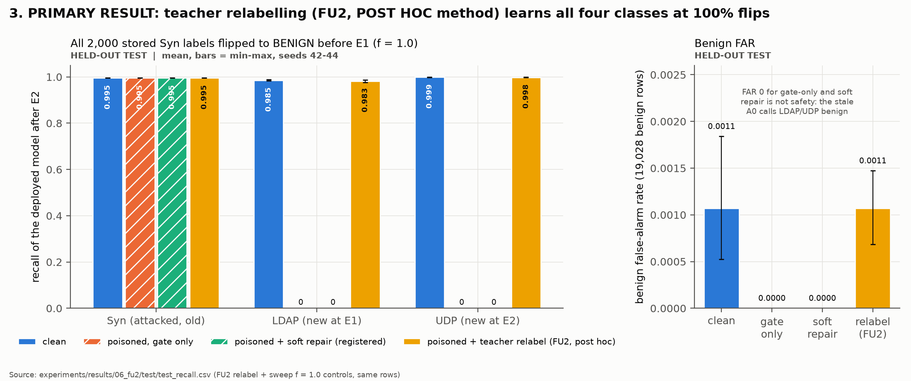
Result: four-class defence at 100% flips (held-out test)
HELD-OUT TEST
POST HOC
mean (min-max) over seeds 42-44; 46,527 test rows, 19,028 benign
arm | Syn | LDAP | UDP | benign FAR
clean | 0.9954 | 0.9851 | 0.9988 | 0.0011
gate only | 0.9953 | 0.0000 | 0.0000 | 0.0000
soft repair | 0.9953 | 0.0000 | 0.0000 | 0.0000
relabel (FU2) | 0.9952 | 0.9825 | 0.9983 | 0.0011
• H3 (Syn ≥ 0.95, LDAP & UDP ≥ 0.80, FAR ≤ 0.05) met in 3/3 seeds
• FAR 0 for gate-only is NOT safety: the stale A0 labels LDAP/UDP traffic benign
• Scope: 4 labels, Syn attacked, CII, 3 seeds
Source: github.com/DevChi1l/cicddos2019-continual-nids (committed files; tables: docs/RESULT_TABLES.md)
8 / 10
Notes:
Same 46,527 test rows for every arm, scored once after the validation commit for FU2. Relabelling learns all four classes, within about 0.01 of clean, with the same benign false-alarm rate. Gate-only and soft repair keep the stale A0, which calls LDAP and UDP benign; their false-alarm rate of 0 is not safety. Scope: four labels, one attacked class, 3 seeds, post hoc method.

Slide 9
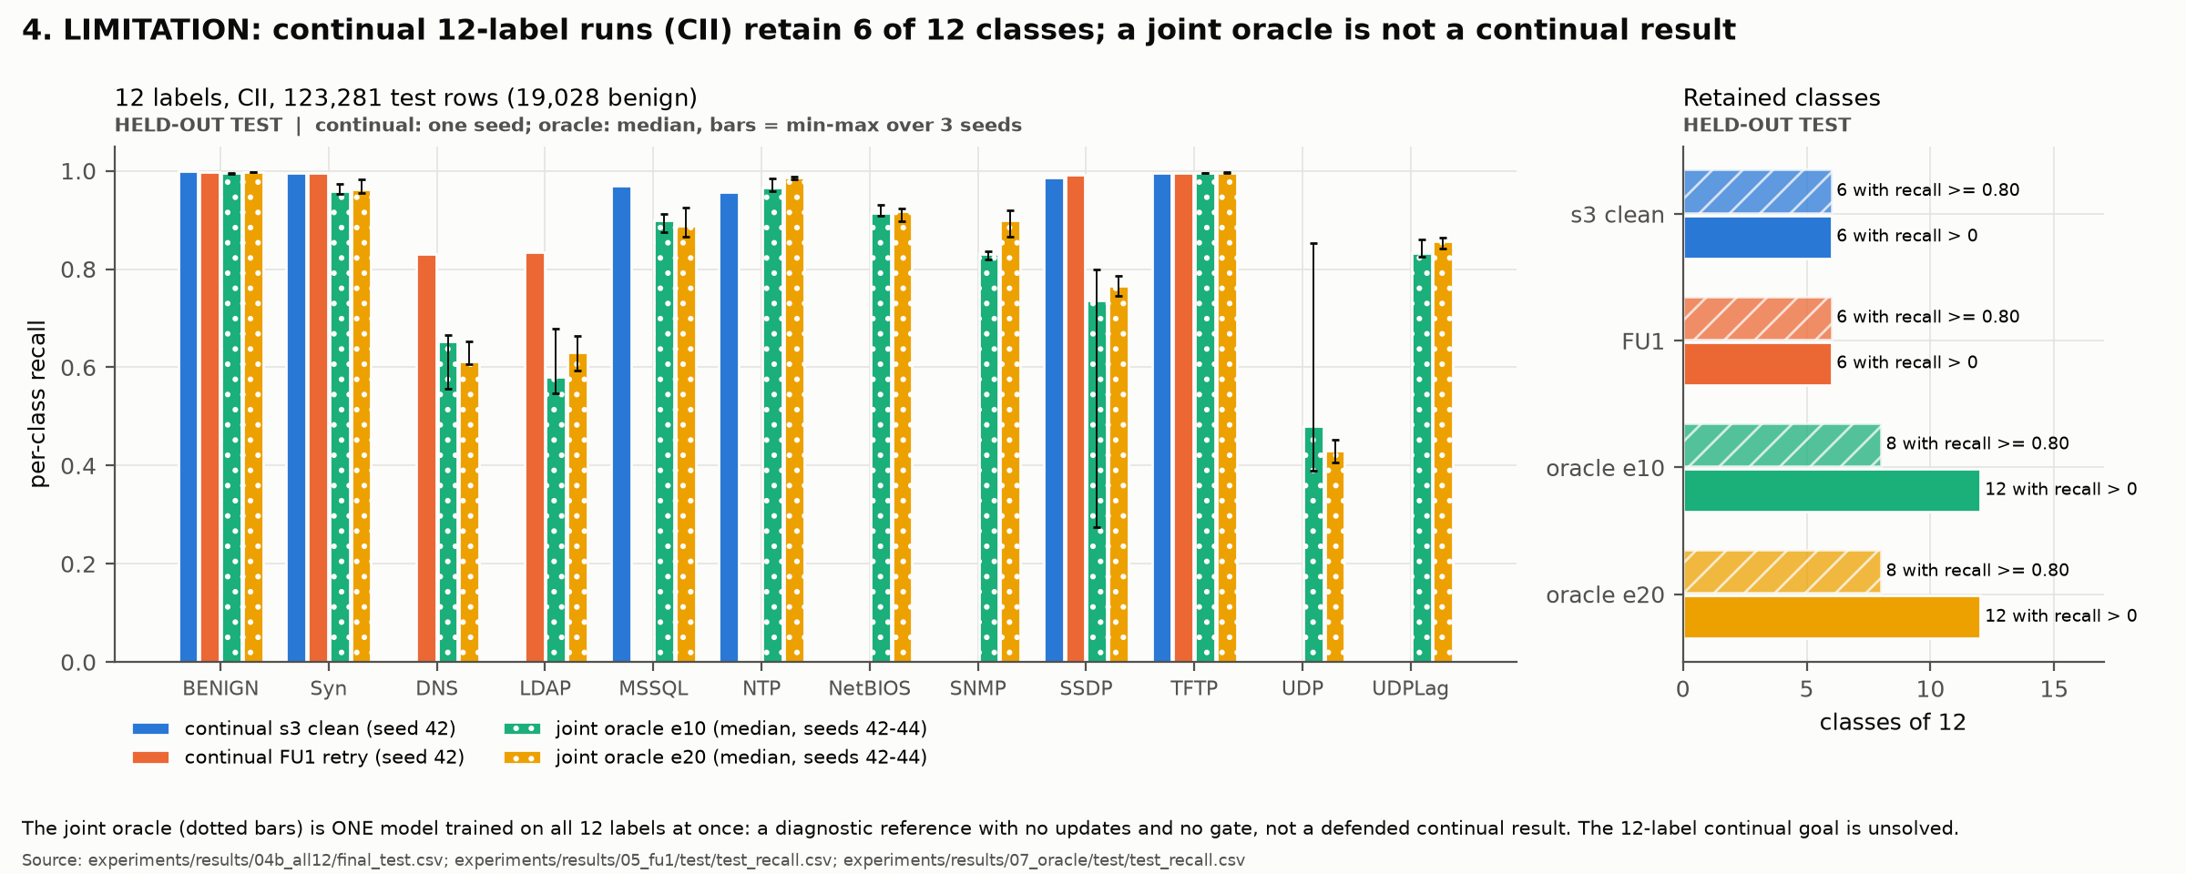
Limitation: the 12-label continual setting is not solved
HELD-OUT TEST
LIMITATION
DIAGNOSTIC
oracle = one jointly trained model, not continual
• Continual s3 clean: 6/12 classes, macro recall 0.492 (one seed)
• FU1 retry: 6/12, macro 0.471; DNS/LDAP 0.83/0.83 learned, MSSQL/NTP lost
• Joint oracle (diagnostic): macro 0.816/0.829; DNS 0.65, LDAP 0.63, UDP 0.48
• Claim: no 12- or 14-label defence
Source: github.com/DevChi1l/cicddos2019-continual-nids (committed files; tables: docs/RESULT_TABLES.md)
9 / 10
Notes:
With 12 labels even CLEAN updates fail the gate: DNS overlaps LDAP and UDP overlaps SSDP, and a rejected block is lost for good. The continual CII models keep 6 of 12 classes. A retry recipe (FU1) learned DNS/LDAP but lost others. A jointly trained oracle reaches all 12 classes but is weak on DNS/LDAP and UDP even without continual learning, and it is a diagnostic, not a defended continual result. So we claim four labels only.

Slide 10
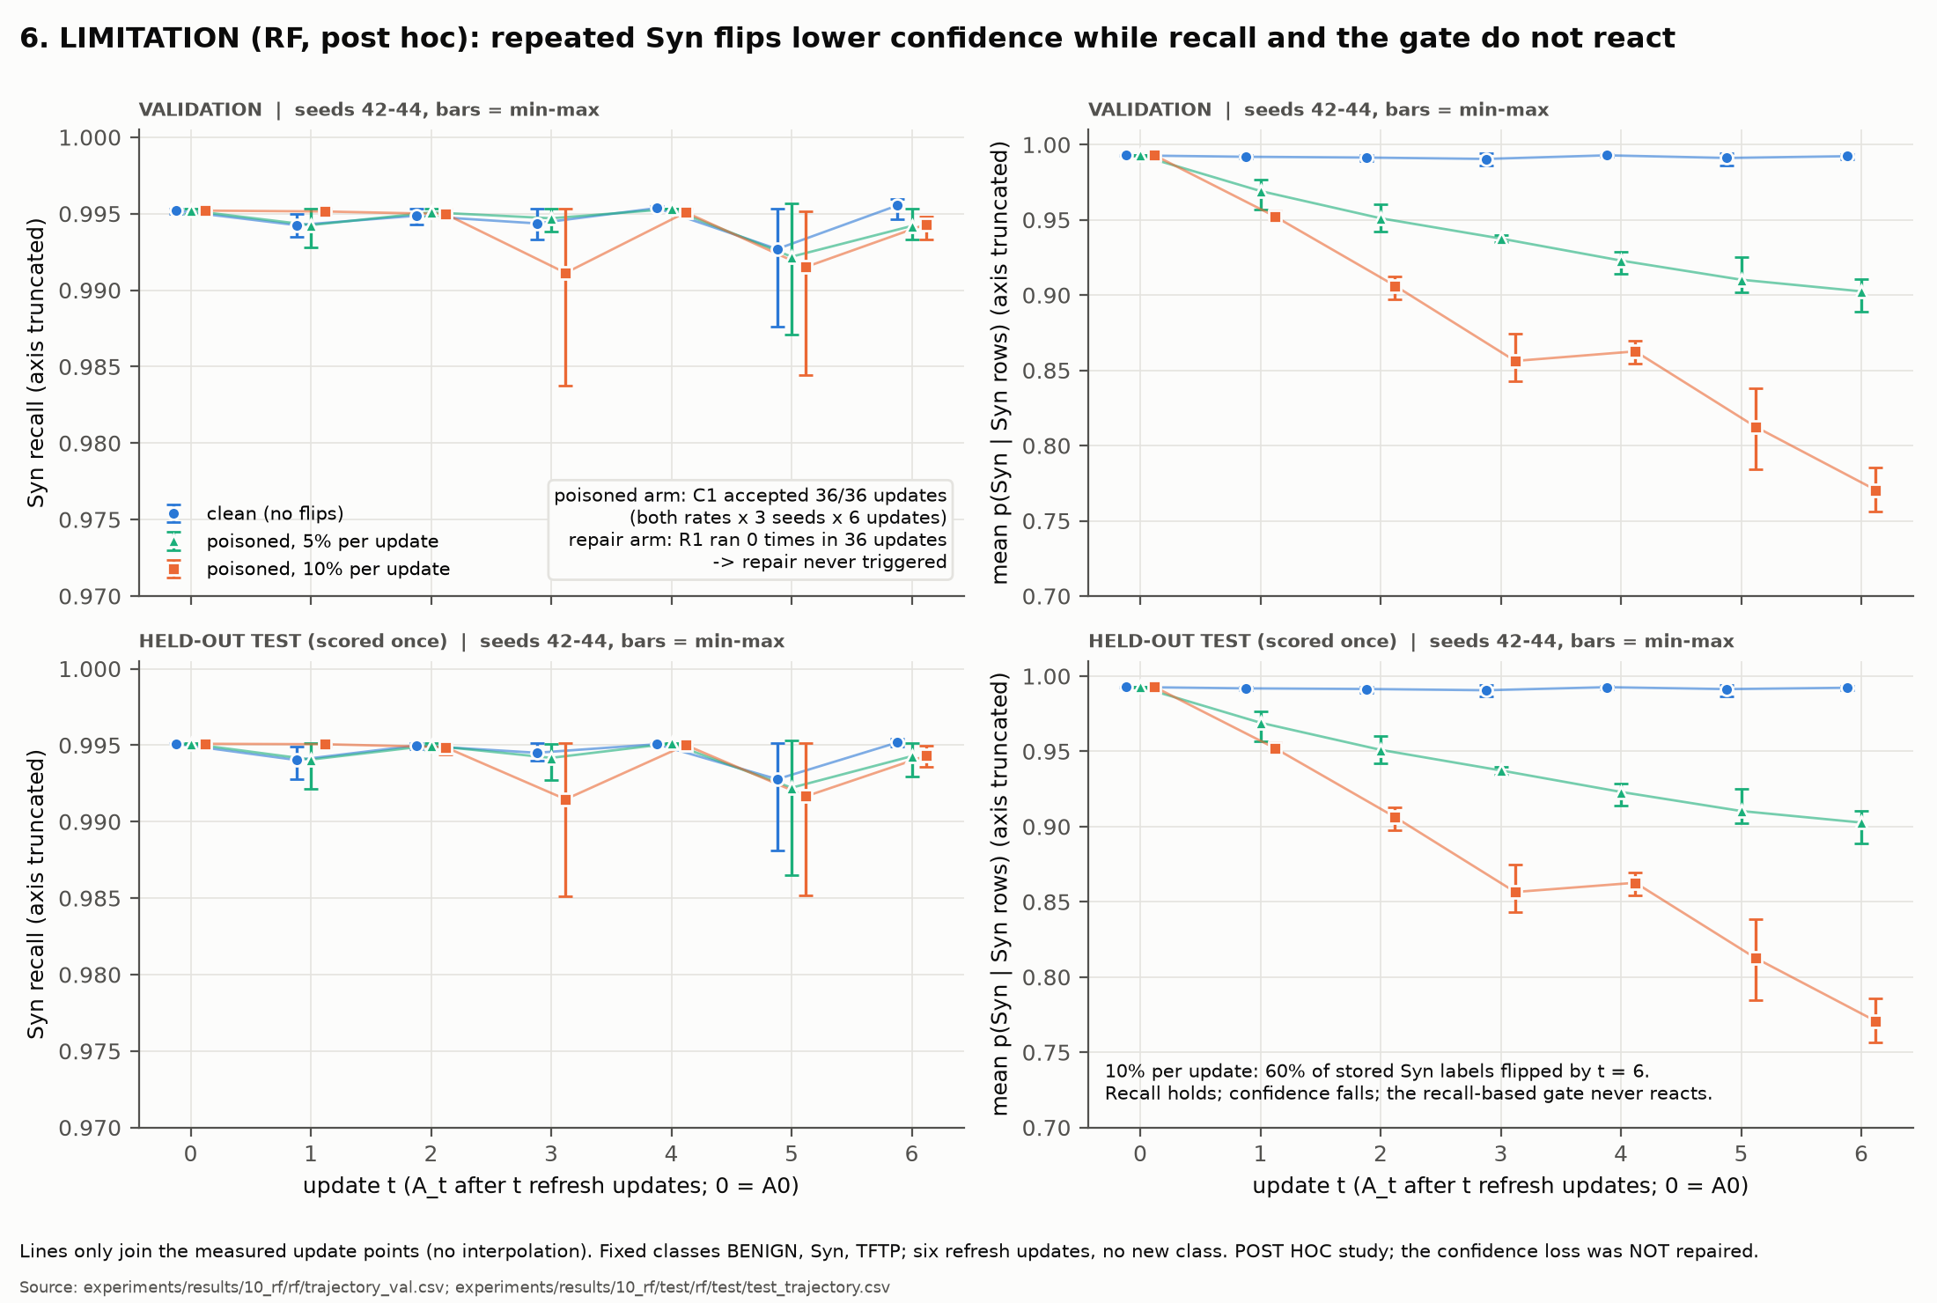
Limitation: confidence loss the recall-based gate does not see (RF)
VALIDATION
HELD-OUT TEST
POST HOC
LIMITATION
• Setting: BENIGN, Syn, TFTP fixed; 6 refresh updates; no new class
• Attack: +10% stored Syn labels flipped per update -> 60% after E6
• Gate: poisoned C1 accepted 36/36; repair R1 ran 0 times
• Test, A6 (10%): Syn recall 0.9943 vs 0.9952 clean; mean Syn confidence 0.7707 vs 0.9922
• Not claimed: that repair fixed this (it never ran); new-class arrival
• Next (proposal): a pre-registered confidence check in the gate
Source: github.com/DevChi1l/cicddos2019-continual-nids (committed files; tables: docs/RESULT_TABLES.md)
10 / 10
Notes:
RF is post hoc and uses three fixed classes with six traffic-refresh updates, no new class. Before every update 10 percent more stored Syn labels are flipped, 60 percent by the end. Every poisoned update passed the gate, so repair never ran. Recall stayed at 0.994, but the model's confidence on Syn fell to 0.77. Validation is the top row of the figure, held-out test the bottom row. Close: the four-class defence works; the gate needs a confidence check, which is our proposed next step, not a result.

