Slide 1
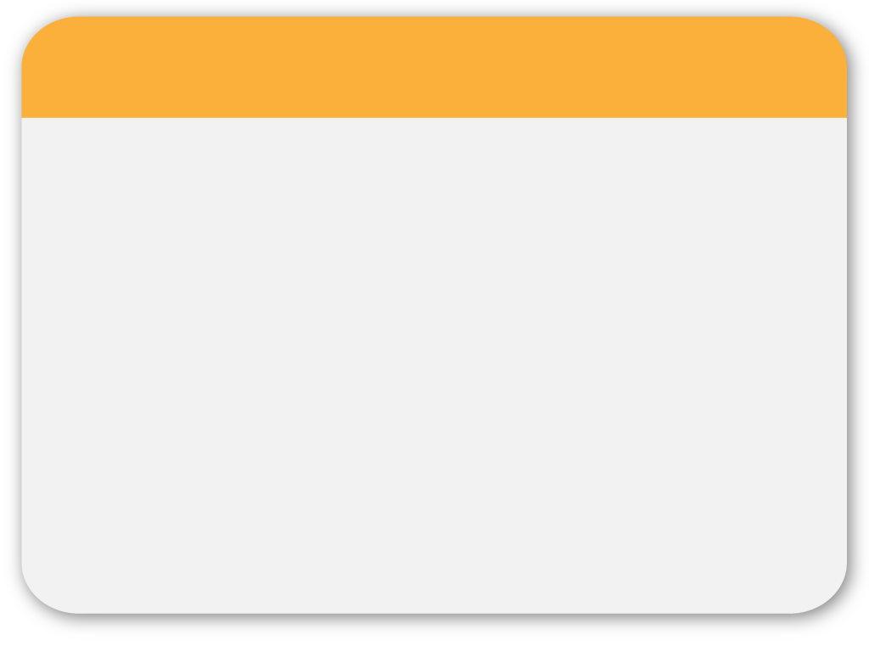
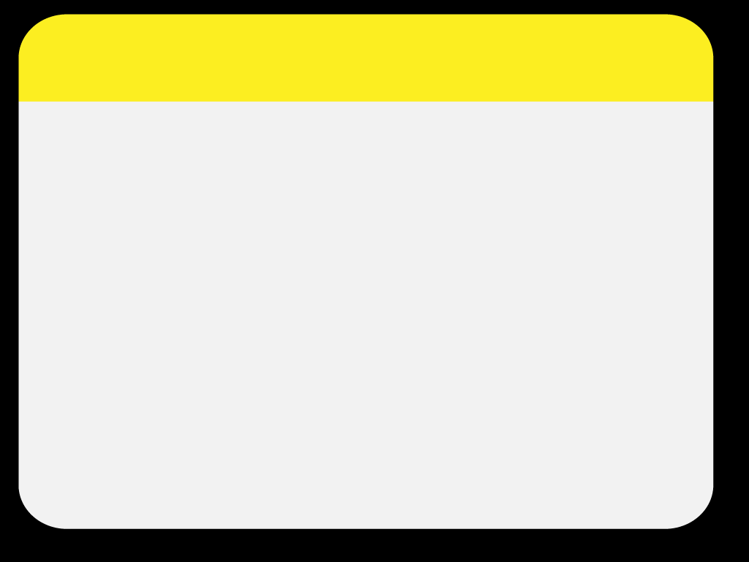
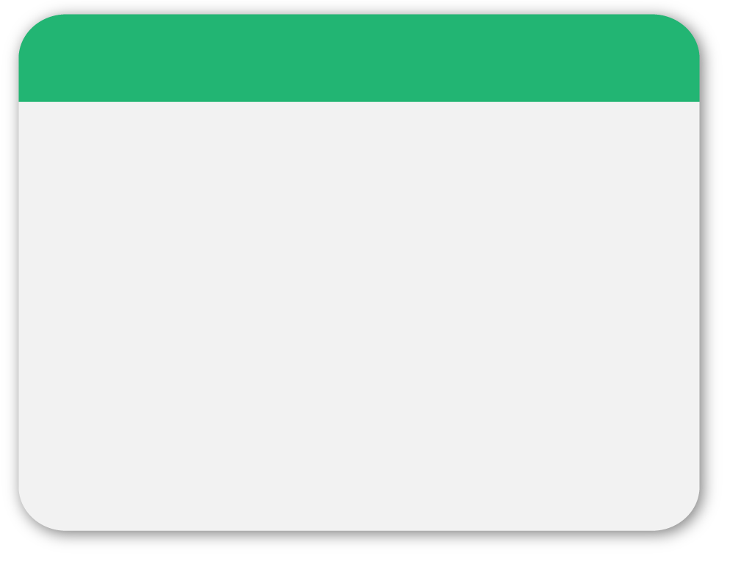
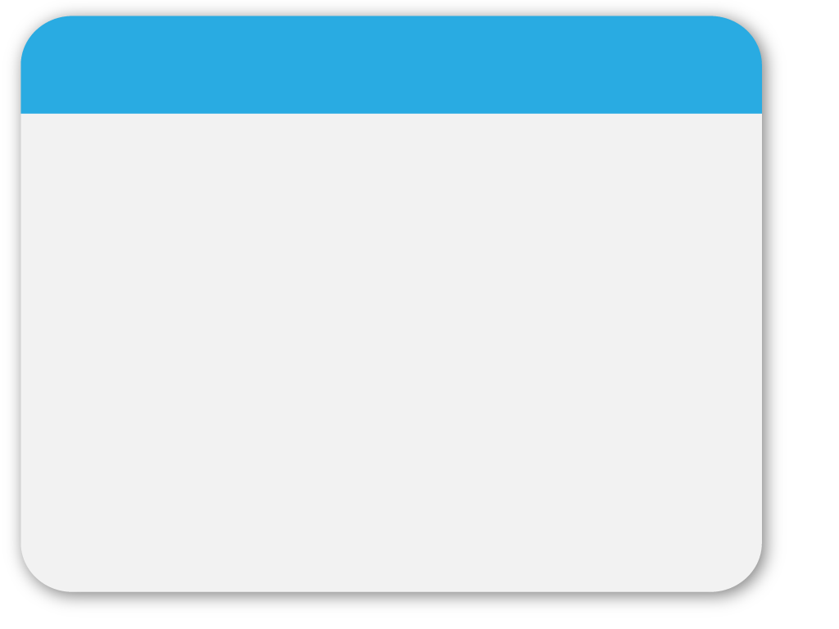
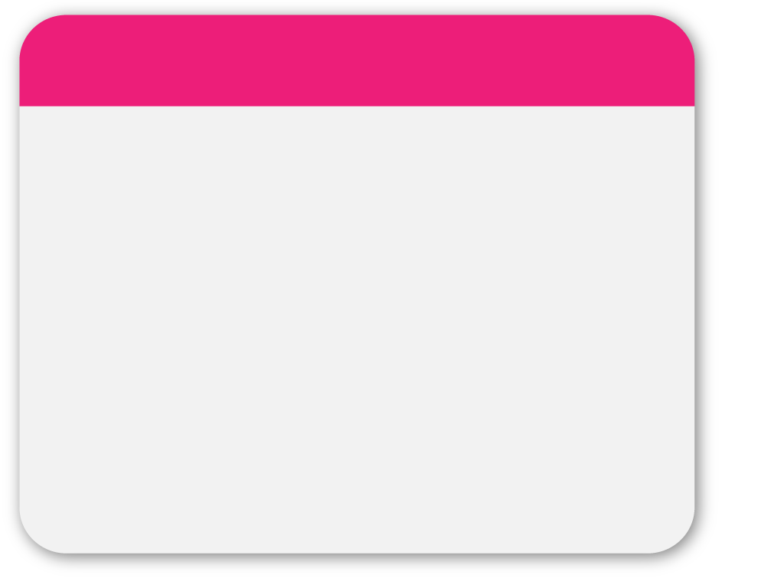

01
WINTER
Capítulo 2 : CONOCIMIENTOS BÁSICOS
ESTRUCTURAS
REPETITIVAS
Template
• While loops
• Until loops
• For loops and nested loops
• Infinite loops

Slide 2
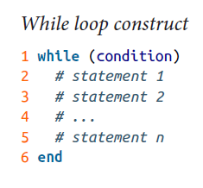
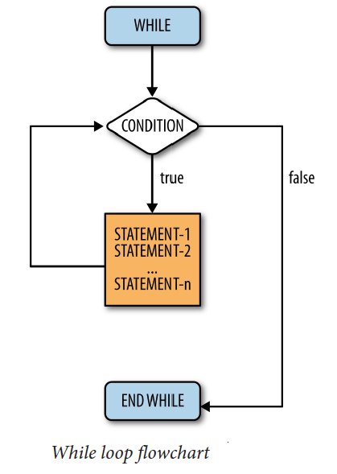
02
WHILE LOOPS

Slide 3
02
WHILE LOOPS
1. while (condition)
2. label redo;
3. goto label next /*next*/
4. goto label break /*break*/
5. goto label redo /*redo*/
6. label next
7. end
8. label break
9. return

Slide 4
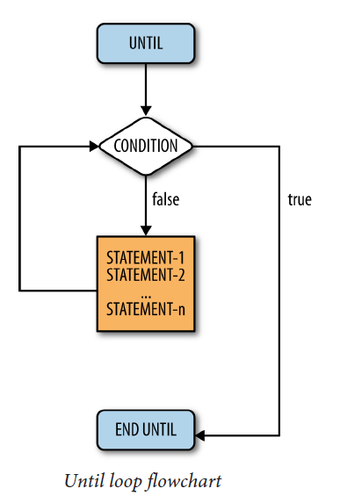
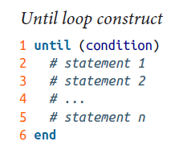
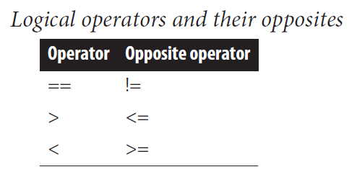
03
UNTIL LOOPS

Slide 5
04
FOR LOOPS
1. for elem in colection
2. ...
3. end

Slide 6
05
NESTED LOOPS
for i in (1..3)
puts ”Bucle exterior: i=”+ i.to_s
for k in (1..4)
puts ”Bucle interior: k=”+ k.to_s
end
end

Slide 7
06
WINTER
INFINITE LOOPS
Template
i=5
while ( i > 0 )
i=i+2
end

Slide 8
Gracias ! =)
@elioycor

