Slide 1

Unlocking Business Potential: A Data-Driven Analysis
Welcome! I'm Abhay, and I'm excited to share insights from your company's data. This analysis will help guide your next business prospects.

Slide 2
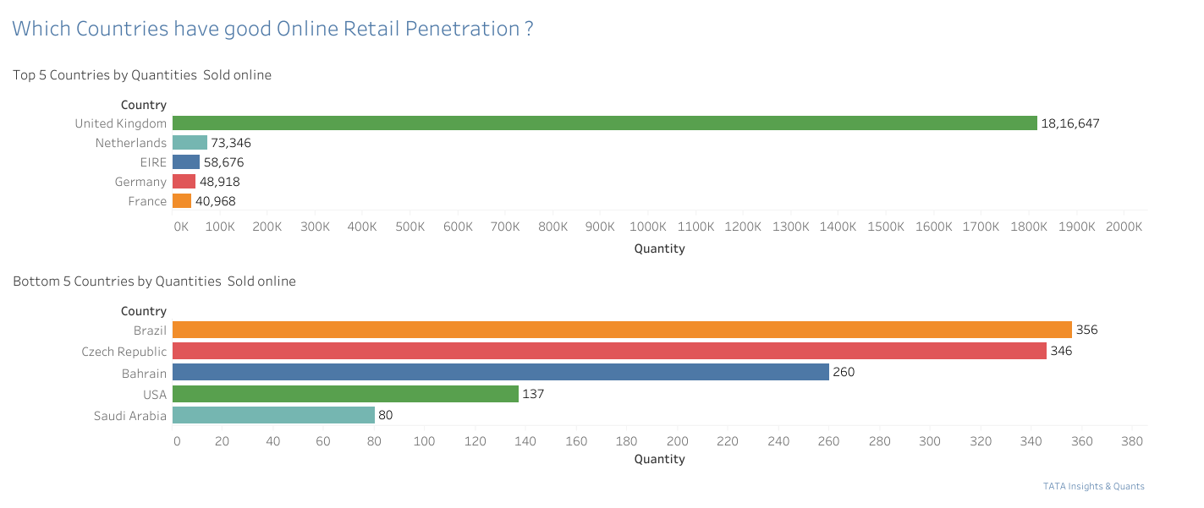
Seasonal Revenue Trends
Retail sales show clear seasonality, with significant growth in the latter part of the year.
Revenue remained stable at $685K monthly from January to August, then surged 40% in September, peaking at $1.5M in November. December data is insufficient.

Slide 3
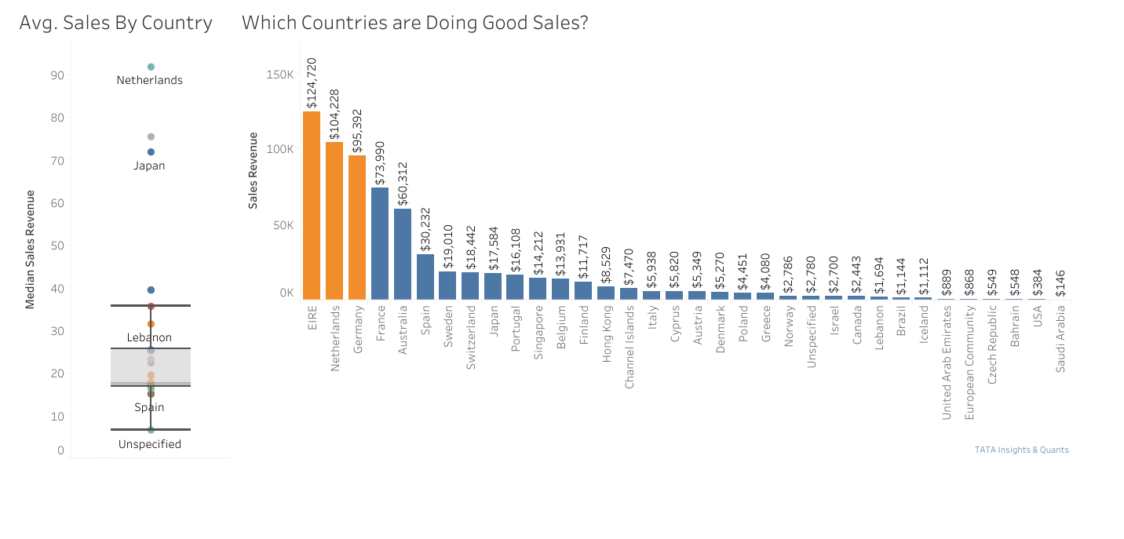

Slide 4





Top Growth Markets (Excluding UK)
Netherlands
Ireland
High unit sales and revenue.
Strong sales performance.
Germany
France
Significant market potential.
Robust demand and sales.
Focus on these countries to further capture and expand market share, as they show high sales and revenue.

Slide 5
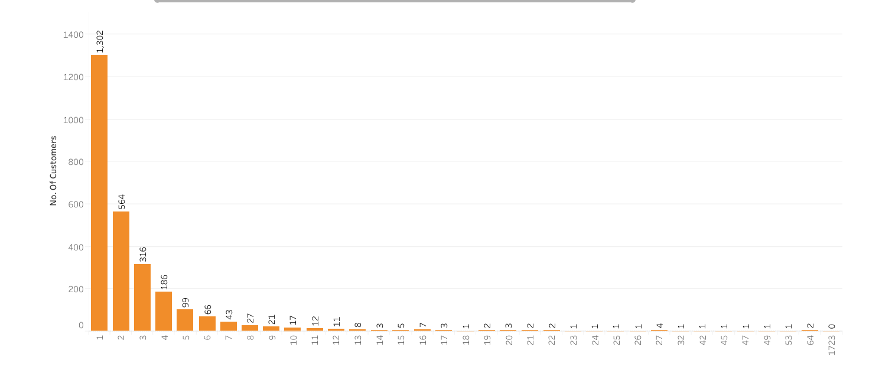

Consumer Purchase Analysis
The top 10 consumers show minimal differences in purchases, indicating no reliance on a few high-spending individuals.
The highest revenue-producing consumer spent only 17% more than the second highest, limiting consumer negotiation power and reflecting a healthy business state.

Slide 6
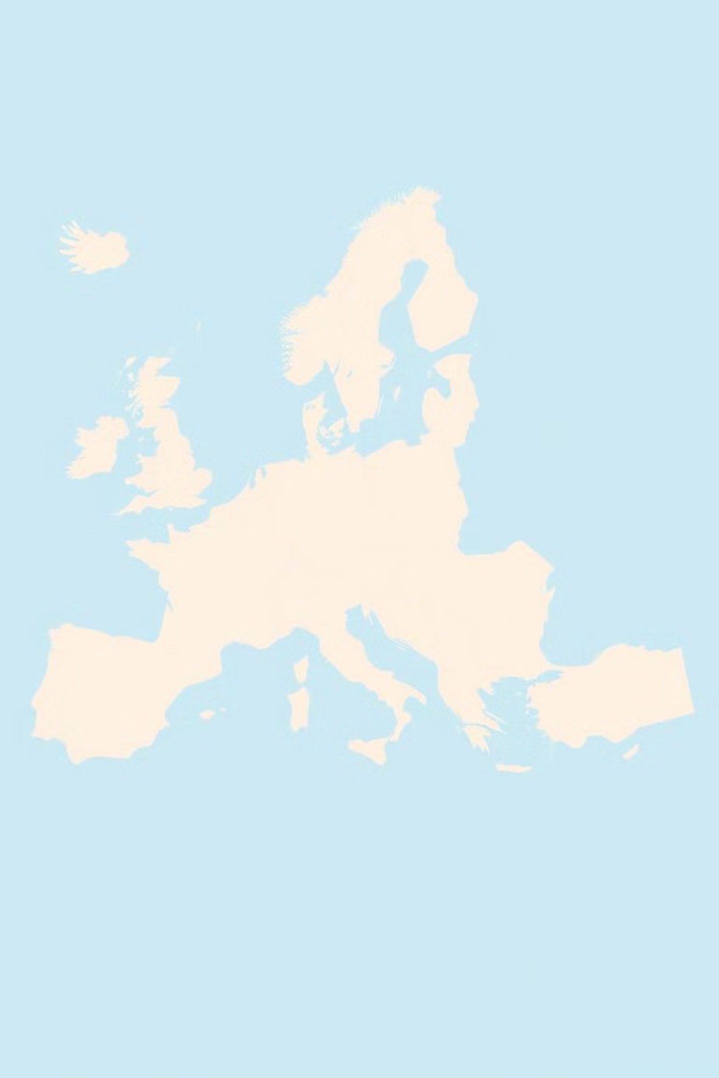
Geographic Revenue Hotspots
Beyond the UK, the Netherlands, Ireland, Germany, France, and Australia are key profit generators.

Slide 7
Market Expansion Opportunities
Current Focus:
Untapped Markets:
Majority of sales concentrated in the European zone.
No market for products in Africa or Asia, including Russia.
Limited presence in the American region.
A new strategy targeting these areas could significantly boost sales and profitability.

Slide 8
Key Takeaways
1
Seasonal Sales Peak
2
High-Growth Countries
Revenue surges in the last four months of the year.
Netherlands, Ireland, Germany, and France offer significant potential.
3
Diversified Customer Base
4
Global Expansion
No over-reliance on a few top consumers.
Untapped markets in Africa, Asia, and parts of America.

Slide 9



Next Steps
Thank you for your time. I'm available to answer any questions or provide further analysis.

