Slide 1


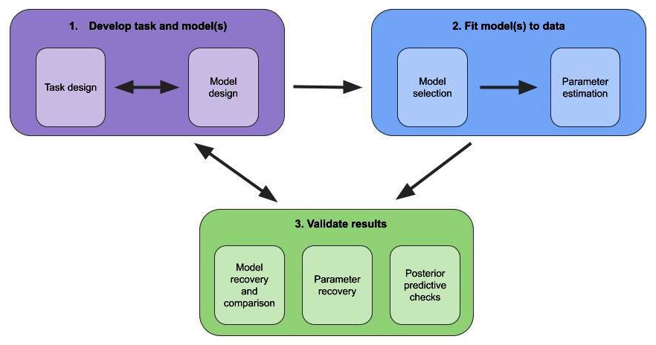

Workshop MODELING FLUX | Session 4 | Model comparison & recoverability
HARTLEY LAB
How reliable are fitted model parameters?
How do they change relative to each other?

Slide 2
Workshop MODELING FLUX | Session 4 | Model comparison & recoverability
HARTLEY LAB
How reliable are model parameters?
How do they change relative to each other?
We need to perform parameter recovery checks
For example, with task described earlier:
Recover softmax decision temperature
Recover learning rates

Slide 3
Parameter recovery
Workshop MODELING FLUX | Session 4 | Model comparison & recoverability
HARTLEY LAB
Steps:
Fit the model to behaviour and define parameters’ range (average/median/min-max)
Simulate the model varying one of the parameter values while keeping other parameters fixed
Fit simulated data with the same model used for the simulation
Compare true and recovered parameters.

Slide 4
Parameter recovery
Workshop MODELING FLUX | Session 4 | Model comparison & recoverability
HARTLEY LAB
Example:
2-arm bandit task with binary outcomes (reward - no reward)
Model with 1 learning rate (for chosen option) and softmax decision rule
N = 30 subjects
T = 100 trials, $p_{reward}=0.8$
Best fitted model group parameters:
chosen learning rate $α_{chosen}=0.5$,
softmax temperature $τ=0.3$

Slide 5
Parameter recovery
Workshop MODELING FLUX | Session 4 | Model comparison & recoverability
HARTLEY LAB
For softmax temperature $τ$
Simulate $τ∈$ [0.1, 1] and $α_{chosen}=0.5$

Slide 6
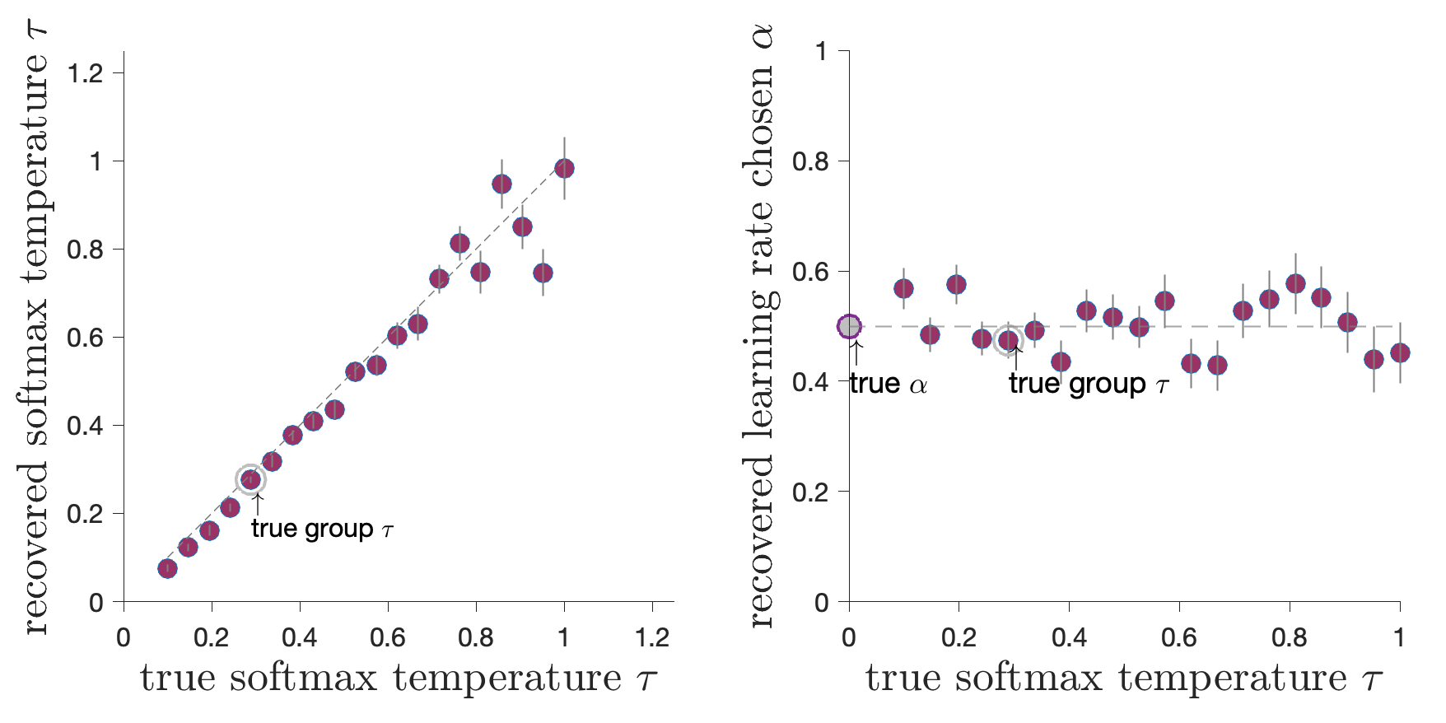
Parameter recovery
Workshop MODELING FLUX | Session 4 | Model comparison & recoverability
HARTLEY LAB
For softmax temperature $τ$
Simulate $τ∈$ [0.1, 1] and $α_{chosen}=0.5$

Slide 7


Parameter recovery
Workshop MODELING FLUX | Session 4 | Model comparison & recoverability
HARTLEY LAB
For softmax temperature $τ$
Simulate $τ∈$ [0.1, 1] and $α_{chosen}=0.5$

Slide 8
Parameter recovery
Workshop MODELING FLUX | Session 4 | Model comparison & recoverability
HARTLEY LAB
For softmax temperature $τ$
Simulate $τ∈$ [0.1, 1] and $α_{chosen}=0.5$
Recovery shows problem with high values of the softmax inverse temperature: $↑τ→$more exploration $→$ less stable estimates
True values for both parameters might be overestimated
Try: increase the number of trials: $100→300$

Slide 9
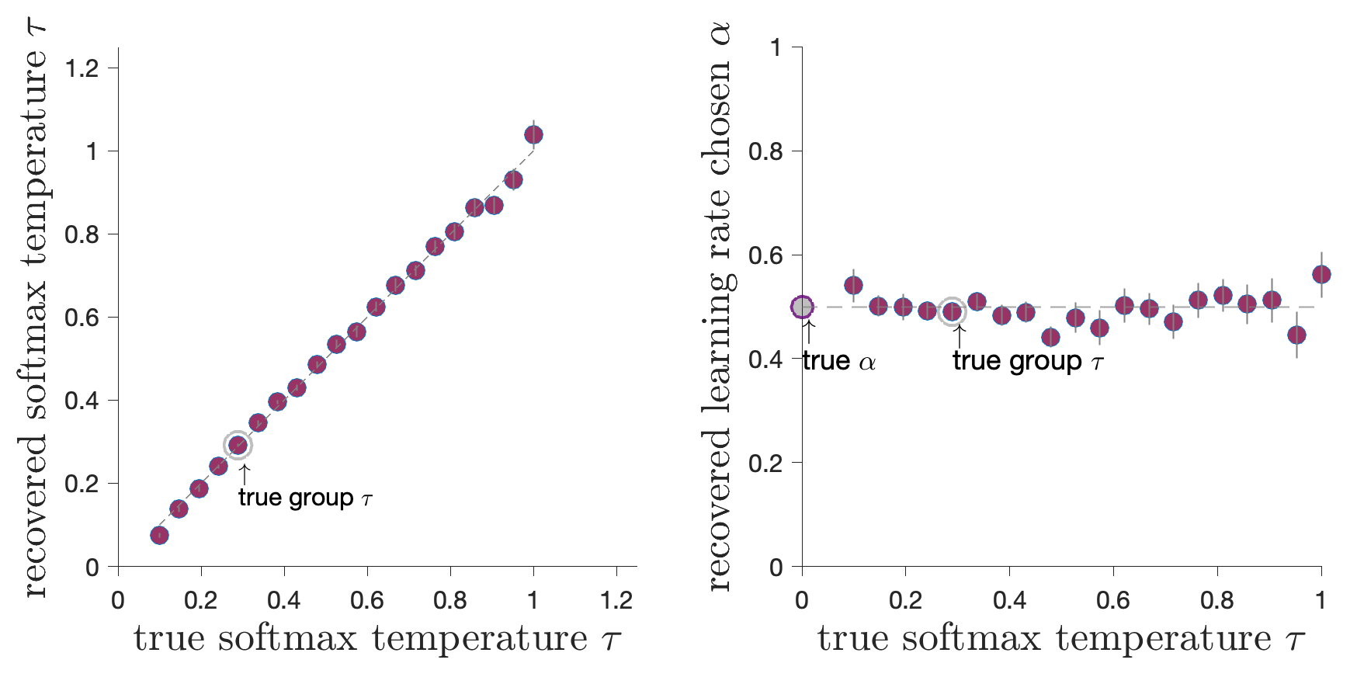
Parameter recovery
Workshop MODELING FLUX | Session 4 | Model comparison & recoverability
HARTLEY LAB
For softmax temperature $τ$
Simulate $τ∈$ [0.1, 1] and $α_{chosen}=0.5$

Slide 10
What is a “good” recoverability?
Workshop No. | Session Length | Title title title
HARTLEY LAB
No hard rule or accepted values
Experimental design and nature of the data: example laboratory well-controlled study vs. online experiment with much noisier data
Simulations help setting a benchmark & optimise the design
Vary number of trials
Vary parameter ranges

Slide 11
Predictive performance and model checks
Workshop No. | Session Length | Title title title
HARTLEY LAB
All models could be wrong — the model comparisons are relative
Better “fit” does not guarantee the model reproduces behaviour
Better “fit” does not guarantee the model could be recovered

Slide 12
Predictive performance and model checks
Workshop No. | Session Length | Title title title
HARTLEY LAB
All models could be wrong — the model comparisons are relative
Better “fit” does not guarantee the model reproduces behaviour
Better “fit” does not guarantee the model could be recovered
Generative performance of the model: how well the model can reproduce behaviour

Slide 13
Predictive performance and model checks
Workshop No. | Session Length | Title title title
HARTLEY LAB
All models could be wrong — the model comparisons are relative
Better “fit” does not guarantee the model reproduces behaviour
Better “fit” does not guarantee the model could be recovered
Generative performance of the model: how well the model can reproduce behaviour
Check model performance against behavioural data qualitatively
Try to find a behavioural pattern that dissociates between the models
The importance of model falsification (Palminteri et al., Trends Cog Sci 2017)

Slide 14
Generative performance of the model
Workshop MODELING FLUX | Session 4 | Model comparison & recoverability
HARTLEY LAB
Steps:
Simulate the models with the best fitted parameters
Define a behavioural marker: where models’ behaviour won’t generate the same predictions
Compare model performance to subjects’ actual behaviour

Slide 15
Generative performance of the model
Workshop MODELING FLUX | Session 4 | Model comparison & recoverability
HARTLEY LAB
Example:
Model 1: fixed learning rate and softmax decision rule
Model 2: decaying learning rate and softmax decision rule: the agent progressively decreases the update of the option values and “ignores” the irrelevant non-rewarding events
The agent is less likely to switch choice after a negative prediction error
Benchmark behaviour: $P(switch)$ after a negative prediction error

Slide 16
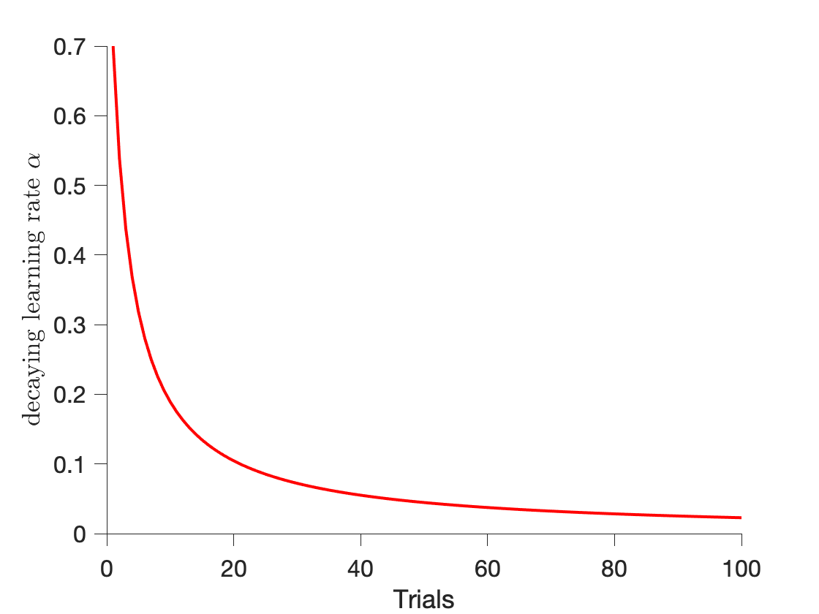
Generative performance of the model
Workshop MODELING FLUX | Session 4 | Model comparison & recoverability
HARTLEY LAB
Example:
N = 30 subjects who played 2-arm bandit task, T = 100 trials, $p_{reward}=0.8$
Best fitted model group parameters:
Model 1: chosen learning rate $α_{chosen}=0.7$, $τ=0.2$
Model 2: initial chosen learning rate $α_{chosen}=0.7$, decay parameter $η=0.02$

Slide 17
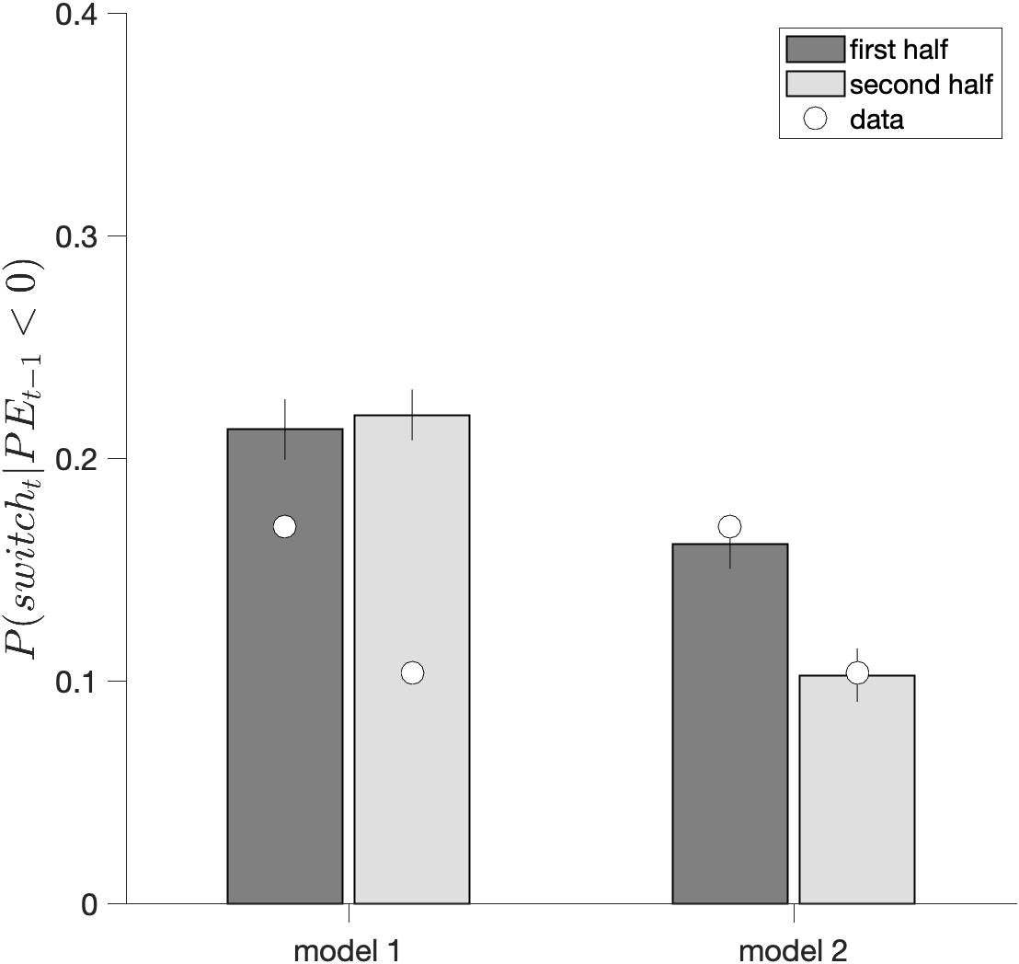
Generative performance of the model
Workshop MODELING FLUX | Session 4 | Model comparison & recoverability
HARTLEY LAB
Example:

