Slide 1

Team - DevCrew
Sri Vatshan V
Suhan T
Vasanth Kumar G
Vishweshvaran M

Slide 2


Voizz
Comprehensive System for Call Center Efficiency

Slide 3

Problem statement
A call centre is a centralised office that handles a large number of incoming and outgoing calls for all companies. It plays a major role in all companies. The call centre employee builds a good relationship between the customer and the company. The purpose of the call centre employee is to solve people's queries regarding products used in day-to-day life. Their job is monotonous and there is a high possibility for them to get stressed and disappoint the customers. We need to devise a method for efficiently evaluating the performance of the employee, so as to improve the customer satisfaction.

Slide 4
PROPOSED SOLUTION
The objective of our project is to develop an application for evaluating the performance of call center employees. This is in response to a demand for the employment history of the employee to be reviewed. It helps us increase customer satisfaction.
We will analyze the voice recording of the employee using a speech recognition approach, and then we will extract variables such as frequency, pitch, and emotional analysis of the data individual who expresses their attitude, allowing us to evaluate them.
This allows us to assess how well the call center agents are performing. Through this, we can assess the effectiveness of the call center agents and, using blockchain, award them with the right amount of cryptocurrency to motivate them and build positive relationships with clients.

Slide 5
EXISTING SYSTEM
They are many people who are working in the call center and current technique which is used to evaluate the Performance of the employee is calculated with the data like
✔Customer Satisfaction Score
✔Average Call Handling time
✔Call Availability
✔Call Abandonment rate
But this data is insufficient to know if the call was satisfactory to the customer or not and we can't exactly predict the quality of the employee's work.

Slide 6

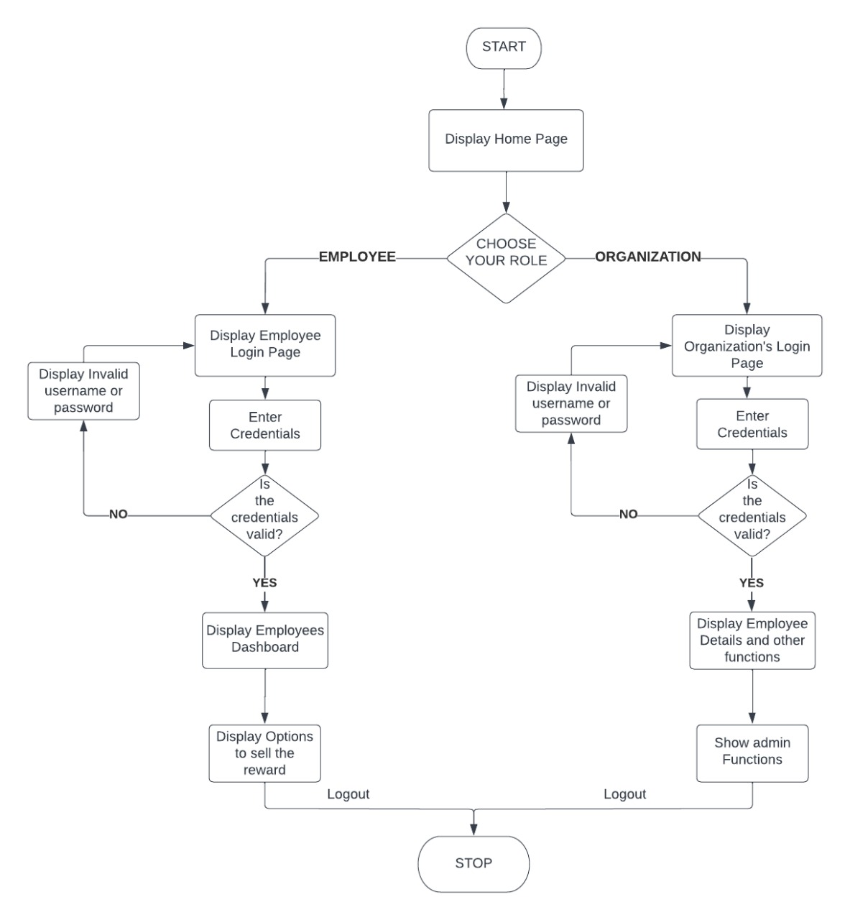
WORKFLOW

Slide 7
Business model
Key Activities:
Analyzing the audio.
Identifying the emotion
Providing rewards based on emotion.
Key Partner:
Customer care call center
Feasibility & Scalability:
No physical involvement of officers
Value Propositions:
Boost employees to work more efficiently
Companies can identify the performance of their employees
Key resources & channels
Employee database
IC Blockchain
Crypto token
Cost Structure:
Zero development cost
Focus groups and end users:
Customer care centers and their employees.
Call centers and their employees.

Slide 8








Tech stack

Slide 9
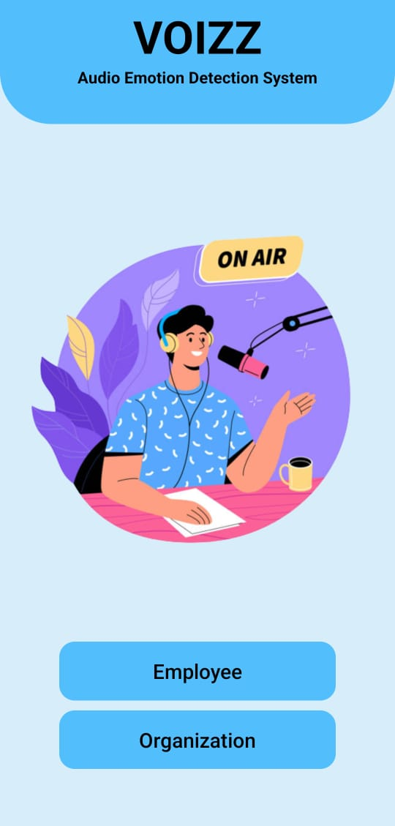
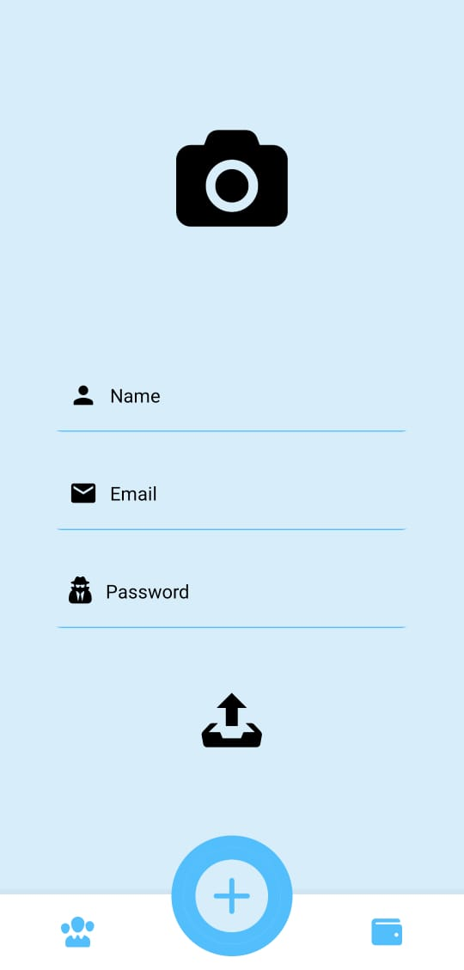
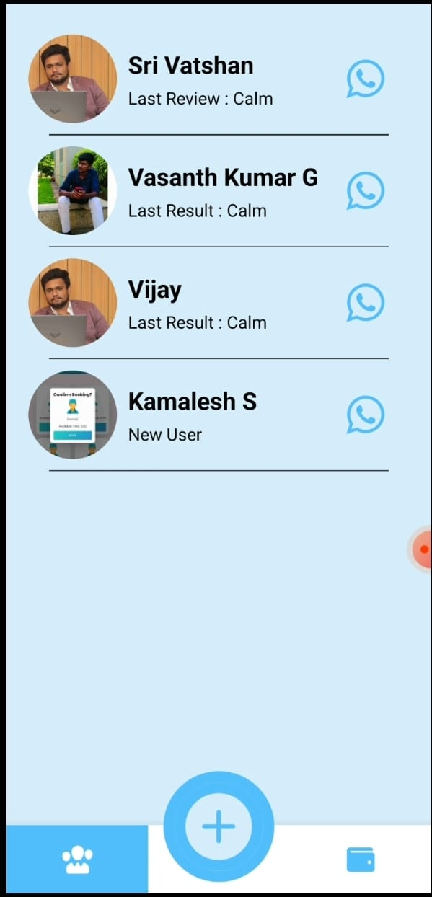
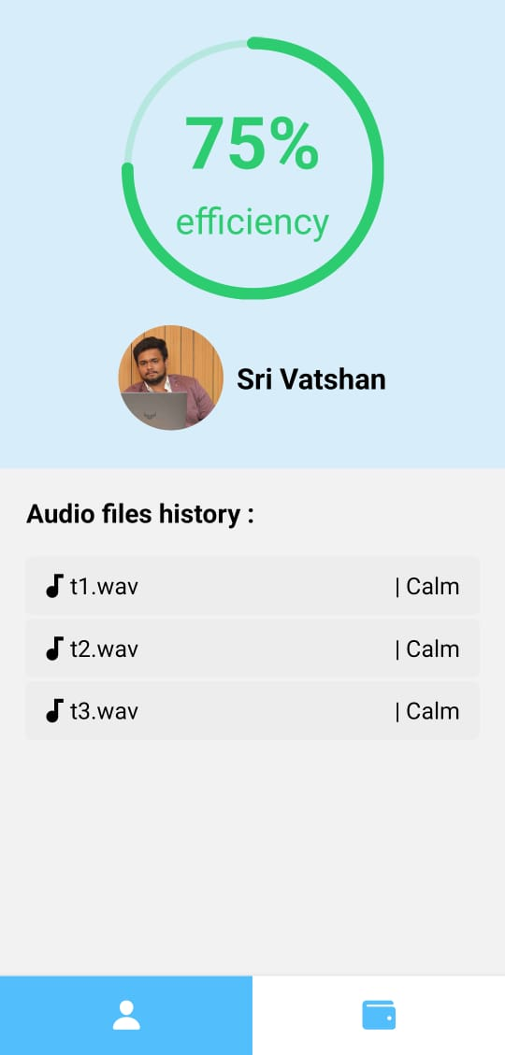
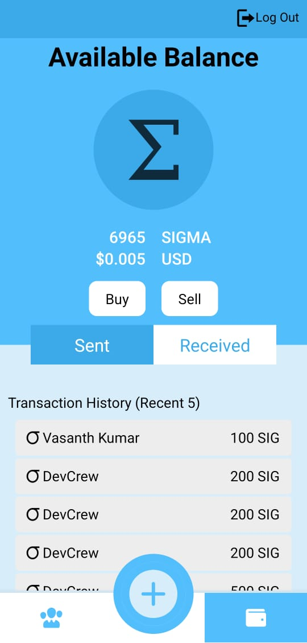
Voizz
Complete audio based emotion
reward system using Blockchain

Slide 10
Thank you

