Slide 1
FACIAL EMOTION RECOGNITION USING SUPERVISED AND SEMI-SUPERVISED LEARNING

Slide 2
AGENDA
INTRODUCTION
DATASET
APPROACH & RESULTS
CONCLUSION
LIFE IN TOSHIBA AND JAPAN

Slide 3

INTRODUCTION
Facial Emotion Recognition Classification (Kaggle challenge 2013)*
Input image
Output category of emotion
0=Angry
1=Disgust
2=Fear
3=Happy
4=Sad
5=Surprise
6=Neutral
*https://www.kaggle.com/c/challenges-in-representation-learning-facial-expression-recognition-challenge

Slide 4
Dataset
Dataset (fer2013)
Training
Testing
Public
Private
Total images:
28,709
3,589
3,589
*https://www.kaggle.com/c/challenges-in-representation-learning-facial-expression-recognition-challenge

Slide 5




Image specification
Each image is 48 x 48 pixels – 2304 pixel values.
Images are grayscale in nature – pixel value ranges from 0 to 255.
Face has been automatically registered – occupies the same amount of space in each image.
Number of images per class: [3995 436 4097 7215 4830 3171 4965]
Good and clear images
Bad images with thumbnails written across

Slide 6
APPROACH & RESULTS
Problem of multi-class (our case: 7) categorization.
Many possible approaches:
k-nearest neighbors (kNN)
Support Vector Machine (SVM)
Hierarchical classification (Decision trees)
Neural networks – Convolutional Neural Networks (CNN)
Divided into two categories:
1. Fully supervised learning – Training the neural network with all the training images (100%) in the dataset.
2. Semi-supervised learning – Training the neural network with only a part of the training images (10%, 20%) and unlabeled data.

Slide 7
Fully supervised learning
Start simple! - With a one layer CNN architecture → accuracy achieved 36%
Convolutional 2D
Maxpooling2D
Flatten
Dense
Literature* suggested to have at least three CNN layers for
multi-class categorization problem
Convolutional 2D
Maxpooling2D
Convolutional 2D
Maxpooling2D
Convolutional 2D
Convolutional 2D
Maxpooling2D
Flatten
Dense
Dropout
Dense
Dropout
Classification
*https://arxiv.org/pdf/1701.08816.pdf

Slide 8
Architectural changes and its impact
CNN architectural change | Accuracy / Impact on accuracy (%)
Simple 1 layer CNN | 36%
4 conv2D, 3 maxpooling, 2 dense | 56%
4 conv2D, 2 maxpooling, 2 dense | 56.7% / increased by ~0.5%
4 conv2D, 1 maxpooling, 1 average pooling, 2 dense | 58.9% / increased by ~2-2.5%
Adding kernel regularizers with l2 regularization (0.001) in the dense layer | 59.7% / increased by ~1.0%
Included strides in the maxpooling layer | 58.6% / decreased by ~1.0%
Replace normal dropout with Gaussian dropout | 59.7% / almost remains the same
Resizing the image (64 x 64) | 59.7% / almost remains the same
Changing the size and number of filters in Conv2D | 59.7% / almost remains the same
Architectural changes were inspired from
the literature* of multi-class categorization.
Main impacts:
Removing an extra Maxpooling2D layer.
Replacing the second Maxpooling2D
layer with Average pooling layer.
l2 kernel regularizers.
*https://arxiv.org/pdf/1701.08816.pdf

Slide 9
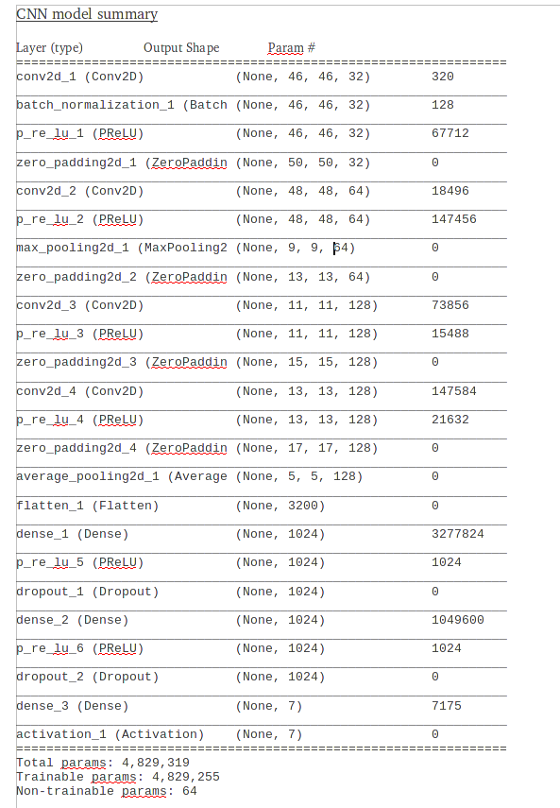
Final cnn architecture for fully supervised learning
Layer | Hyperparameters
Convolutional | 32 filters, 3 x 3, L2 regularization (0.001), activation: prelu, zeropadding (2, 2)
Convolutional | 64 filters, 3 x 3, activation: prelu, zeropadding (1, 1)
Pooling | Maxpool (5 x 5)
Convolutional | 128 filters, 3 x 3, activation: prelu, zeropadding (1, 1)
Convolutional | 128 filters, 3 x 3, activation: prelu, zeropadding (1, 1)
Pooling | Average pool (3 x 3)
Dense | 1024
Dropout | 0.25
Dense | 1024
Dropout | 0.25
Softmax | Fully connected
Total parameters:
4,829,319
Trainable parameters:
4,829,255
Non-trainable parameters:
64

Slide 10




Data augmentation on the training images
Instead of training the network with the original images in the training dataset, manipulate the images and then train the network.
ImageDataGenerator in keras has this functionality.
Original image
Augmented images
Image rotation, flip, blur

Slide 11
Impact on accuracy due to synthetic images
Parameters | Accuracy
rotation_range=20, width_shift_range=0.1, height_shift_range=0.1, shear_range=0.1, zoom_range=0.1, horizontal_flip=True | 63.14%
rotation_range=40, width_shift_range=0.2, height_shift_range=0.2, shear_range=0.2, zoom_range=0.2, horizontal_flip=True | 60.62%
rotation_range=90, width_shift_range=0.4, height_shift_range=0.4, shear_range=0.4, zoom_range=0.4, horizontal_flip=True | 48.55%
Highest accuracy achieved on kaggle competition: 70% ; Approach used > CNNs with
Support Vector Machine & Transformation to images generating more data.
Two recent papers claim to achieve accuracy around 75%:
1. CNN-SIFT algorithm*
2. Illumination correction, landmark facial features first#
*https://arxiv.org/pdf/1608.02833.pdf
#https://arxiv.org/pdf/1612.02903.pdf

Slide 12
Confusion matrix
Class | 0 | 1 | 2 | 3 | 4 | 5 | 6 | Total
0 | 197 | 4 | 44 | 58 | 90 | 8 | 89 | 490
1 | 17 | 8 | 10 | 9 | 9 | 1 | 1 | 55
2 | 47 | 2 | 153 | 46 | 145 | 59 | 76 | 528
3 | 13 | 0 | 14 | 765 | 33 | 12 | 42 | 879
4 | 41 | 0 | 43 | 63 | 298 | 5 | 144 | 594
5 | 10 | 0 | 63 | 45 | 20 | 258 | 20 | 416
6 | 17 | 1 | 29 | 66 | 107 | 12 | 394 | 626
Total | 342 | 15 | 356 | 1052 | 702 | 355 | 766 | 3588

Slide 13
Semi-supervised learning
Selecting the ratio of labeled / unlabeled data.
Percentage (labeled/unlabeled) | Accuracy (%) of the built CNN architecture
(100/0) | 59
(50/50) | 53
(30/70) | 49
(20/80) | 45
(10/90) | 40
Selecting the architecture for semi-supervised learning with
Neural Networks:
1. Entropy minimization*
2. Autoencoder#
3. Ladder Network$
3. Mean Teacher^{ᵝ}
* https://papers.nips.cc/paper/2740-semi-supervised-learning-by-entropy-minimization
# http://proceedings.mlr.press/v27/baldi12a/baldi12a.pdf
$ https://arxiv.org/abs/1507.02672
ᵝ https://arxiv.org/abs/1703.01780

Slide 14
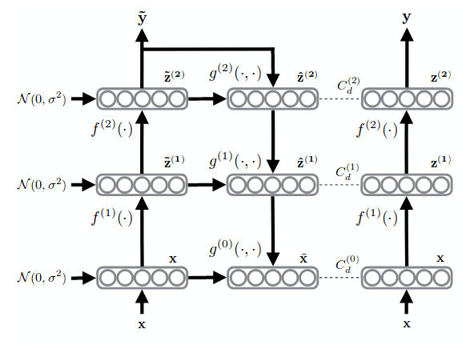
Ladder network
Main parts:
1. Encoder – clean and noisy
2. Decoder
3. Denoising function
Loss function:
1. Categorical cross entropy -
Noisy Y and labeled data.
2. Mean squared error – Between the
outputs of the decoder and clean encoder
at each layer.
Image source: Main paper (Ladder Network)
Implementation:
Encoder - Pre-trained CNN architecture designed for supervised
learning with only 10% labeled data.
Decoder - Basically an inverse of an encoder - Deconvolutional and upsampling.
Denoising function - Function which reconstructs a noisy signal from encoder to a
clean signal which will be compared with the clean encoder.

Slide 15
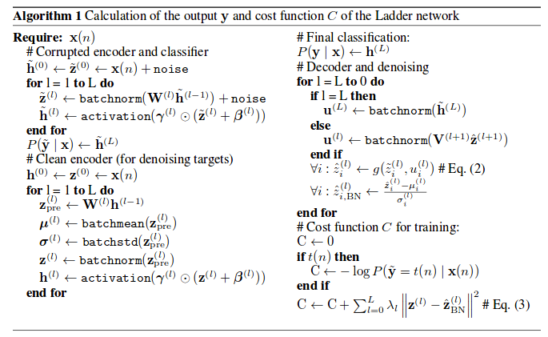
Breaking the ladder network architecture
Noisy encoder and clean encoder:
x_{_n}, z⁽¹⁾_{_n}, … z^{(L)}_{_n}, y_{_n} = Encoder_{noisy}
x, z⁽¹⁾,… z^{(L)}, y = Encoder_{clean}
x^, z^{^(1)}, … z^{^(L)} = Decoder
Encoder [additional parameters before activation]:
Batchnormalization()
Mean and scaling ()
Noisy encoder [additional parameters to the clean encoder]:
Gaussian noise (σ = 0.2) added to each layer.
Image source: Main paper (Ladder Network)
Loss function:
1. Supervised learning - Categorical cross entropy (y_{_n},Y)
2. Unsupervised learning – Mean squared error (z^{(L)}, z^{^(L)})
Denoising function:
g(z^{^(L+1)}, z^{(L)}_{_n}) -> element wise multiplication, passed to the below layer
Decoder: Output from dense layer of the noisy encoder.
Deconvolution()
Upsampling()

Slide 16
Implementation of the ladder network architecture
Noisy encoder and clean encoder:
x_{_n}, z⁽¹⁾_{_n}, … z^{(L)}_{_n}, y_{_n} = Encoder_{noisy}
x, z⁽¹⁾,… z^{(L)}, y = Encoder_{clean}
x^, z^{^(1)}, … z^{^(L)} = Decoder
Decoder: Output from dense layer of the noisy encoder.
Deconvolution()
Upsampling()
Trained the CNN architecture previously built with 10% labeled data and including noise (noisy encoder) – Loaded this pre-trained network.
Connected the output from the noisy encoder using Lambda encapsulation to the new layers of decoder (deconvolution and upsampling)
}
Encoder [additional parameters before activation]:
Batchnormalization()
Mean and scaling ()
Noisy encoder [additional parameters to the clean encoder]:
Gaussian noise (σ = 0.2) added to each layer.
Element wise multiplication – Used merge layer.
Lambda encapsulation for multiplying scalar with tensor
Denoising function:
g(z^{^(L+1)}, z^{(L)}_{_n}) -> element wise multiplication, passed to the below layer
ae = Model(inp_img, outputs = [ns_enc_op, de_op_1, de_op_2, .. de_op4])
ae.compile(opt, loss=['cat','mse','mse'..], loss_weights=[alpha,beta,beta,..])
ae.fit(X, [Y, cl_enc_1, cl_enc_2,... cl_enc_4], batch_size...)
Used Callbacks for dividing the training data into labeled and unlabeled.
Loss function:
1. Supervised learning - Categorical cross entropy (y_{_n},Y)
2. Unsupervised learning – Mean squared error (z^{(L)}, z^{^(L)})

Slide 17
Preliminary Result
Testing with 10% labeled data:
Baseline accuracy of supervised learning – 40%
With semi-supervised learning – no denoising function yet – 43.5%
Future work:
> Test with different variations of the Gaussian noise (σ = 0.1, 0.3, 0.5).
> Test with variations in architecture. Only one layer denoising function.
> Test with different denoising functions.
> Testing with different ratio of labeled to unlabeled data.

Slide 18
CONCLUSION
Dataset needs to be studied properly:
> Manipulating the dataset features which may suit the CNN architecture.
> Illumination and occlusion inclusion.
> Class balance in the dataset.
Supervised learning can achieve exceptional accuracy, however, labeled data for many categorization tasks is not readily available. At the same time, it does not reflect how humans learn.
Semi-supervised learning:
> Can improve the accuracy compared to only supervised learning with a very small amount of labeled data.
> Diverse applications in many fields where there is a scarcity of labeled data.
> Combine CNN with some clustering technique for predicting the inherent structure in the dataset.
> More intuitive and related to how humans learn.
Using keras:
> Suitable for simple model implementation and initial start-up.
> Modifications in layer outputs, going deep in the network, changing the architecture, combining two different models – better switch to Tensorflow, PyTorch.

