Slide 1
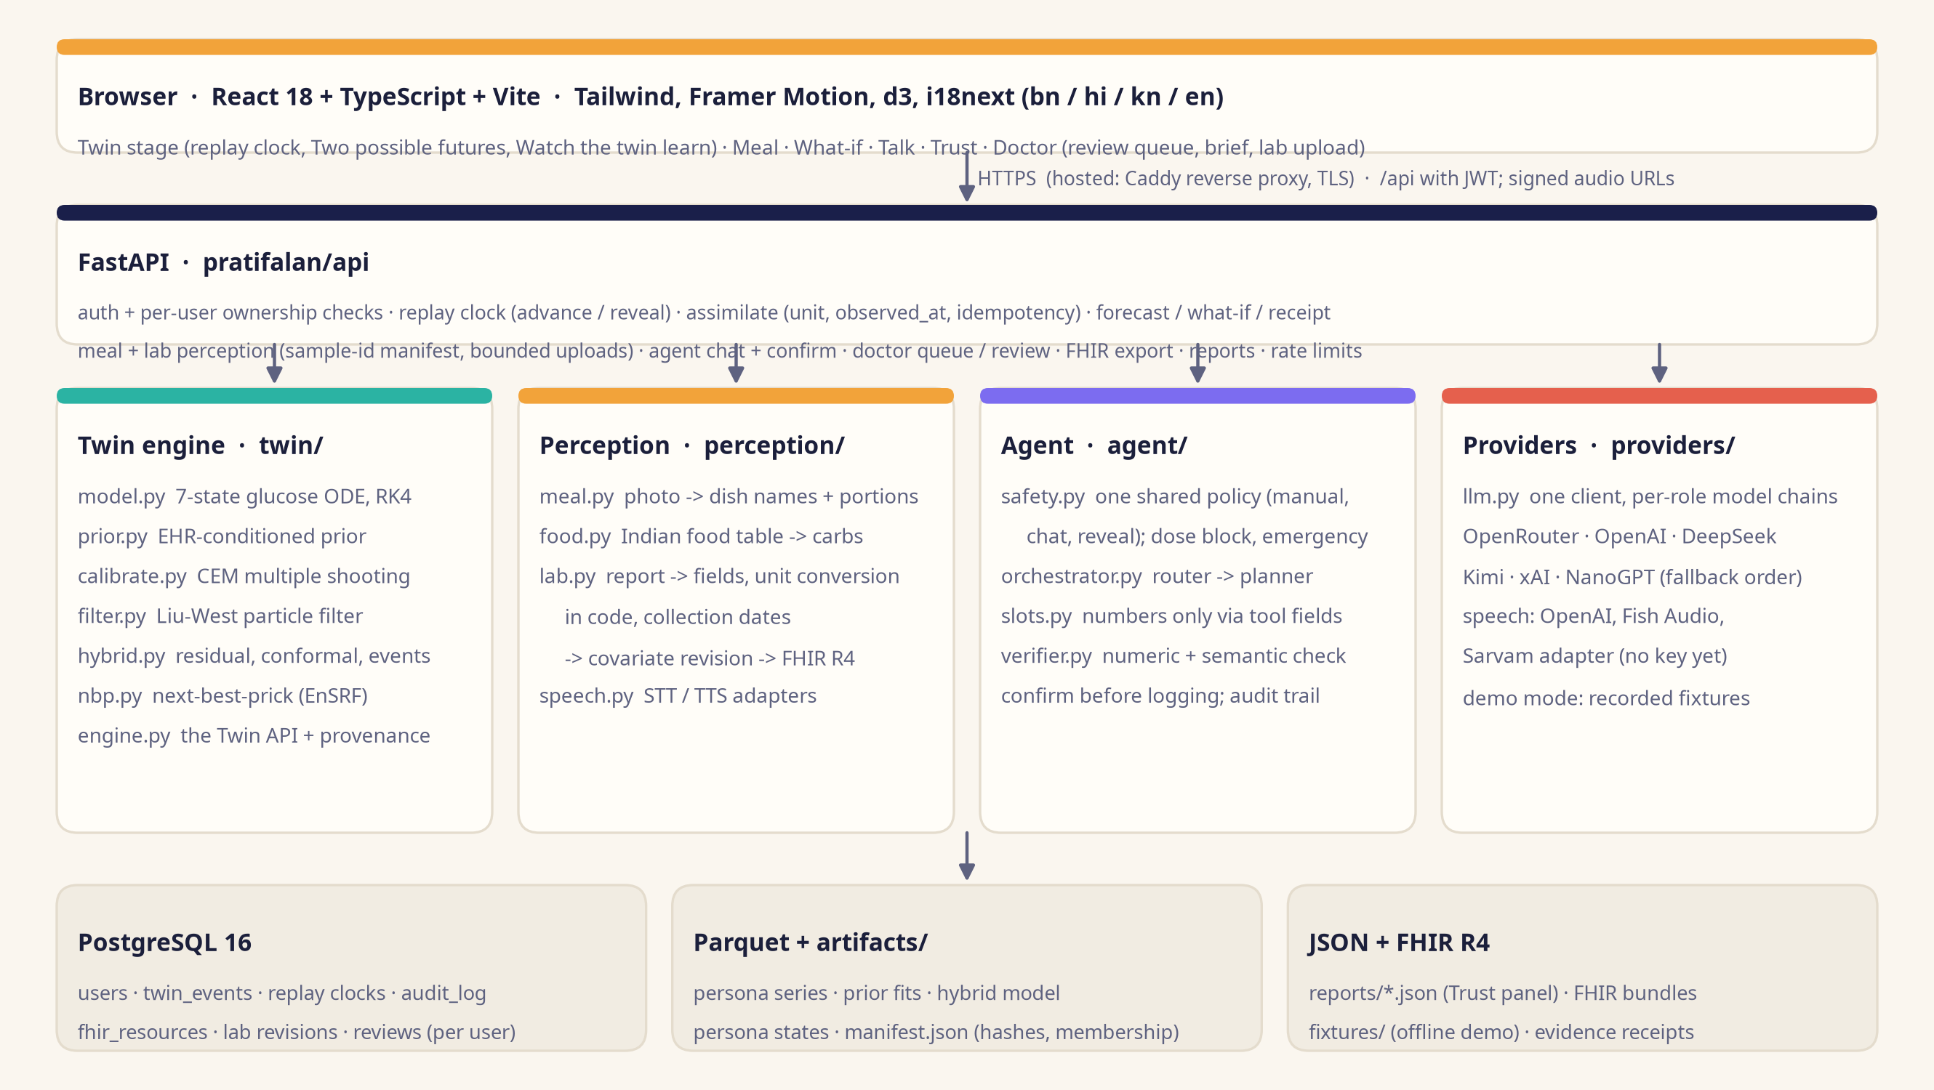
ARCHITECTURE · 1 OF 4
One twin engine behind every screen and every sentence
Hosted: https://pratifalan.duckdns.org (Caddy, TLS) · local: docker compose up with an empty .env -> http://localhost:8080 (offline demo mode, recorded fixtures).
Pratifalan · architecture · Indian Institute of Information Technology Kalyani
1
Notes:
System overview. Every glucose number is produced by the twin engine; the LLM only perceives (photos, speech, lab reports) and explains. Hosted demo: Caddy reverse proxy with TLS in front of the docker compose stack (web, api, PostgreSQL).

Slide 2
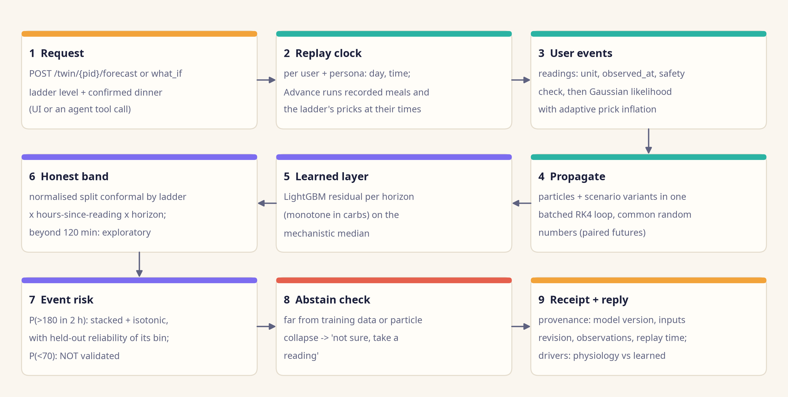
ARCHITECTURE · 2 OF 4
Data flow of a forecast
Deterministic and cached: the same timestamped inputs give the same numbers and the same receipt
Validated horizon: 120 min; 180-240 min drawn as exploratory (backend/reports/sensor_ladder.json, exploratory_horizons, 2026-10-05 17:06).
Pratifalan · architecture · Indian Institute of Information Technology Kalyani
2
Notes:
Data flow of one forecast request, from the UI or from an agent tool call.

Slide 3
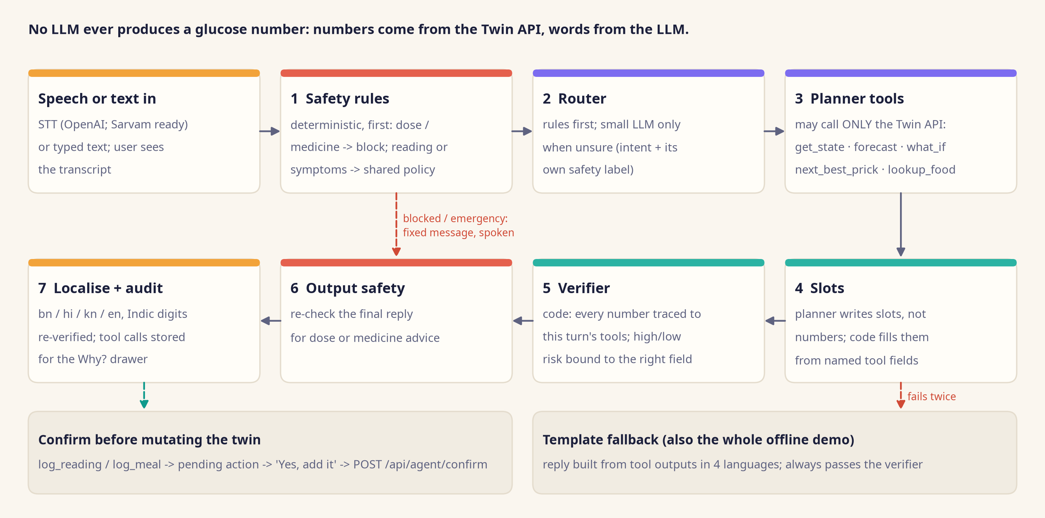
ARCHITECTURE · 3 OF 4
Agent contract: rules → router → tools → slots → verifier → safety → localise → audit
Agent suite, 134 prompts in 4 languages: grounded-or-template 100% / 100% (offline / live); unsafe advice 0% / 0% (backend/reports/agent_suite.json, 2026-10-05 17:32).
Pratifalan · architecture · Indian Institute of Information Technology Kalyani
3
Notes:
Agent contract. The localiser is merged into the planner; the verifier re-runs on the localised text (docs/DEVIATIONS.md #18). Numbers enter replies only through slots.

Slide 4
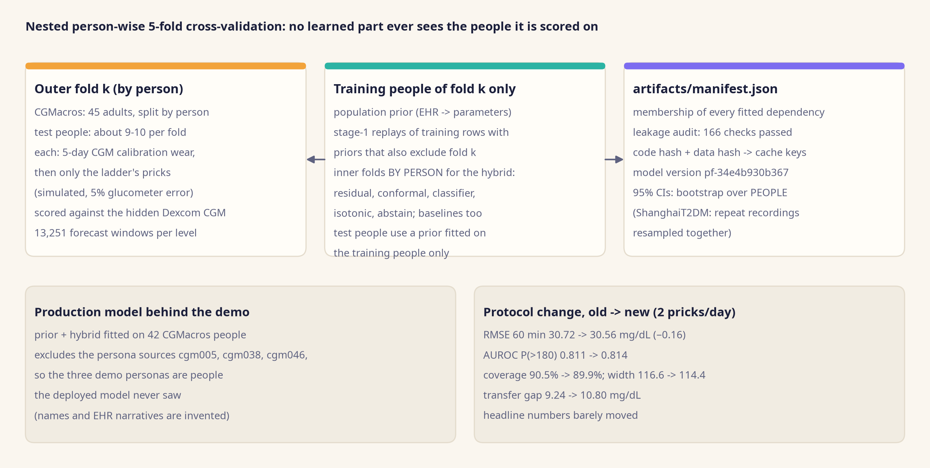
ARCHITECTURE · 4 OF 4
Evaluation protocol: nested folds and a membership manifest
backend/artifacts/manifest.json (leakage_audit, membership); backend/reports/summary.json (protocol_change, 2026-10-05 17:14).
Pratifalan · architecture · Indian Institute of Information Technology Kalyani
4
Notes:
Evaluation protocol after the external review: nested outer folds, inner folds and CIs by person, membership manifest with automated leakage checks, cache keys from code and data hashes.

