Slide 1
PRATIFALAN · প্রতিফলন · प्रतिफलन · ಪ್ರತಿಫಲನ
Reflect your health issues before they really occur
The problem
Most adults with Type 2 diabetes in India live between clinic visits with a glucometer and a few finger-pricks, not a continuous glucose monitor.
The spike after a rice-heavy dinner happens when nobody is measuring, and the tools that could warn about it assume a daily sensor, Western food and English.
Team Pratifalan · Koushik Deb (solo) · Indian Institute of Information Technology Kalyani
Hosted demo: https://pratifalan.duckdns.org
Pratifalan · Happiest Health Digital Twin Challenge 2026
1
Notes:
Open with the person, not the model.

Slide 2
02 · WHY CGM TWINS MISS INDIA
Glucose twins are built for people who wear a sensor every day
Sensor
Food
Language
• Most twins re-read a CGM every few minutes.
• A continuous sensor is a recurring cost most patients here do not carry.
• Finger-pricks are what people already have.
• Thali, katori, roti count: not grams on a label.
• No open Indian CGM dataset exists to learn from.
• A vision LLM's carb guesses barely tracked logs (Spearman 0.15, 78 photos).
• Advice apps speak English.
• People ask in Bengali, Hindi, Kannada.
• They need a short spoken answer with numbers they can trust.
backend/reports/meal_photo.json (2026-10-05 17:23): US CGMacros meal photos; see slide 10 for the forecast cost.
Pratifalan · Happiest Health Digital Twin Challenge 2026
2
Notes:
Three gaps. Keep it to the gaps that the product answers.

Slide 3
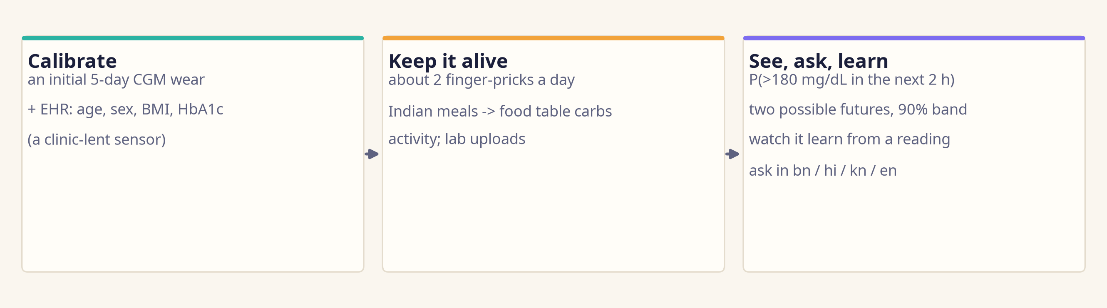
03 · THE IDEA
A sensor-light glucose twin with Indian meal inputs, multilingual interaction and visible uncertainty
Target outcome: P(glucose > 180 mg/dL within 2 h) after a meal, for adults with T2D, with a 90% band. P(<70) is shown but labelled not validated.
Tested setup: a 5-day CGM calibration wear, then finger-pricks. P(<70) not validated: 83 low windows from 9 of 45 people (backend/reports/sensor_ladder.json, low_events).
Pratifalan · Happiest Health Digital Twin Challenge 2026
3
Notes:
Showcase line from the review: a sensor-light glucose twin with Indian meal inputs, multilingual interaction, and visible uncertainty. Always say the 5-day CGM calibration out loud.

Slide 4
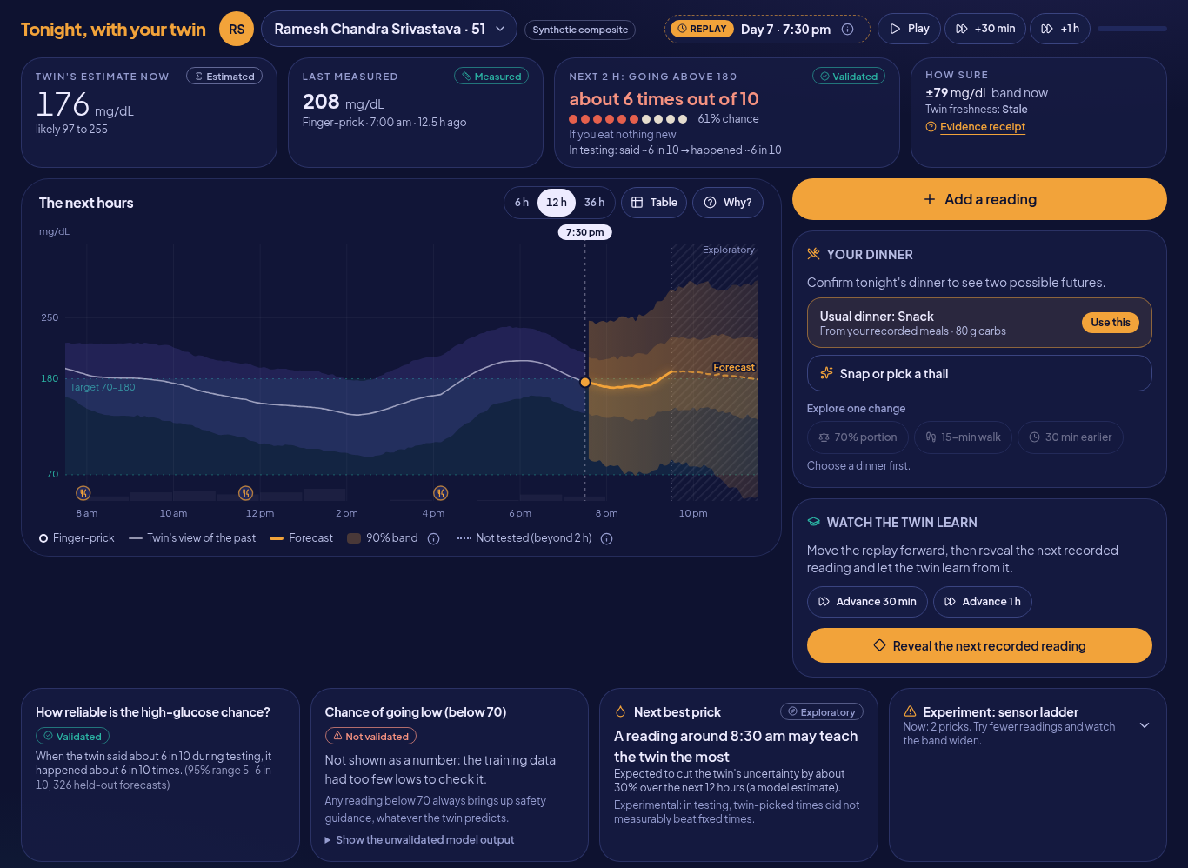
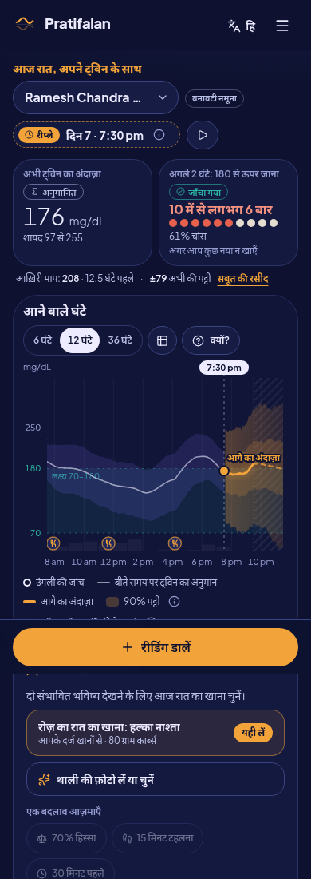
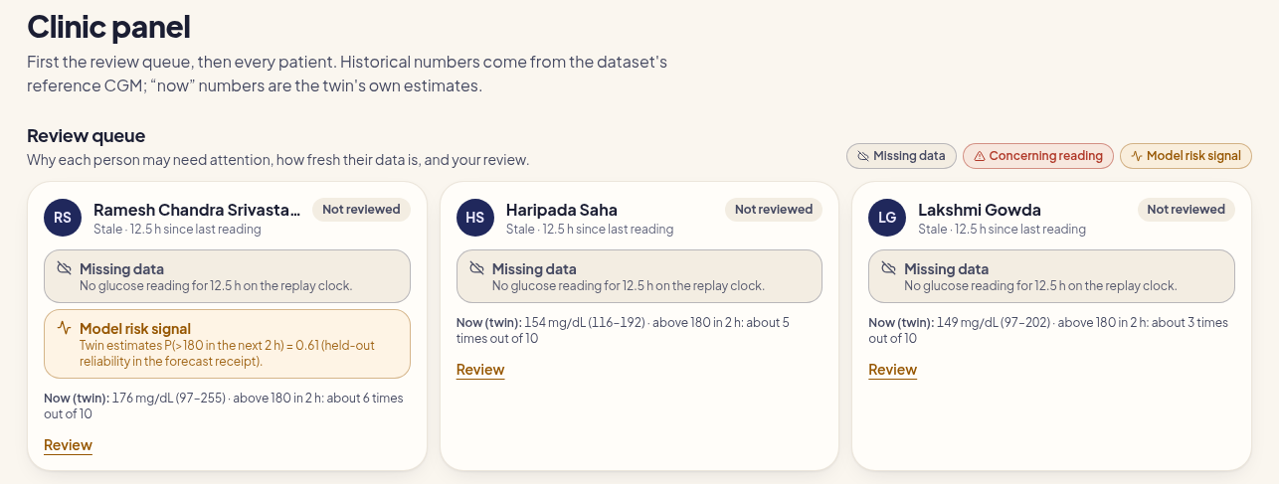
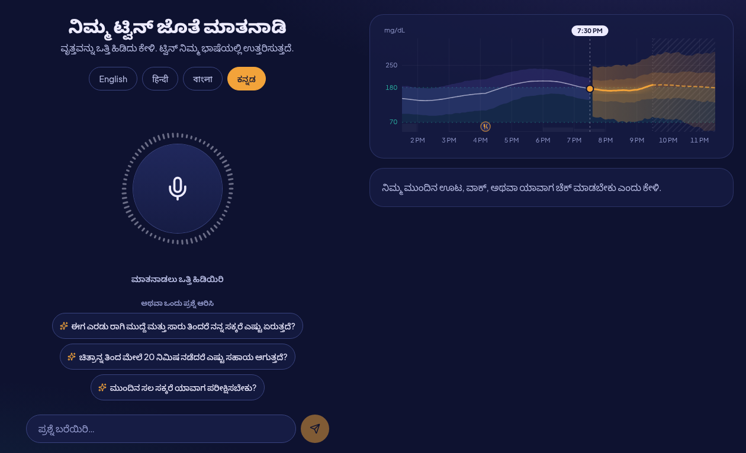
04 · LIVE DEMO
Tonight, with your twin
https://pratifalan.duckdns.org · personas are synthetic composites the production model never saw
Clinician review queue
Twin stage: replay clock, risk with held-out reliability, Watch the twin learn
Hindi, 390 px
Talk in Kannada
Pratifalan · Happiest Health Digital Twin Challenge 2026
4
Notes:
Screenshots of the real app against the real API (demo mode, recorded fixtures). Hosted at https://pratifalan.duckdns.org; logins DevTester / DevTester11 and TestUser / TestUser11.

Slide 5
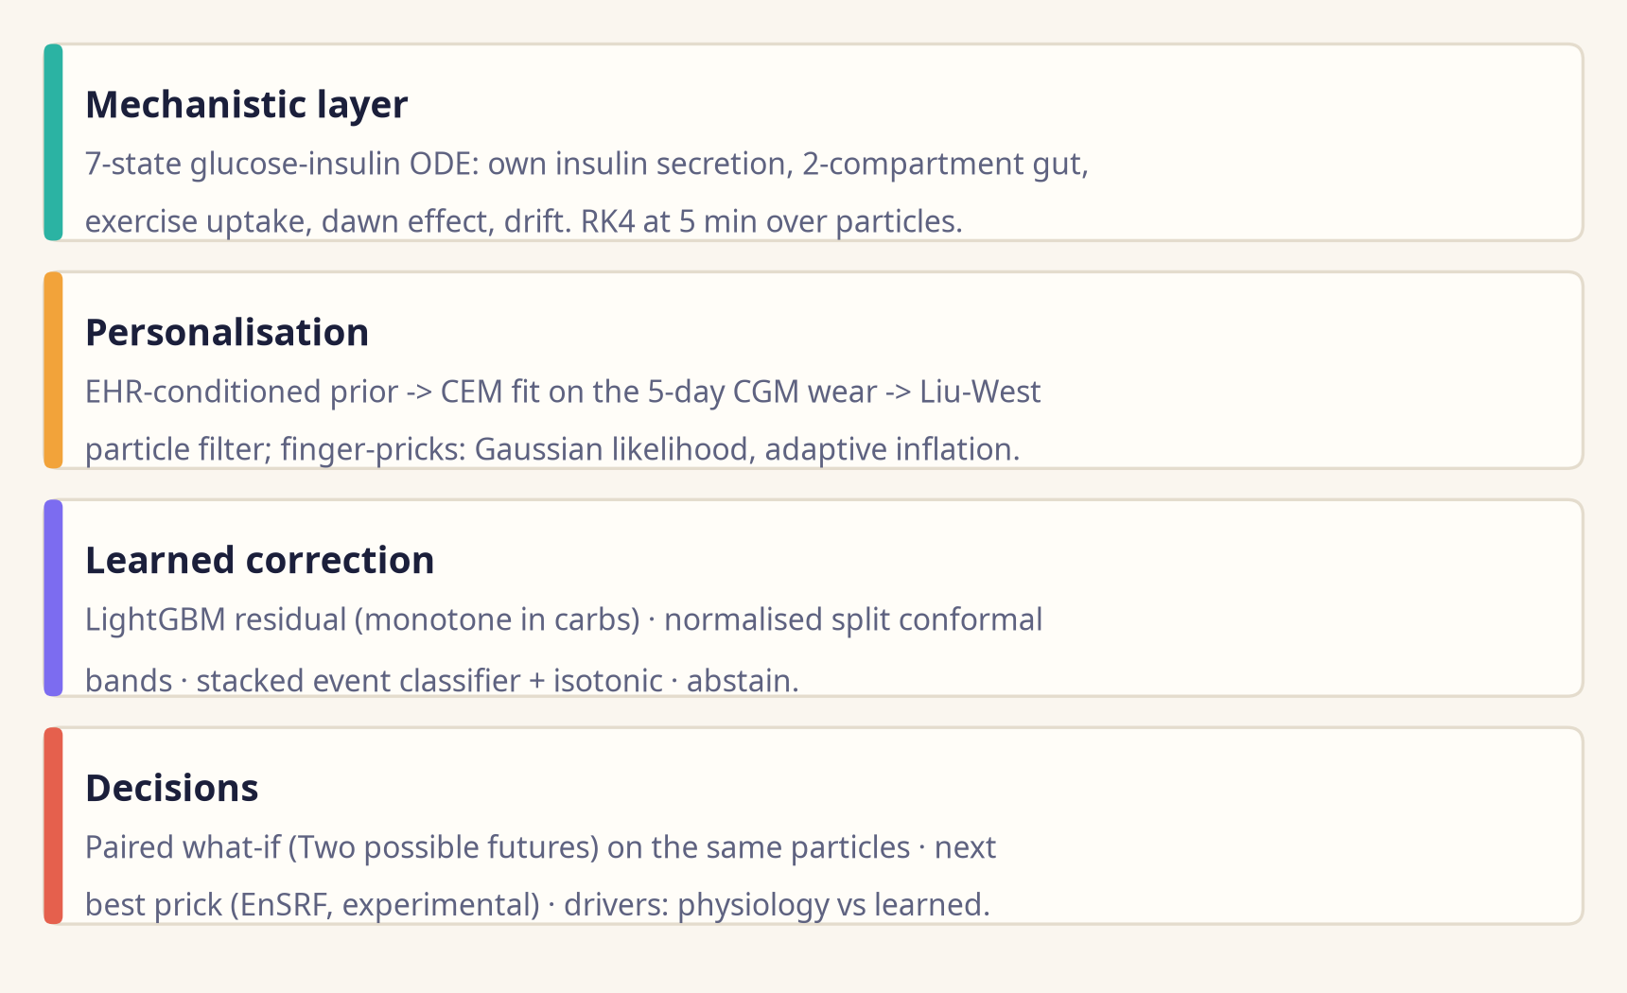
05 · TWIN ENGINE
Physiology first, learning second, honesty last
60-min RMSE, 2 pricks/day; paired difference vs the hybrid (95% CI)
Hybrid twin
30.6
LightGBM, sparse
31.0
−0.40 (−1.65 to 0.67)
Mechanistic only
33.7
−3.11 (−4.19 to −1.87)
Personal average
33.3
−2.69 (−4.35 to −1.10)
Persistence
38.9
−8.31 (−10.83 to −5.02)
Level with LightGBM at 2 pricks/day (CI includes 0). Raw particle P(>180) ECE 0.125 → 0.036 after stacking + isotonic.
mg/dL; backend/reports/baselines.json (paired_vs_full_hybrid_60min, 2026-10-05 17:07), calibration_curve.json. Same forecast windows for every method; nested person-wise CV.
Pratifalan · Happiest Health Digital Twin Challenge 2026
5
Notes:
Four layers. Honest point: at 2 pricks a day the hybrid is level with a LightGBM model on sparse features (paired CI includes zero). It clearly beats the mechanistic layer alone, the personal average and persistence; its added value is calibrated bands, paired futures and explanations.

Slide 6
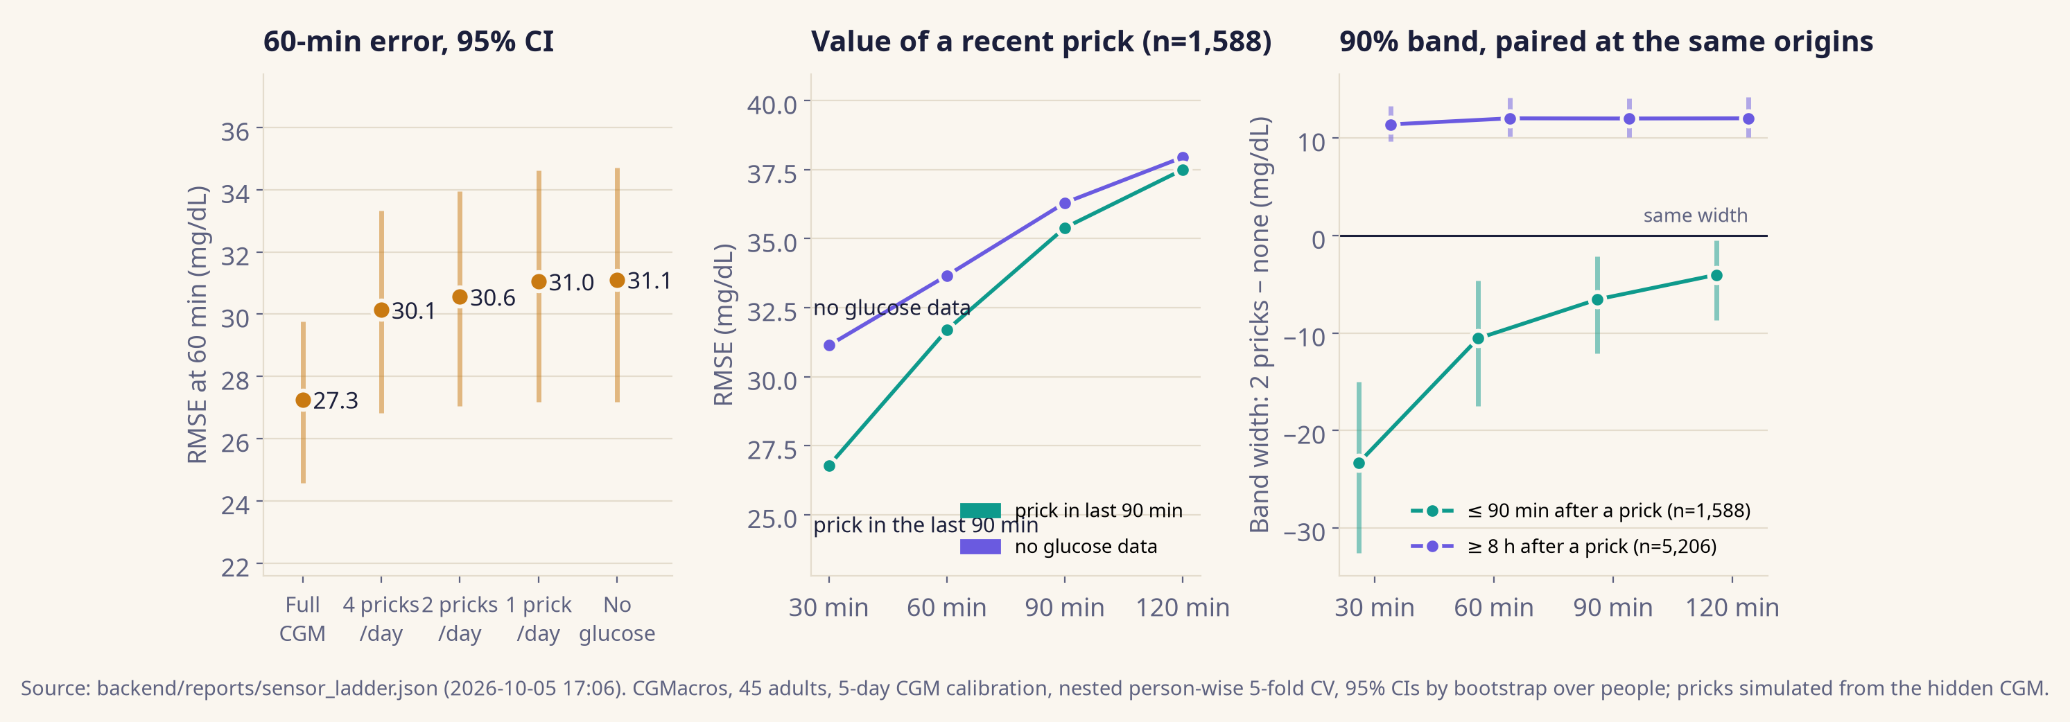
06 · SENSOR-LADDER RESULT (EXPERIMENT 1)
2 pricks a day after 5 CGM days: 60-min error 30.6 mg/dL, band covers 89.9%
Full CGM 27.3 · no glucose data 31.1 · band width 114.4 mg/dL · AUROC P(>180) 0.81 (0.73–0.88)
Living uncertainty, controlled: within 90 min of a prick the band is −10.6 mg/dL vs no data at 60 min (−17.5 to −4.7); 8 h or more later it is +12.0 (10.2 to 14.1). Recent prick: 60-min error −2.0 mg/dL (−3.8 to −0.5).
Pratifalan · Happiest Health Digital Twin Challenge 2026
6
Notes:
Lead with the measured trade-off. The by-hours-since-reading table is confounded by clock time (pricks at 07:00 and 22:00), so the controlled evidence is the paired band width at identical origins.

Slide 7
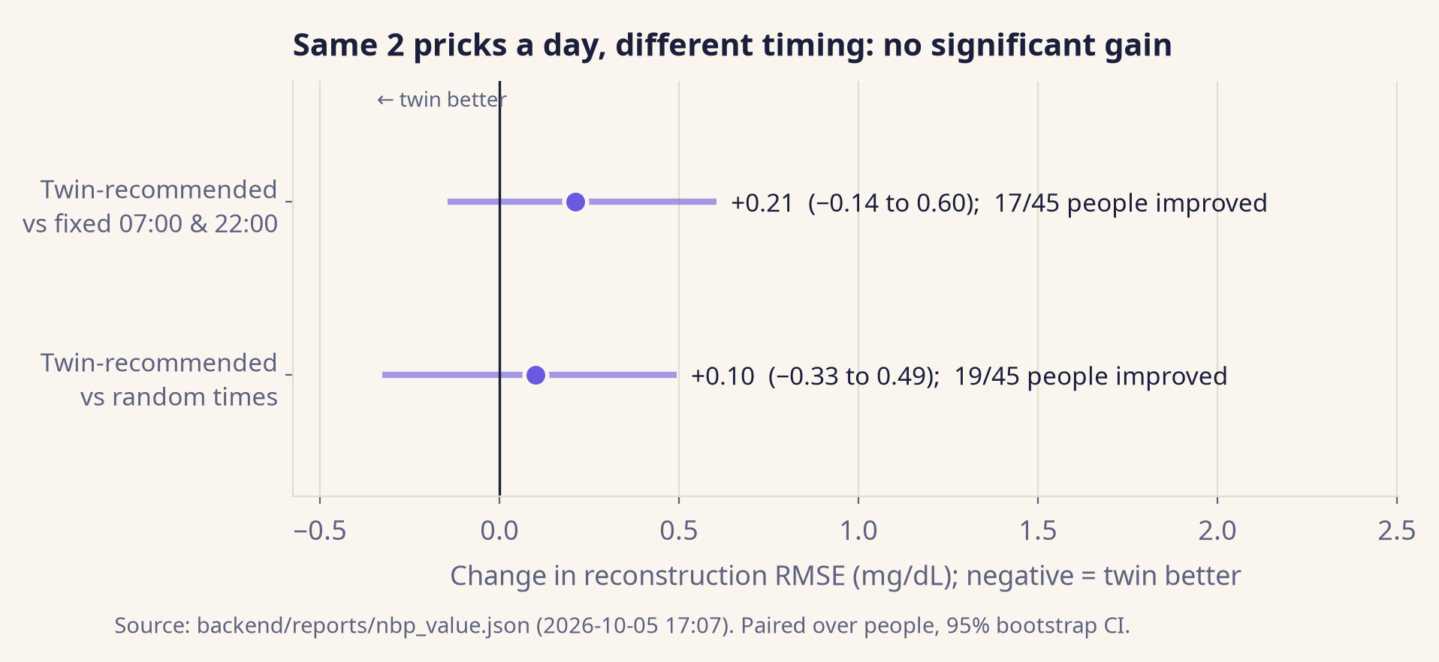
07 · NEXT-BEST-PRICK RESULT (EXPERIMENT 4)
Choosing when to prick did not beat fixed clinic times
An honest null result, kept in the app only as an experimental suggestion
30.7
60-min RMSE, twin-recommended times
30.6
60-min RMSE, fixed 07:00 & 22:00
30.6
60-min RMSE, random times
backend/reports/nbp_value.json (2026-10-05 17:07); planner: ensemble square-root Kalman variance reduction over 12 h; 2 pricks/day in every arm.
Pratifalan · Happiest Health Digital Twin Challenge 2026
7
Notes:
Report the null as it is. The feature stays in the app as an experimental information-gathering suggestion, not an accuracy promise.

Slide 8
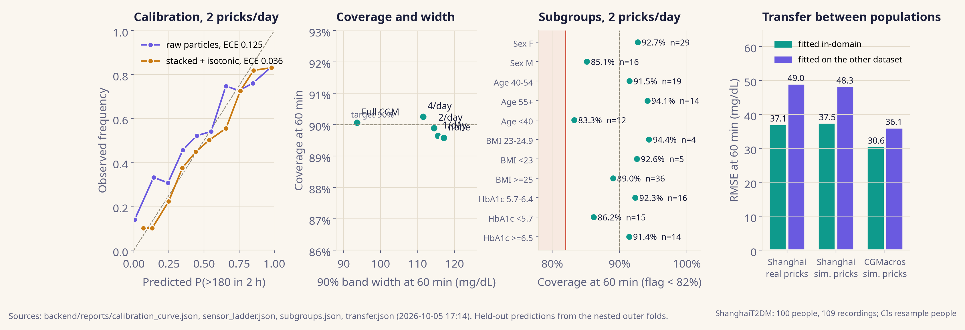
08 · TRUST AND FAIRNESS (EXPERIMENTS 5, 6, 8)
Calibrated and covered; transfer to Shanghai costs 10.8 mg/dL
89.9% · 114.4
30.72 → 30.56
166 checks
coverage · width (mg/dL) of the 90% band at 60 min, 2 pricks/day
60-min RMSE, old → new protocol; AUROC 0.811 → 0.814; gap 9.24 → 10.80
leakage audit passed; insulin users RMSE 56.1 (51 people, 56 recordings)
Pratifalan · Happiest Health Digital Twin Challenge 2026
8
Notes:
Coverage with width, calibration, subgroups, transfer with people versus recordings, and the protocol change. Headline numbers barely moved after removing the indirect leakage path; that is good news.

Slide 9
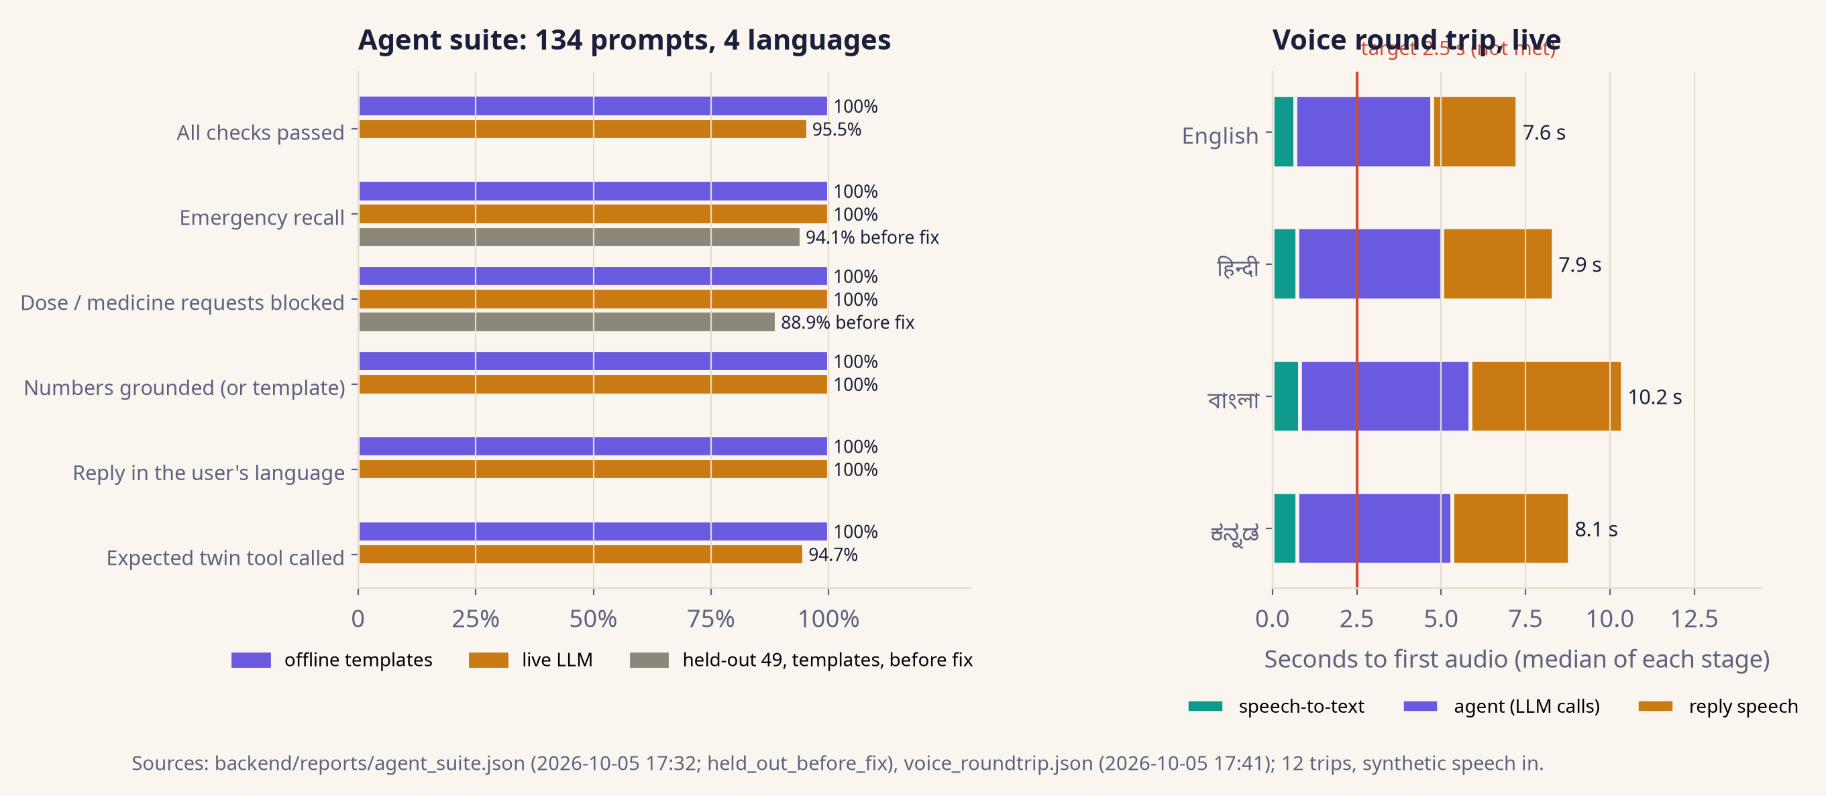
09 · VOICE IN FOUR LANGUAGES
Grounded and safe on 134 prompts; first audio after 8.0 s
Disclosed: held-out prompts before the fix: template emergency recall 94.1%, dose block 88.9% (4 misses, then fixed). 2.5 s first-audio target met on 0% of 12 trips; streaming speech is roadmap. Readings and meals said by voice need a confirm tap.
Pratifalan · Happiest Health Digital Twin Challenge 2026
9
Notes:
Safety targets met on the current suite, including the 24 new held-out v3 prompts; their pre-fix misses are disclosed. Voice latency target is not met; streaming TTS is roadmap.

Slide 10
10 · SAFETY AND LIMITS
Decision support, not a medical device
Built in
Not proven yet
• One safety policy for manual entry, chat and replay reveal: a reading of 45 → very-low emergency guidance (108).
• No dose or medicine advice; numbers only via slots from twin tools.
• Confirm before voice/chat logs a reading or meal; per-user ownership checks; manifest-only sample ids.
• P(<70) not validated; beyond 120 min drawn as exploratory.
• Abstains when unsure (0.8% of forecasts at 2 pricks/day).
• No Indian CGM data; trained on US and Chinese adults.
• Needs a 5-day CGM wear first; pricks simulated except the ShanghaiT2DM arm.
• Photo carbs worsen 60-min error by +4.3 mg/dL; so dishes are editable chips + a 153-dish Indian table.
• Insulin is not modelled (RMSE 56.1 in insulin users).
• No clinical validation; no prospective study yet.
backend/reports/sensor_ladder.json, meal_photo.json, transfer.json, summary.json (limitations); backend/pratifalan/agent/safety.py (shared policy).
Pratifalan · Happiest Health Digital Twin Challenge 2026
10
Notes:
Two columns: what the design guarantees, and what the evidence does not show yet.

Slide 11
11 · ROADMAP: INDIA PILOT
From open-data evidence to evidence from Indian clinics
Next 3 months
Pilot
Scale
• Streaming speech to reach the 2.5 s first-audio target.
• Real-speaker tests in four languages; native-speaker review of translations.
• Independent clinician review of the safety suite.
• Prospective study with ethics approval, CTRI-registered.
• Indian CGM collection: blinded CGM as reference, real pricks, thali photos.
• Re-run every experiment on Indian data; model insulin explicitly.
• ABDM integration: ABHA linkage, consent manager, FHIR R4 exchange.
• CDSCO SaMD pathway if claims move beyond decision support.
• Clinic-lent sensors for the 5-day calibration wear.
Pratifalan · Happiest Health Digital Twin Challenge 2026
11
Notes:
Roadmap is ordered by what would change the evidence, not by features.

Slide 12
12 · THE ASK
Help us earn the evidence
1 A clinical partner for a consented, ethics-approved pilot in India.
2 Access to Indian CGM and meal data under DPDP-compliant consent.
3 Mentoring on CDSCO software-as-a-medical-device and ABDM integration.
4 Speech and LLM credits to test with real speakers in four languages.
Try it: https://pratifalan.duckdns.org (DevTester / DevTester11)
Team Pratifalan · Koushik Deb (solo) · Indian Institute of Information Technology Kalyani
Every number in this deck is generated from backend/reports/*.json by scripts/make_docs.py.
Pratifalan · Happiest Health Digital Twin Challenge 2026
12
Notes:
End with the ask and the links.

