Slide 1

Team Details
Team name: SAARTHI
Team leader name: Koushik Deb
Problem Statement: Default Prediction Model

Slide 2
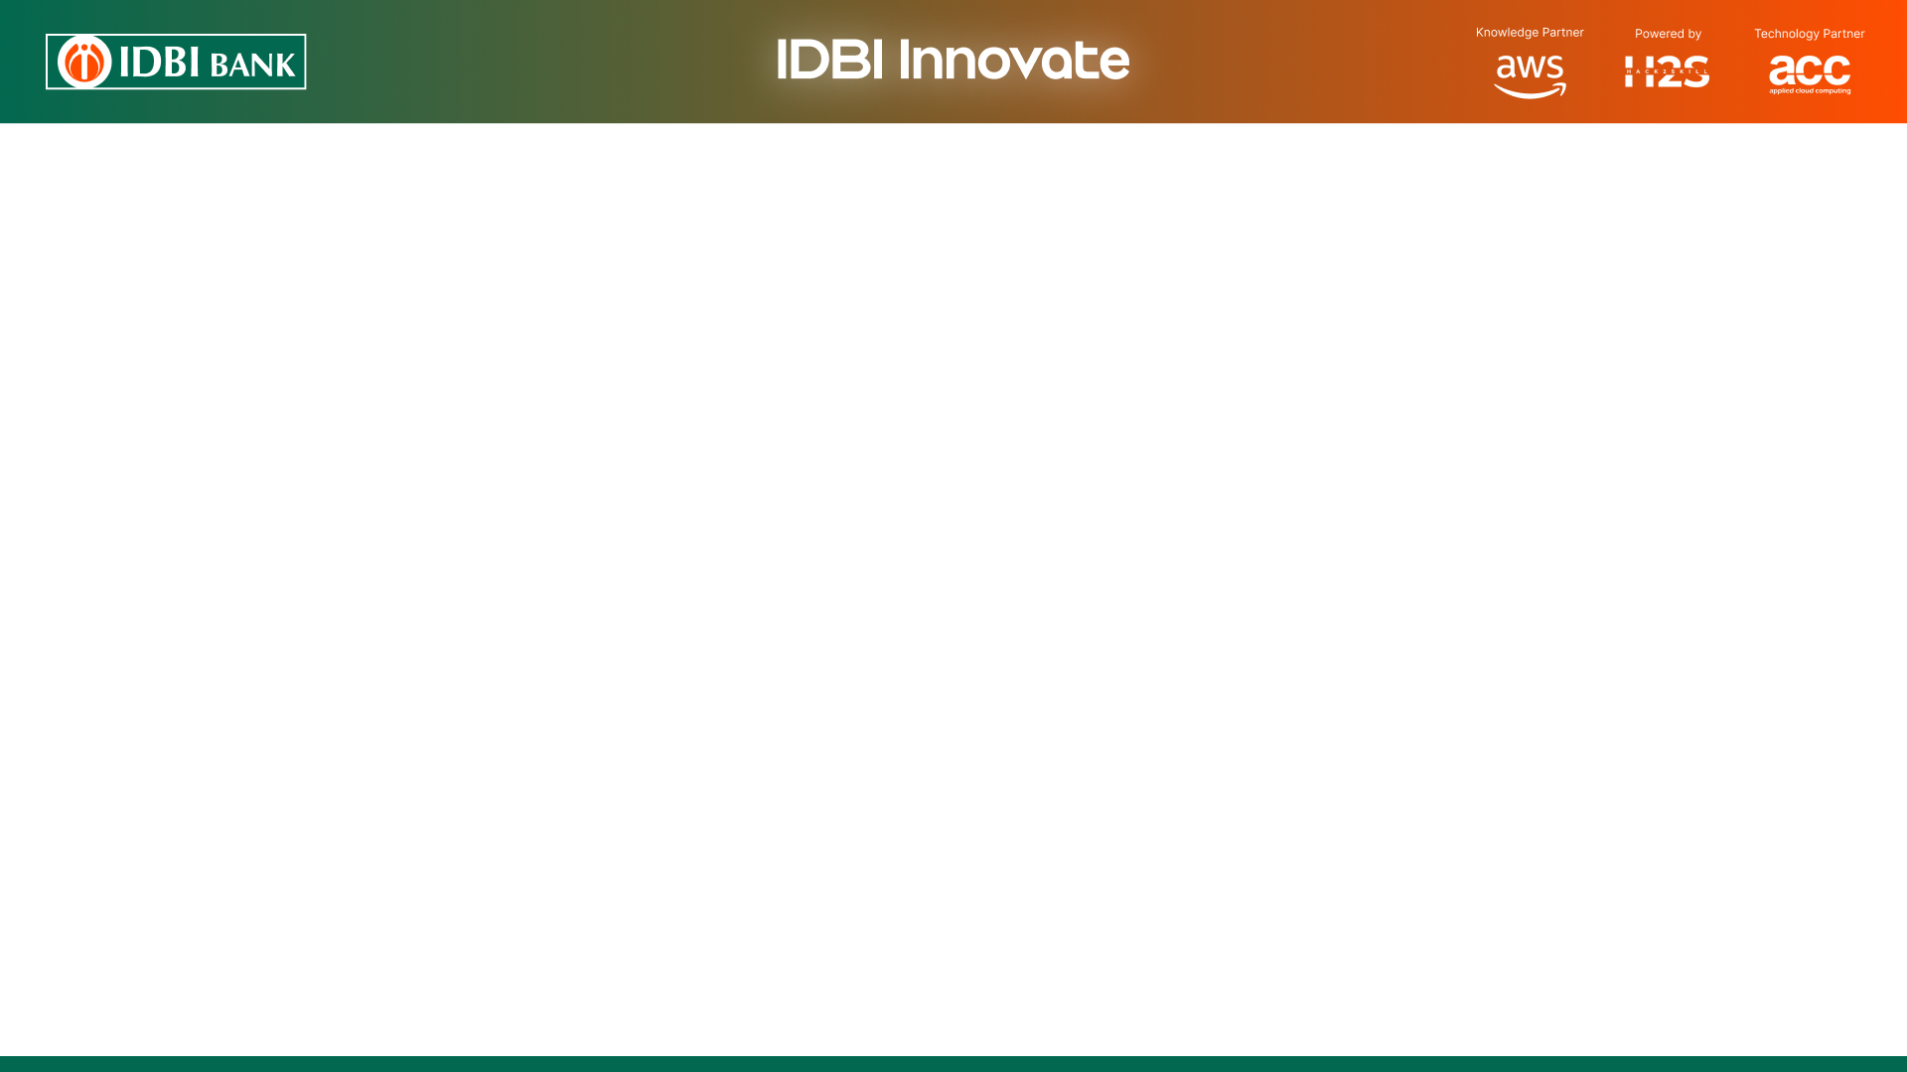
Brief about the idea
SAARTHI is an MSME loan default early-warning system. A lender uploads a loan dataset (CSV); SAARTHI auto-maps the columns, trains a calibrated model, and for every loan predicts the probability of default over the next 12 months.
But it never stops at a number. Each loan comes with a plain-English reason, a recommended action to reduce the risk, and a fairness check — and every explanation is verified by a second AI, so it cannot make things up.
In short: it turns a raw risk score into a decision a credit officer can act on.

Slide 3
Opportunities
How different is it from any of the other existing ideas?
How will it be able to solve the problem?
USP of the proposed solution
How it is different: Most tools give only a risk score. SAARTHI adds a verified plain-English reason, a 12-month timeline, and a concrete fix for every loan — all in one common vocabulary, so any two loans are comparable.
How it solves the problem: The ML model gives a calibrated default probability; SHAP finds the drivers; an AI writes the reason and the action; a second 'faithfulness judge' checks it against the evidence; and a fairness audit guards against bias.
USP: Trustworthy, explained output — never a bare number. The AI can describe the model but is not allowed to invent it, and the single move that lowers the risk is shown as before to after.

Slide 4
List of features offered by the solution
• Auto column mapping — any CSV to a fixed schema, with user override
• Calibrated 12-month probability of default (PD) for every loan
• Early-warning risk curve that flags the onset month
• SHAP-based reasons in a fixed, comparable vocabulary (common interpretation framework)
• Plain-English explanation, verified by a faithfulness judge (anti-hallucination)
• Recommended action with before to after PD (recourse)
• Difference-aware fairness audit — protected attributes are never used to predict
• Portfolio dashboard + per-loan drill-down + model trace
• Multi-provider AI gateway with automatic fail-over; honest labelling of estimates

Slide 5
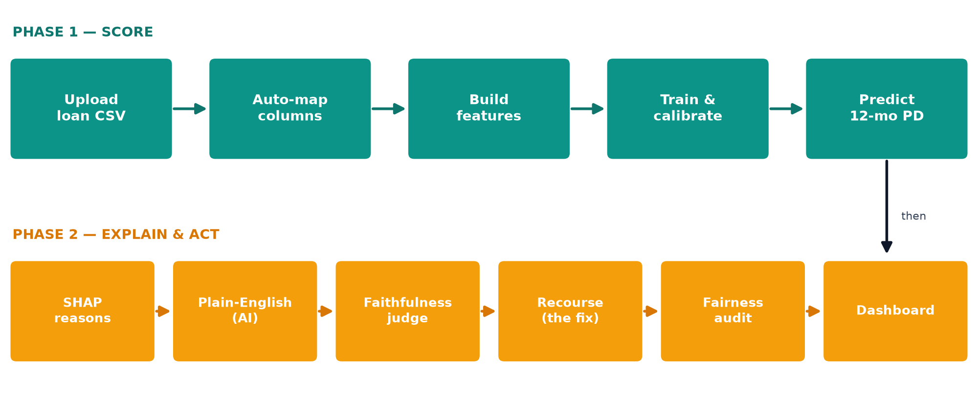
Process flow diagram or Use-case diagram

Slide 6
Wireframes/Mock diagrams of the proposed solution (optional)

Slide 7
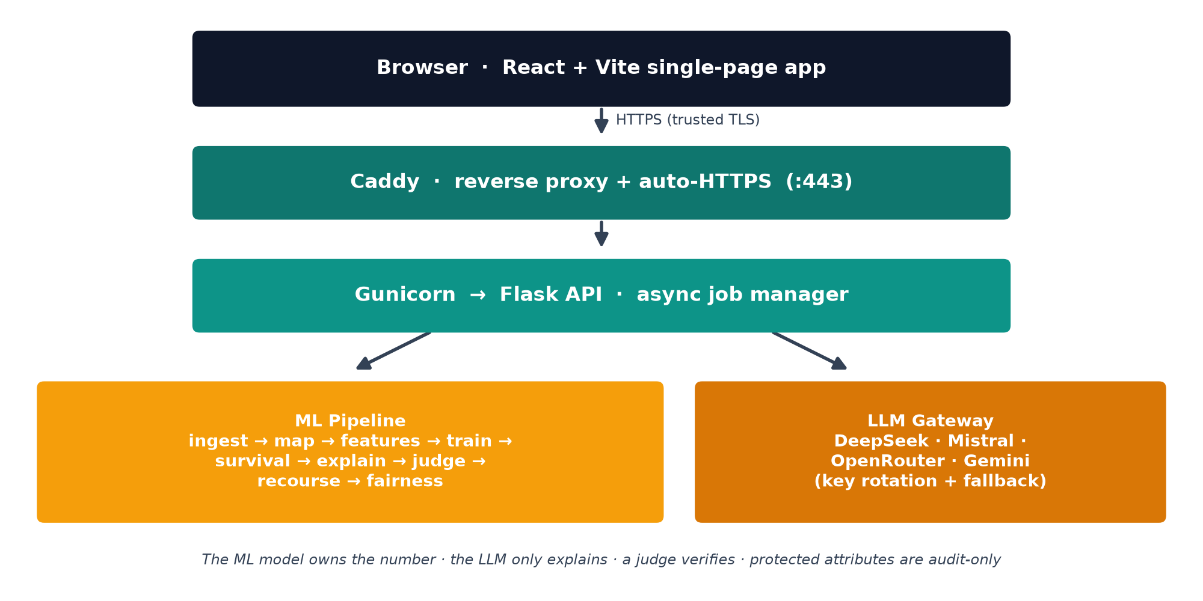
Architecture diagram of the proposed solution

Slide 8
Technologies to be used in the solution
Frontend: React, Vite, TypeScript, Tailwind CSS, Recharts
Backend: Python, Flask, Gunicorn (async job manager)
Machine Learning: LightGBM, scikit-learn, SHAP, lifelines (survival), fairlearn, pandas, polars
AI / LLM: DeepSeek, Mistral, OpenRouter, Google Gemini (OpenAI-compatible) · pydantic + json-repair
Hosting: Caddy (automatic HTTPS), systemd, DuckDNS, Ubuntu server

Slide 9
Estimated implementation cost (optional)

Slide 10
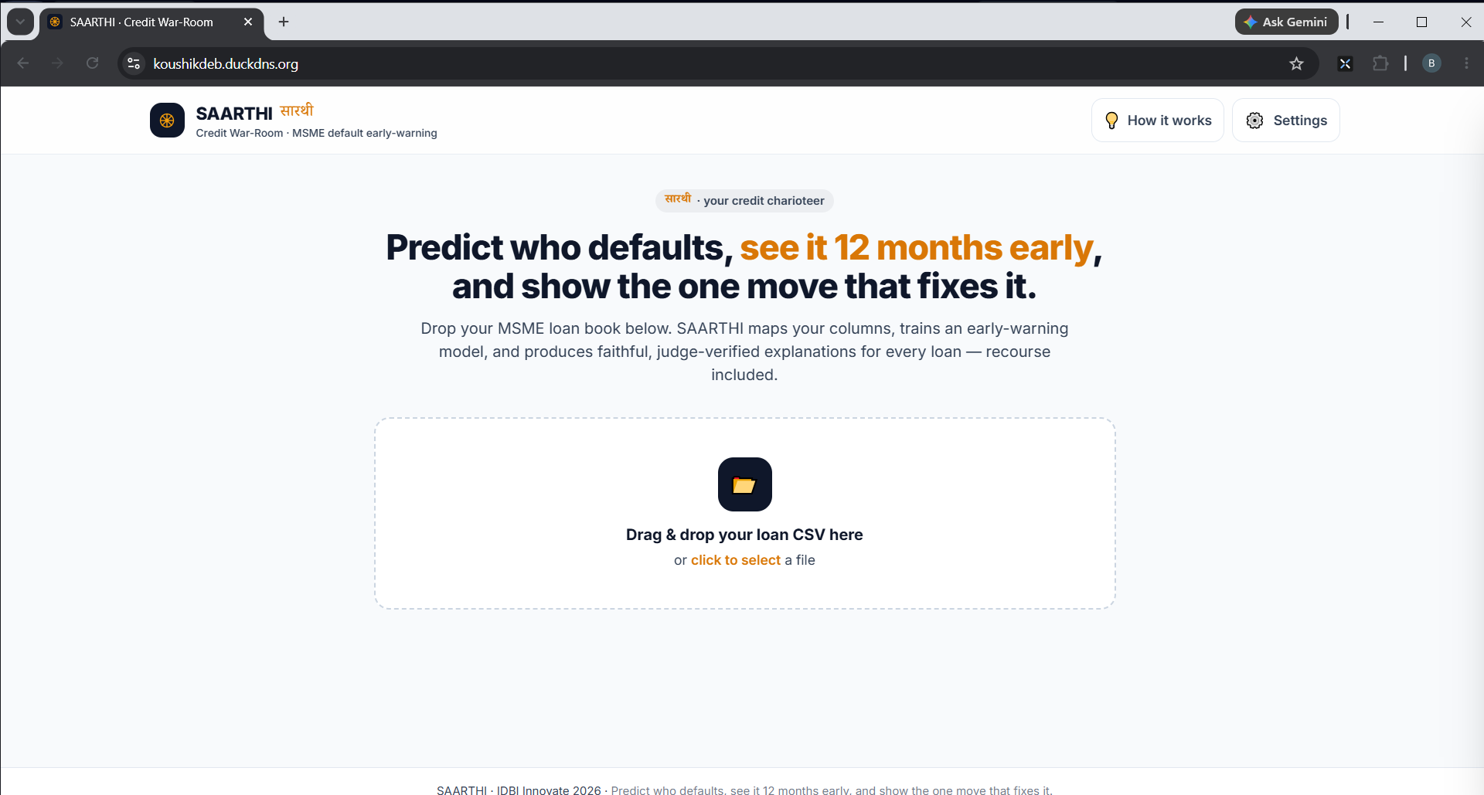
Snapshots of the prototype

Slide 11
Prototype Performance report/Benchmarking
• Accuracy (AUC-ROC): 0.97 on the real SBA loan book (~900K loans); 0.68–0.79 on German & MSME sets
• Calibration (ECE): about 0.05 — the probabilities are reliable, not just a ranking
• Explanation faithfulness: ~90–100% verified by the judge across test loans
• Scale & speed: scores 148K+ loans; trains in seconds; a per-loan explanation takes ~10–20s
• Fairness: demographic-parity & equalized-odds gaps reported per protected attribute — Pass on test data
• Reliability: 33/33 automated end-to-end checks and 12/12 live API checks pass

Slide 12
Additional Details/Future Development (if any)
• Integration with bank core / loan-origination systems and scheduled portfolio re-scoring
• Role-based access and on-premise / private deployment
• More models (TabPFN, XGBoost) and automatic data-drift monitoring
• Regulator-ready audit logs and exportable reason reports
• Research paper on the capability-diverse faithfulness judge

Slide 13
Provide links to your:
GitHub Public Repository: https://github.com/DevDaring/IDBI_SAARTHI
Demo Video Link (3 Minutes): https://youtu.be/-HglTjzO5qc
Final Product Link: https://koushikdeb.duckdns.org

Slide 15


