Slide 1
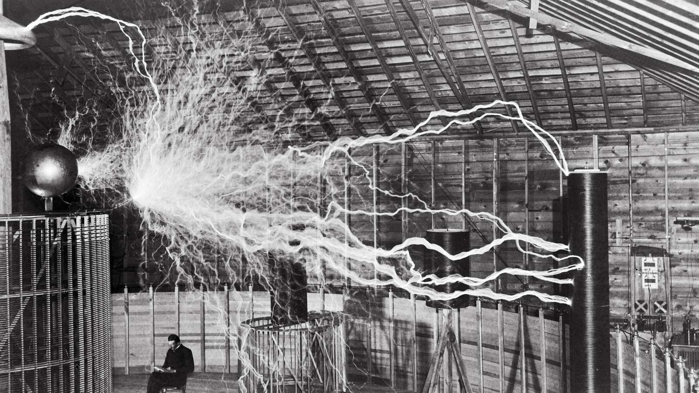
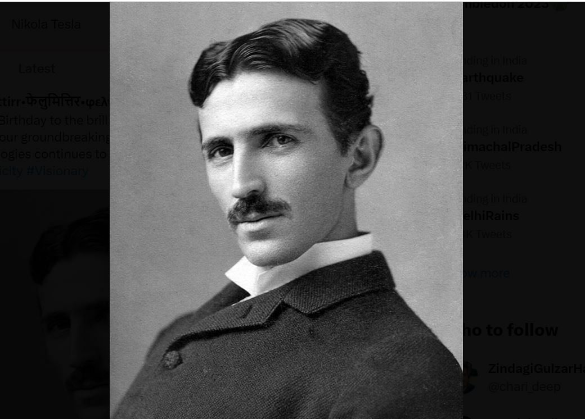
Nikola Tesla

Slide 2
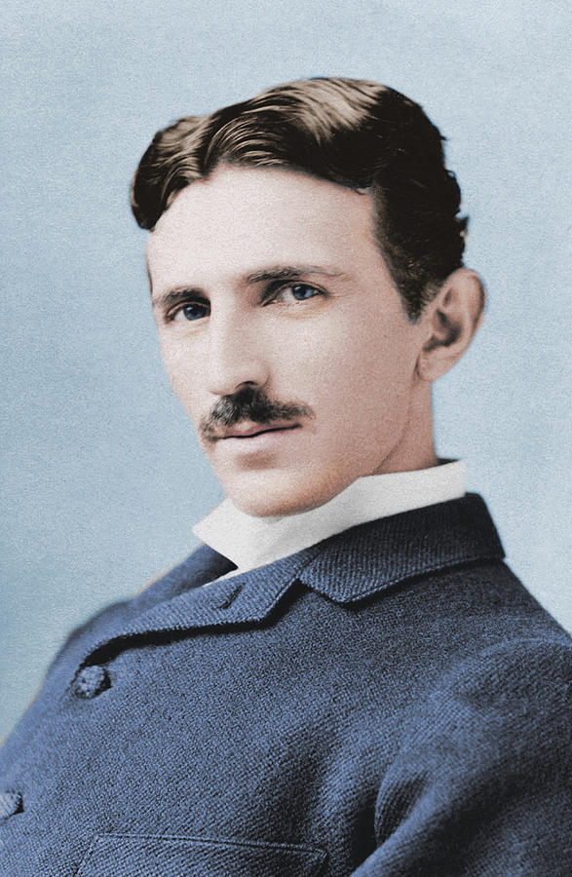
Introduction
Sir Isaac Newton (1643–1727) was an English mathematician, physicist, and astronomer. He made groundbreaking contributions to science, including the laws of motion and universal gravitation.

Slide 3
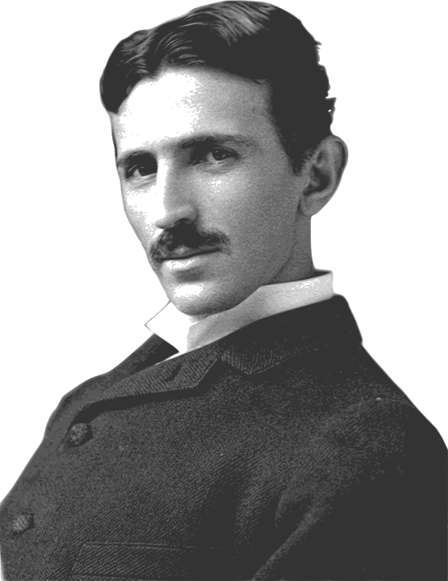
Early Life Nikola Tesla
Nikola Tesla, born July 10, 1856, in Smiljan, Croatia (then Austria), was an inventor and electrical engineer. He studied in Europe and later immigrated to the US, pioneering alternating current electricity.

Slide 4
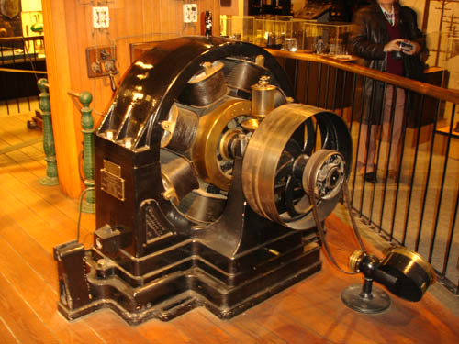
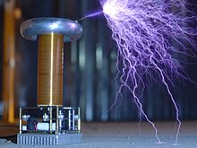
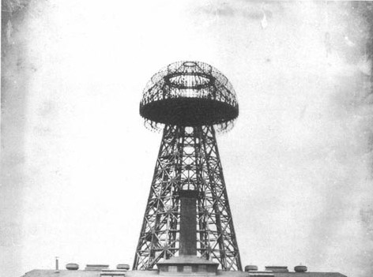
Inventions Of Nikola Tesla
Alternating Current (AC) System
Efficient electrical power transmission and distribution.
Tesla Coil
High-voltage transformer for wireless energy and radio experiments.
Wireless Transmission
Visionary concept for electricity without wires.

Slide 5
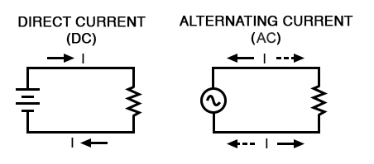
AC (Alternating Current):
Efficient long-distance power transmission.
Tesla's preference; high-voltage, adaptable, practical.
AC vs. DC
Tesla championed AC over DC in the late 19th-century "War of Currents," revolutionizing electrical power distribution.
DC (Direct Current):
Limited voltage transformation.
Edison's choice; stable, but less efficient for distance.

Slide 6
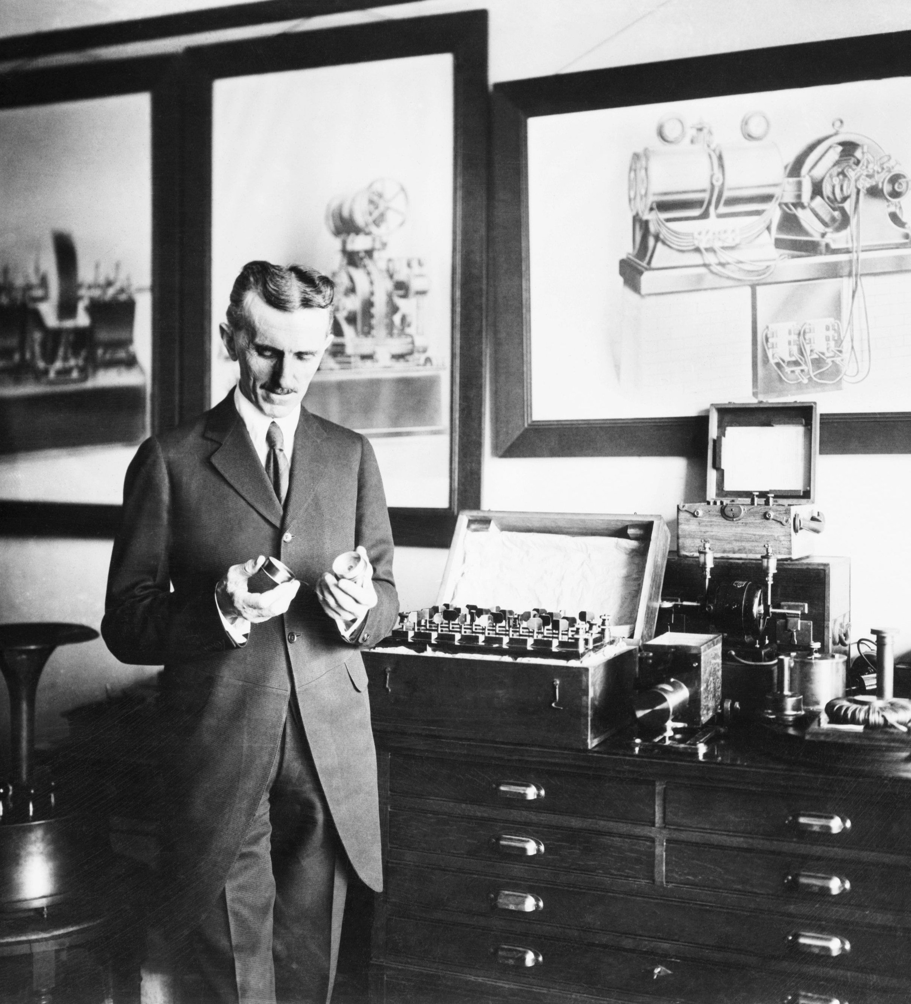
Contributions to Radio
Nikola Tesla's contributions to radio include pioneering high-frequency electrical currents, understanding electromagnetic waves, and wireless power transmission, laying the groundwork for modern radio communication.

Slide 7
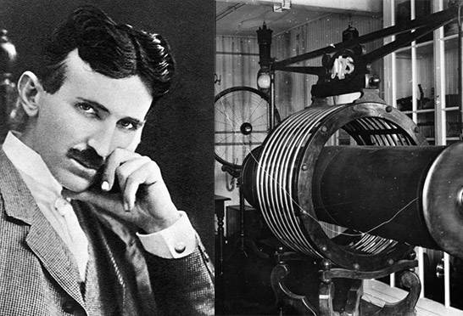
Death Ray Myth
The "Death Ray" myth falsely attributes a destructive invention to Nikola Tesla. While he explored defensive technologies, no conclusive evidence supports the existence of a functional "Death Ray" device.

Slide 8
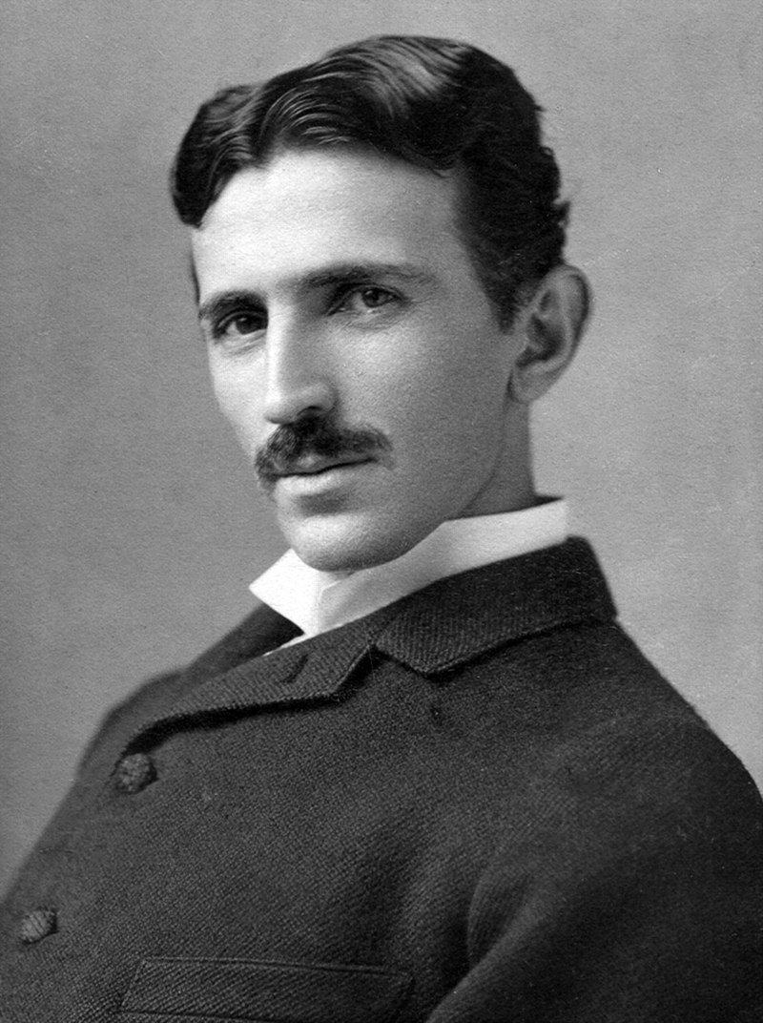
Legacy & Influence
Nikola Tesla's legacy includes pioneering AC electricity, wireless communication concepts, and inventions shaping modern technology. His visionary ideas continue to inspire scientific innovation and captivate popular culture worldwide.

Slide 9
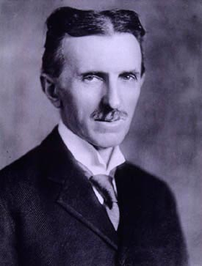
Honors And Recognitions
Order of St. Sava
Serbian honor for scientific achievements.
Edison Medal
Recognized for outstanding contributions to electrical engineering.
Tesla (unit)
Magnetic flux density unit named in his honor.
Tesla Motors
Electric car company bearing his name for innovation.

Slide 10
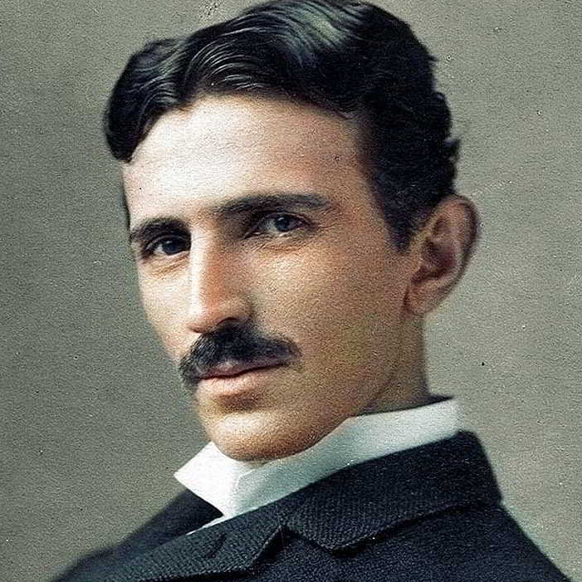
Conclusion
Nikola Tesla, a visionary inventor and electrical engineer, left an indelible mark on the world. His contributions to electricity, technology, and science continue to inspire innovation and shape our modern lives.

Slide 11
Icons

Slide 12
Icons

Slide 13
How To Edit Shapes
You can add and edit some shapes to your presentation to present your data in a visual way.
Choose your favourite infographic and insert it in your presentation using Ctrl C + Ctrl V or Cmd C + Cmd V in Mac.
Select one of the parts and ungroup it by right-clicking and choosing “Ungroup”.
Change the color by clicking on the paint bucket.
Then resize the element by clicking and dragging one of the square-shaped points of its bounding box (the cursor should look like a double-headed arrow). Remember to hold Shift while dragging to keep the proportions.
Group the elements again by selecting them, right-clicking and choosing “Group”.
Repeat the steps above with the other parts and when you’re done editing, copy the end result and paste it into your presentation.
Remember to choose the “Keep source formatting” option so that it keeps the design. For more info, please visit Slideegg (Tips & Tricks).

Slide 14
Terms Of Use (Free Users)
If you are a free subscriber, you should credit SlideEgg by keeping the “ThankYou” slide.
Kindly refer to the following slide for the Terms of Use for premium users.
You can:
Customize or edit this template
Use this template for both business and personal endeavors.
You can not:
Sell, rent, or second-license SlideEgg content or its altered version. Promulgate, unless explicitly permitted, SlideEgg content, by SlideEgg.
Incorporate SlideEgg content in any database or file online or offline.
Obtain SlideEgg content’s copyright.
Kindly refer to our Tutorial page or FAQ for advanced slide modification guidelines.

Slide 15
Terms Of Use (Premium Users)
Being a premium subscriber, you have the privilege of using this PPT template
without giving attribution to SlideEgg or keeping the “ThankYou” slide.
You can:
Customize or edit this template.
Use this template for both business and personal endeavors.
Circulate or share the editable format of this template with anyone you want.
You can not:
Sell, rent or second-license SlideEgg content or the altered version of it. Promulgate or include the templates in any other services database
that performs as distribution or resale platform, unless explicitly permitted, by SlideEgg.
Incorporate the elements used in SlideEgg’s templates separately.
Obtain SlideEgg’s copyright for the elements used in this template as a logo or trademark.
Kindly refer to our Tutorial page or FAQ for advanced slide modification guidelines.

Slide 16





Thank You!
We respect your valuable time with SlideEgg!
If you have any questions, please reach us
Do you have a design request, please visit our redesign page.
CREDIT: SlideEgg created this PowerPoint template.
Let this slide be kept for attribution.
www.slideegg.com

