Slide 1









Thread1
Thread2
Thread3
COMPLETABLE FUTURE
JAVA8

Slide 2
FUTURE INTERFACE
Since JAVA5

Slide 3
TRADITIONAL VS MODEL ASYNCHRONOUS
TRADITIONAL
JAVA FUTRURE
Runnable
Callable
MainThread
MainThread
Separate Thread
Separate Thread
Task
Task
doSomething
doSomething
Runnable
Callable
Return Value with get()
Thread thread2 = new Thread(new Runnable() {
@Override
public void run() {
System.out.println(2 * 3);
}
});
//do something else
thread2.start();
thread2.join();
Future<Integer> future = executor.submit(
new Callable<Integer>() {
public Integer call() throws Exception {
return 2 * 3;
}
});
//do something else
System.out.println(future.get());

Slide 4

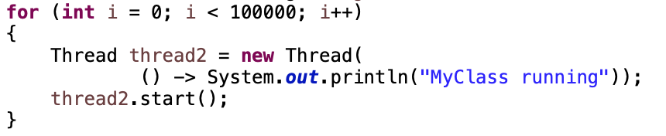
EXECUTOR SERVICE FOR BETTER PERFORMANCE
EXECUTOR SERVICE
Thread Pool
Submit Tasks
Thread1
Task
1
Task
2
Task
3
…
Task 100000
Thread2
Java Executor Service
…
Thread10
ExecutorService executor = Executors.newFixedThreadPool(10);
for (int i= 0; i < 100000; i++) {
executor.submit(() -> System.out.println("My Class is running"));
}
Notes:
Advantage;
Thread Creation, Thread Management, Task submission and execution
shutdown()
shutdownNow()

Slide 5
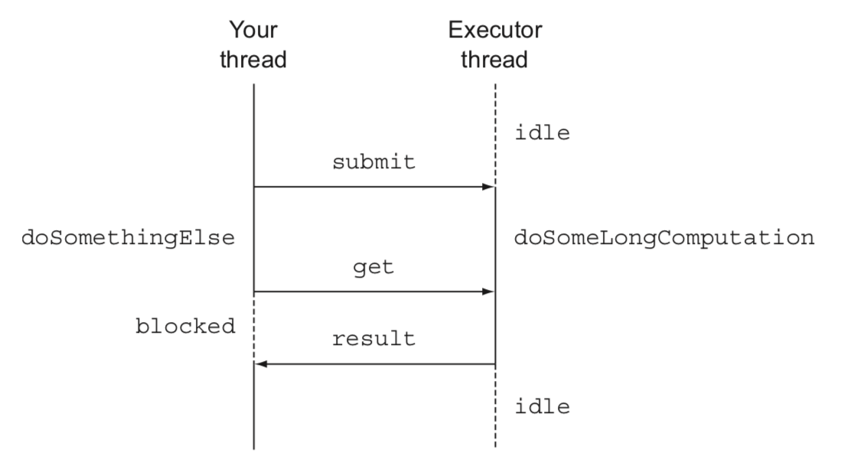
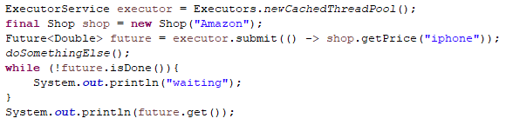
FEATURES OF FUTURE
isDone()

Slide 6
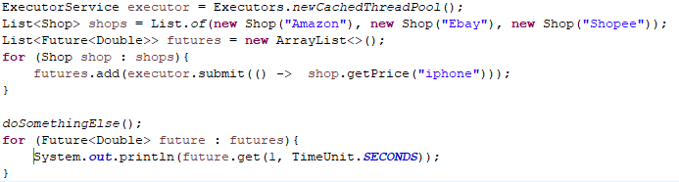
FEATURES OF FUTURE
List of Futures
isDone()
get(timeout, unit )
isTerminal
cancel()
isCancel()

Slide 7
COMPLEX BUSINESS
Thread1
Thread2
Thread3
Asynchronous
Synchronous
Manually Completed
HandleException
Non-blocking

Slide 8
DISADVANTAGE OF FUTURE
Thread1
Thread2
1. Non-blocking
2. Manually Completed
3. Multiple Futures chain(Synchronous)
4. Multiple Futures combine (Asynchronous)
5. Exception Handling

Slide 9
findPrice()
getNonDiscountPrice()
COMPLETABLE FUTURE
Since JAVA8
extractData()
getDiscountPercent()
calculate()

Slide 10
Executor Thread
SUPPLYASYNC
findPrice()
getNonDiscountPrice()
Amazon|20$|Gold
private final static Executor executor = Executors.newFixedThreadPool(100);
public static CompletableFuture<String> findPrice(String product) {
Shop amazon = new Shop(”Amazon");
return CompletableFuture.supplyAsync(() -> amazon.getNonDiscountPrice("iphone11”), executor);
}
<U> CompletableFuture<U> supplyAsync(Supplier<U> supplier)
<U> CompletableFuture<U> supplyAsync(Supplier<U> supplier, Executor executor)

Slide 11

Executor Thread
Executor Thread
SUPPLYASYNC
findPrice()
getNonDiscountPrice()
getNonDiscountPrice()
Amazon|20$|Gold
Ebay|22$|Silver
private final static Executor executor = Executors.newFixedThreadPool(100);
static List<Shop> shops = List.of(new Shop("Amazon"), new Shop("Ebay"), new Shop("Shopee"));
public static Stream<CompletableFuture<String>> findPrice(String product) {
return shops.stream().map(
shop -> CompletableFuture.supplyAsync(() -> shop.getNonDiscountPrice("iphone11"), executor));
}
<U> CompletableFuture<U> supplyAsync(Supplier<U> supplier)
<U> CompletableFuture<U> supplyAsync(Supplier<U> supplier, Executor executor)

Slide 12
Executor Thread
findPrice()
THENAPPLY
getNonDiscountPrice()
public static Stream<CompletableFuture<Quote>> findPrice(String product) {
return shops.stream()
.map(shop -> CompletableFuture.supplyAsync(() -> shop.getNonDiscountPrice("iphone11")))
.map(future -> future.thenApply(Quote::parse));
}
Amazon|20$|Gold
parse()
Price: 20|Discount: Gold
<U> CompletableFuture<U> thenApply (Function<? super T,? extends U> fn)
<U> CompletableFuture<U> thenApplyAsync(Function<? super T,? extends U> fn)
<U> CompletableFuture<U> thenApplyAsync(Function<? super T,? extends U> fn, Executor executor)

Slide 13
Executor Thread
findPrice()
THENCOMPOSE
getNonDiscountPrice()
parse()
Gold
public static Stream<Object> findPrice(String product) {
return shops.stream()
.map(shop -> CompletableFuture.supplyAsync(
() -> shop.getNonDiscountPrice ("iphone11"), executor))
.map(future -> future.thenApply(Quote::parse))
.map(future -> future.thenCompose(
quote -> CompletableFuture.supplyAsync(
() -> Discount.getDiscountPrecent(quote), executor)));
}
getDiscountPercent()
20%

Slide 14
Executor Thread
Executor Thread
findPrice()
THENCOMBINE
From:$ To:VND
getNonDiscountPrice()
getExchangeCurrency()
22500
parse()
getDiscountPercent()
public static Stream<Object> findPrice(String product) {
return shops.stream()
.map(shop -> CompletableFuture.supplyAsync(
() -> shop. getNonDiscountPrice("iphone11"), executor))
.map(future -> future.thenApply(Quote::parse))
.map(future -> future.thenCompose(
quote -> CompletableFuture.supplyAsync(
() -> Discount.getDiscountPercent(quote), executor)))
.map(future -> future.thenCombine(
CompletableFuture.supplyAsync(() -> ExchangeService.getRate("USD", "VND")),
(quote, rate) -> quote.getShopName() + " " + quote.getDiscount() * rate));
}
Quote
calculate()

Slide 15
public static Stream<Object> findPrice(String product) {
return shops.stream()
.map(shop -> CompletableFuture.supplyAsync(
() -> shop. getNonDiscountPrice("iphone11"), executor))
THENACCEPT
CompletableFuture[] futures = findPrice(”iphone11")
.map(f -> f.thenAccept(
s -> System.out.println(s)))
.toArray(size -> new CompletableFuture[size]);
Executor Thread
findPrice()
thenAccept()
thenAccept()
Executor Thread
findPrice()
ALLOF/ANYOF
CompletableFuture.allOf(futures).join();
join()

Slide 16
HANDLE EXCEPTION
public static Stream<CompletableFuture<String>> findPrice(String product) {
return shops.stream()
.map(shop -> CompletableFuture.supplyAsync(() -> shop.getPrice("iphone11"), executor))
.map(future -> future.exceptionally(ex -> {return ”Unknow";}
));
}

Slide 17
THINGS TO DO
supplyAsync
supplyAsync
SIMPLE!!!
Apply Completable Future in
DefaultSearchingService.java
thenApply
thenCombine
thenCompose
thenCombine
thenAccept

