Slide 2
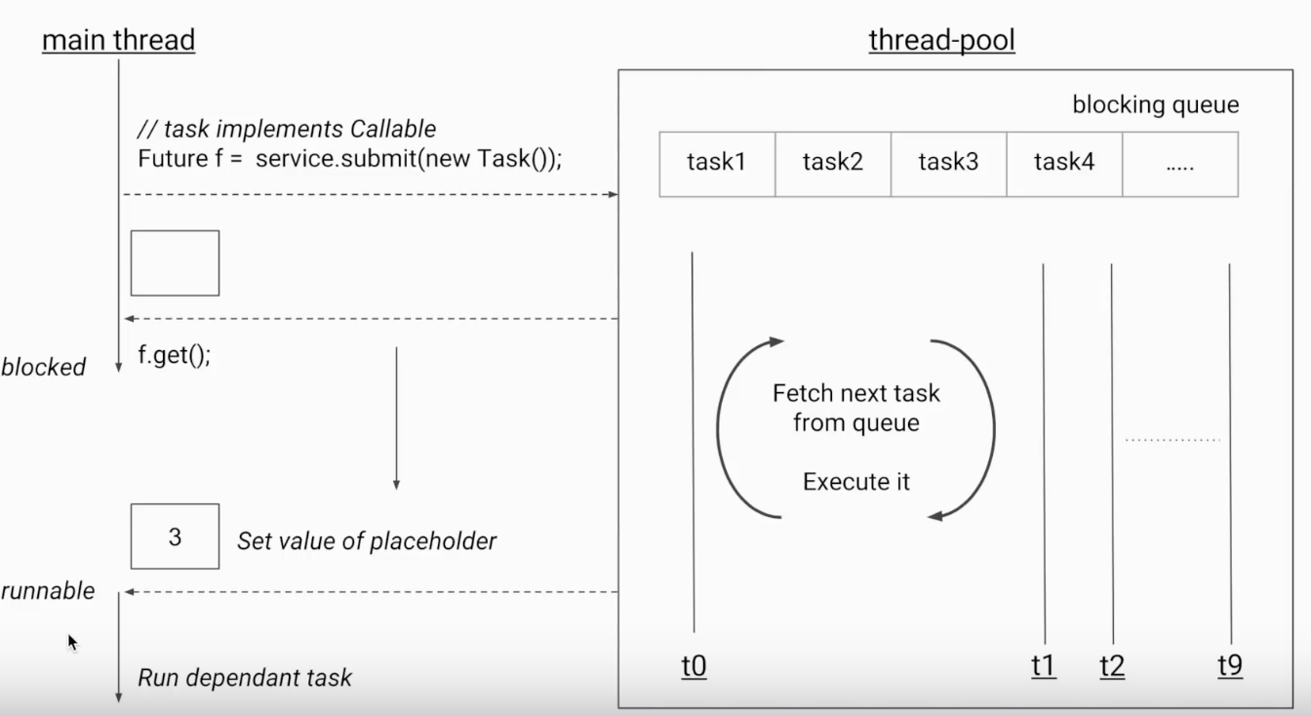
JAVA FUTURE
WHAT IS JAVA FUTURE?
10 threads
100 task

Slide 3
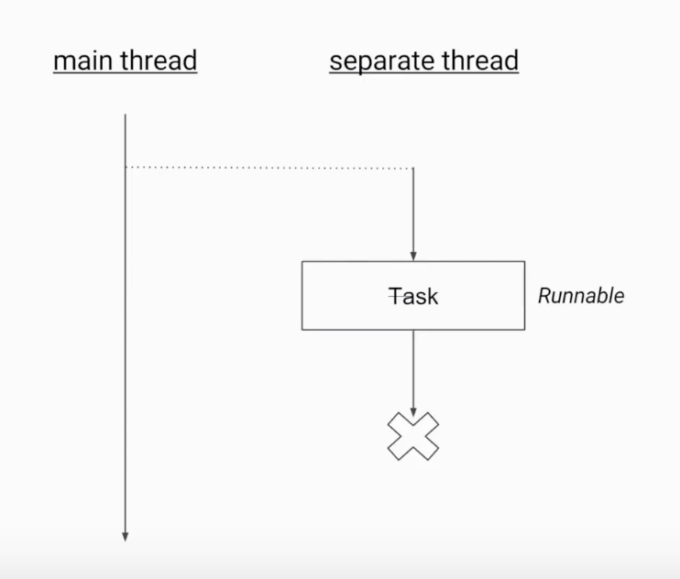
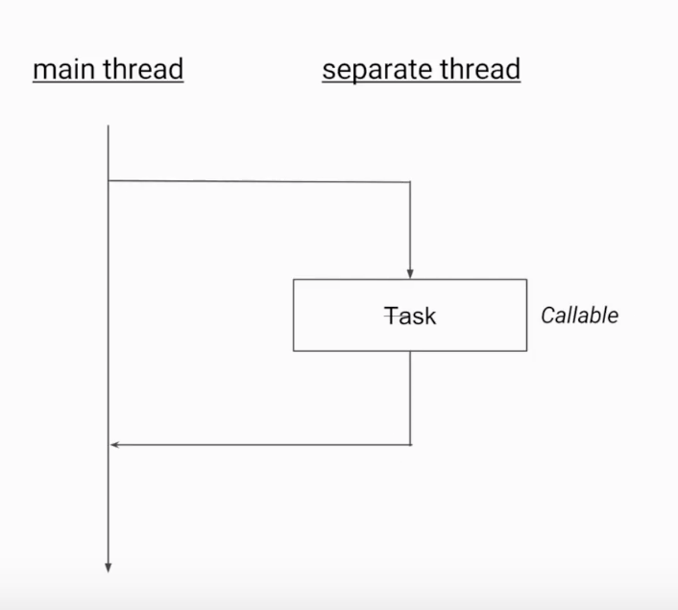
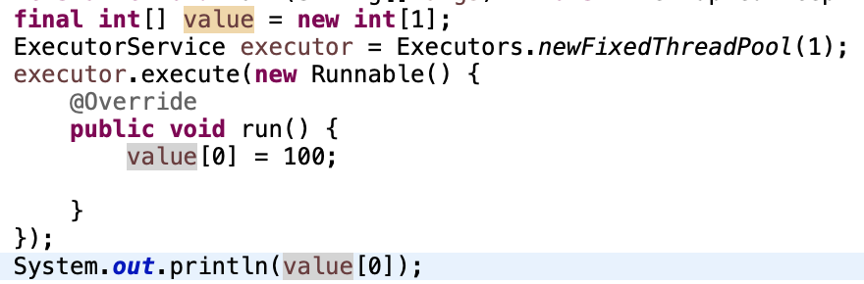
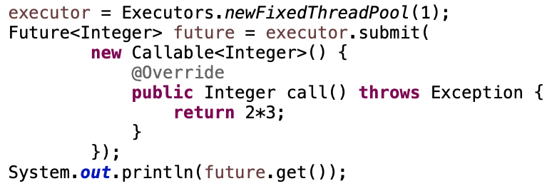
JAVA FUTURE
WHAT IS JAVA FUTURE?

Slide 4
JAVA FUTURE
ANYTHING ELSE?
get(timeout, unit ) :
Get return value in limit of time
isDone():
check whether the task is completed or not
cancel() isCancel()
invokeAll():
Submit multiple tasks and wait for all of them to complete.
invokeAny():
Submit multiple tasks and wait for any one of them to complete

Slide 5
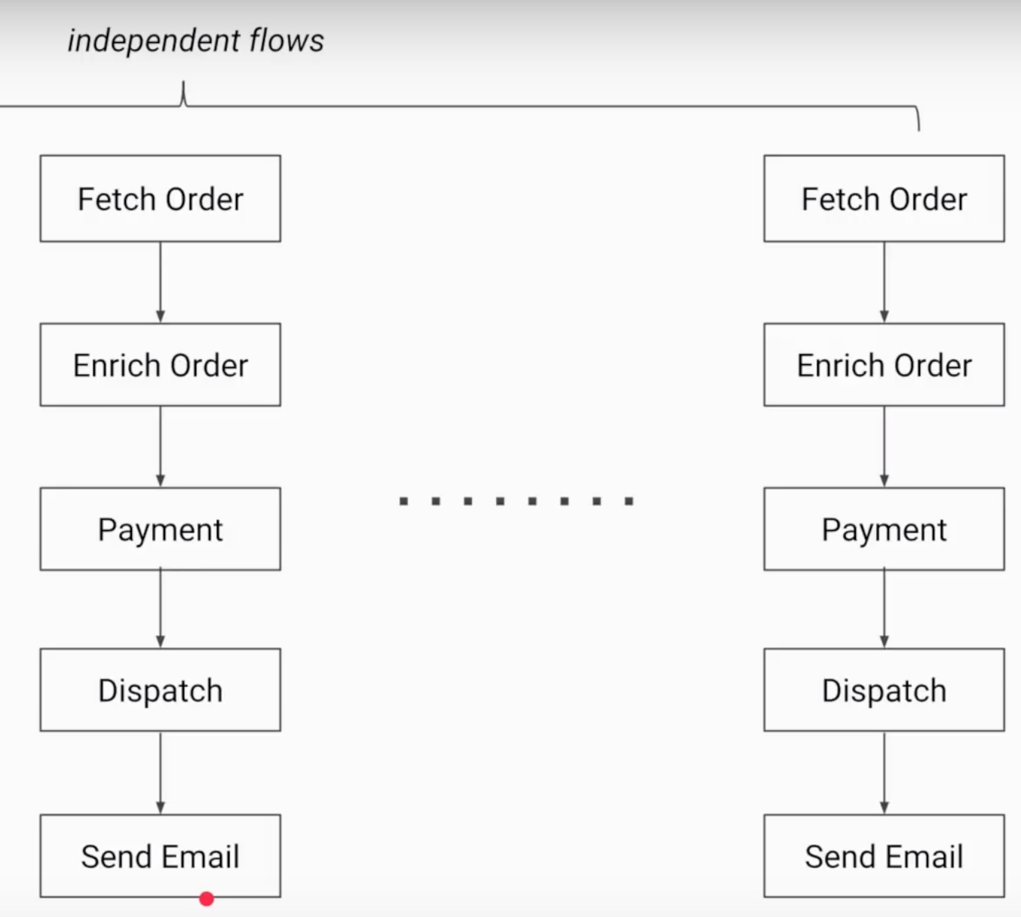
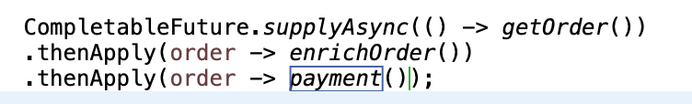
JAVA FUTURE
COMPLETABLE FUTURE

