Slide 2







GraphQL
Describe your data
Ask for what you want
Get predictable results
Enable Contract Driven Development

Slide 3
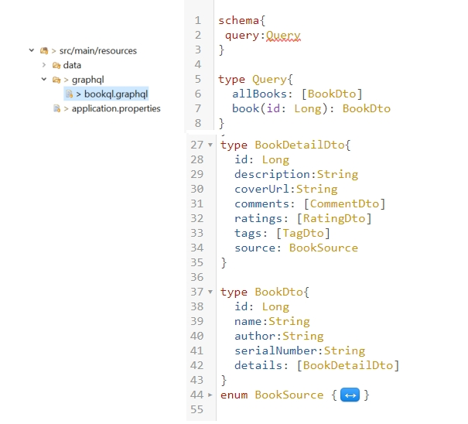
Describe Data

Slide 4
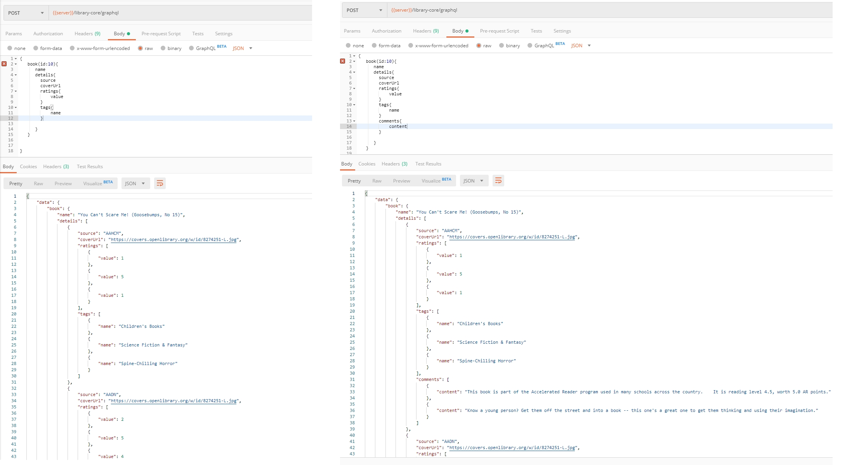
Ask for what you want (based on the schema, of course)

Slide 5
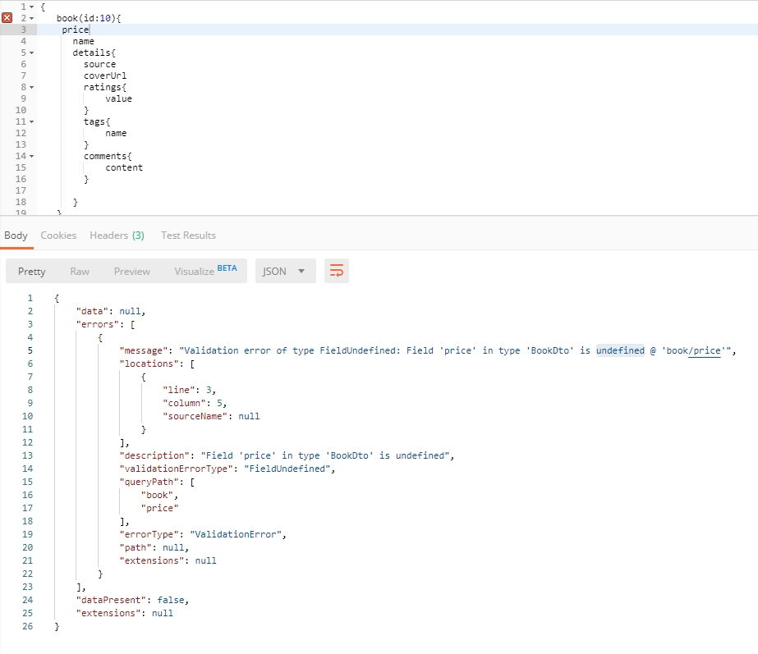
When I try to be naughty and ask for something not on the schema

Slide 6
Support Multiple API version
Everything will change and grow
Backward compatible (aka: not breaking existing clients)
How?
Point to point: URL
/library-core/api/v1
/library-core/api/v2
Compatible:
Custom request header:
api-version: 2
Accepted header:
Accept: application/vnd.haveibeenpwned.v2+json
Continuous versioning
…
Notes:
“The correct handling of API versioning has been one of the most difficult issues faced by developers of distributed systems. Various schemes have been proposed, ranging from the laissez faire approach taken by CORBA (Common Object Request Broker Architecture) to the stricter schemes used in DCOM (Distributed Component Object Model). With the advent of Web services, there are some new features that you can take advantage of that can help alleviate the problem, but the brutal fact of the matter is that versioning has not been built into the Web services architecture.”

Slide 7
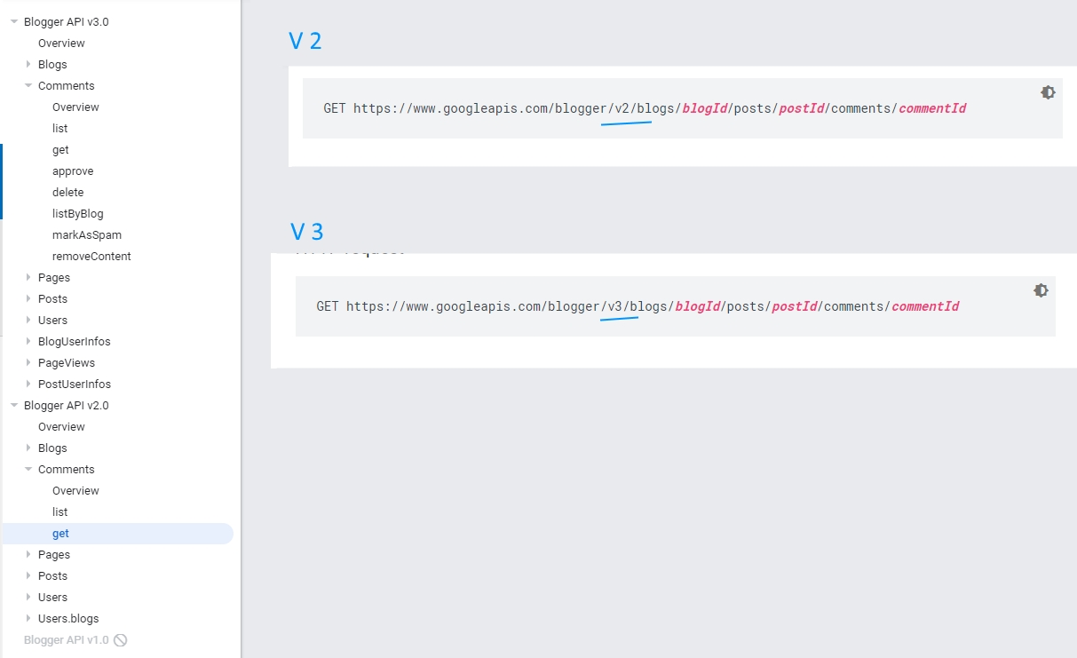
Point to point
URLs:
/library-core/api/v1
/library-core/api/v2
DevOps
Footprints
Maintenance
Notes:
Same approach: Twitter
Trace off:
need strong devops
Leave big footprint

Slide 8
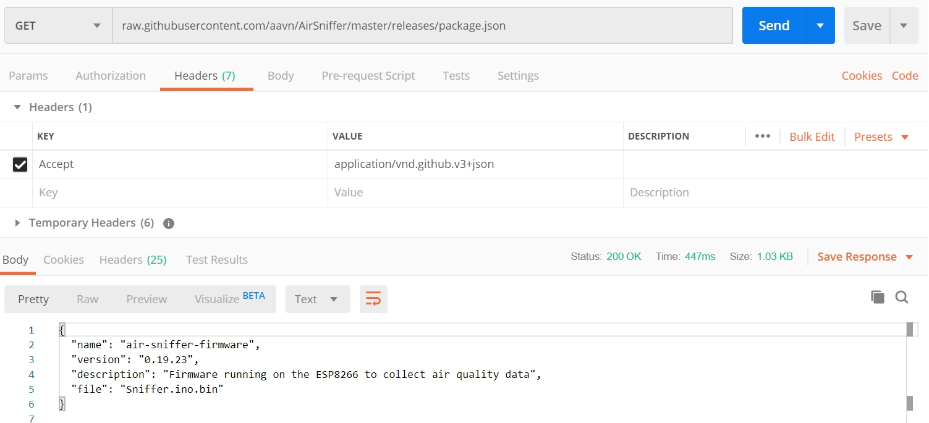
Compatible
Accepted header: Accept: application/vnd.github.v3+json
Consumer’s effort Not calling directly from browser
Not easy to test
Notes:
Control more
Not Expose version on url
Trace off:
Be ware off firewall
Convention/Standardise?
HTML form
Difficult to test
Cannot call directly from browser

Slide 9
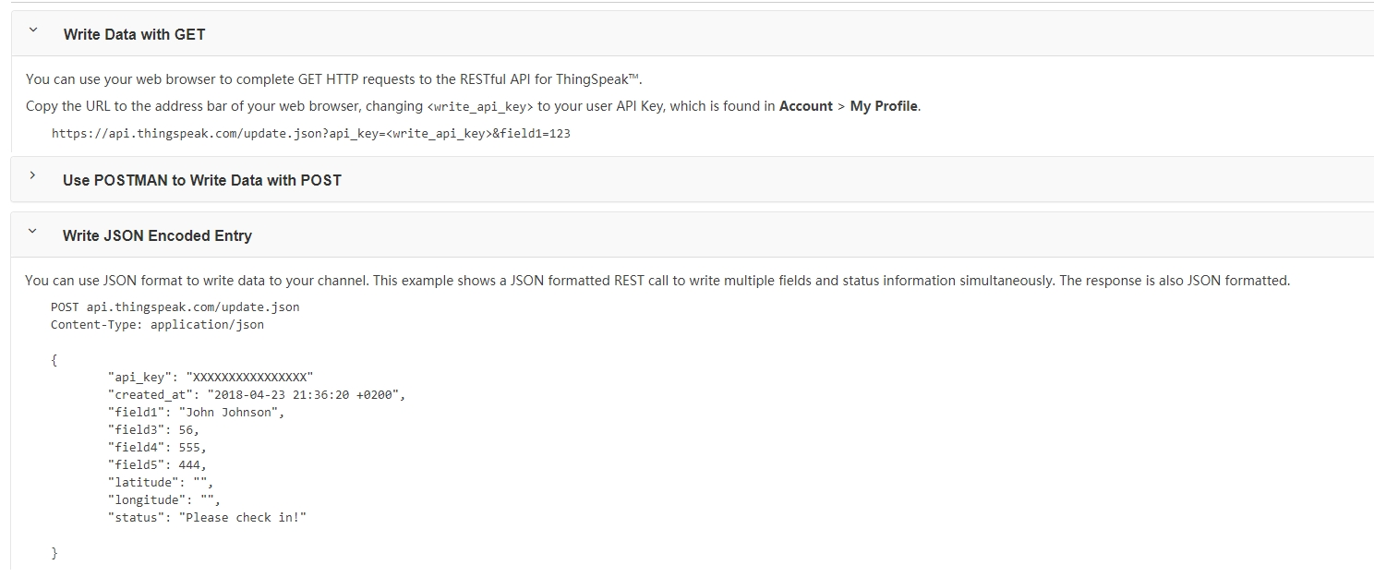
Compatible
Continuous versioning
Engineering awareness
Notes:
Trace off:

Slide 10
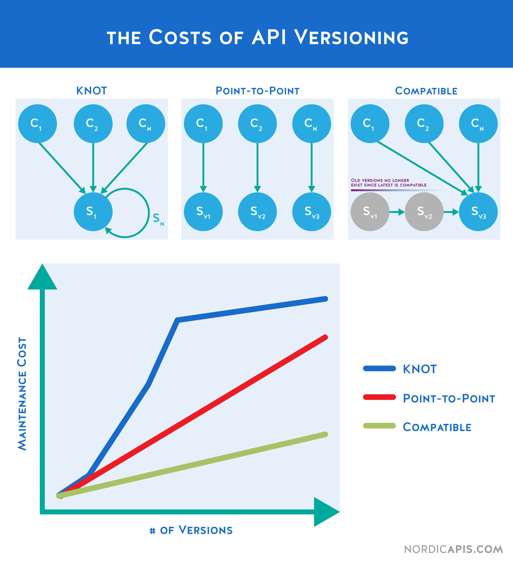
Which way is better?
Product need
Business motives
Vision

Slide 11
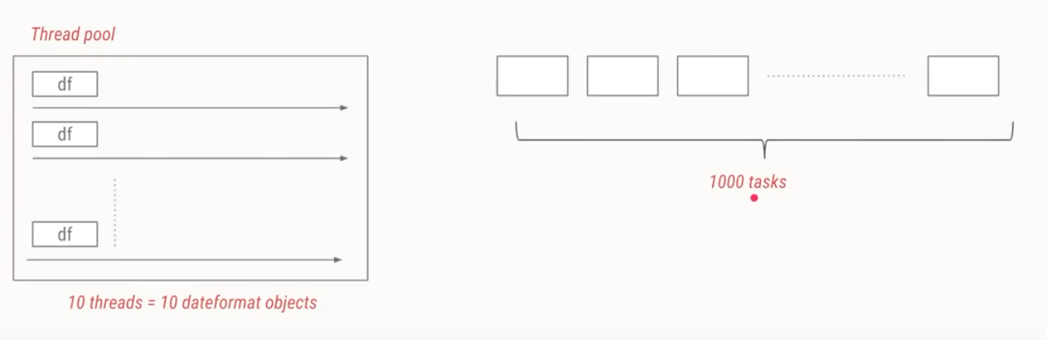
JAVA FUTURE
WHAT IS JAVA EXECUTOR?

Slide 12
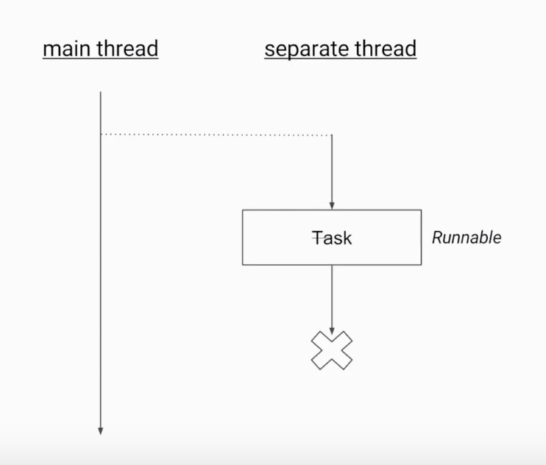
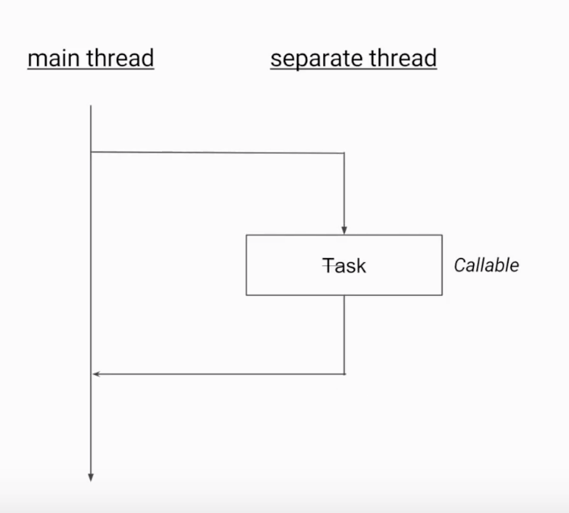
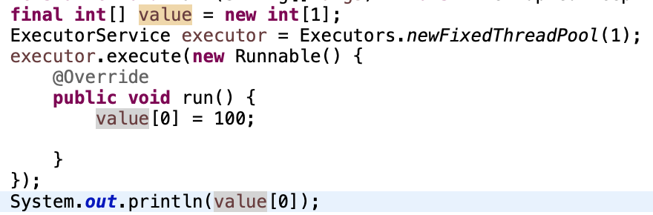
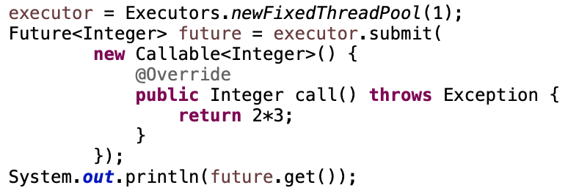
JAVA FUTURE
WHAT IS JAVA FUTURE?

Slide 13
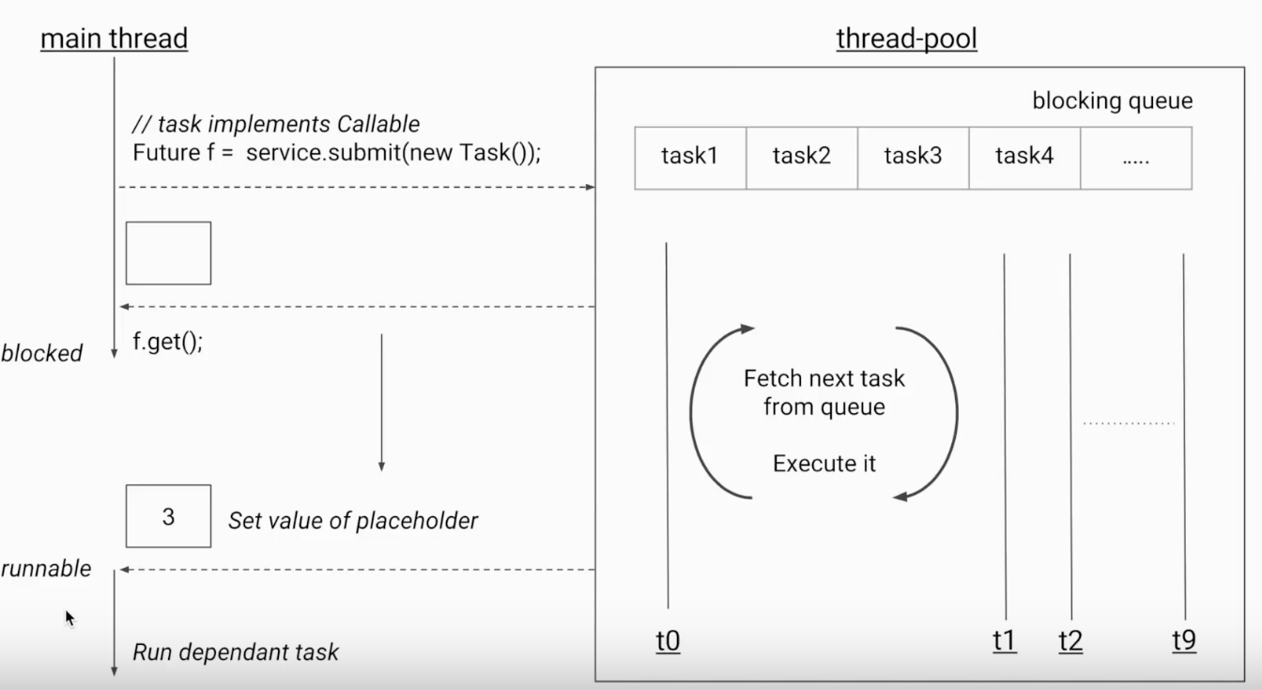
JAVA FUTURE
ANYTHING ELSE?
invokeAll(): Start all tasks same time
isDone(): Check a task is finished
get(timeout, unit ) : Get return value in limit of time
isTerminal
cancel()
isCancel()

Slide 14
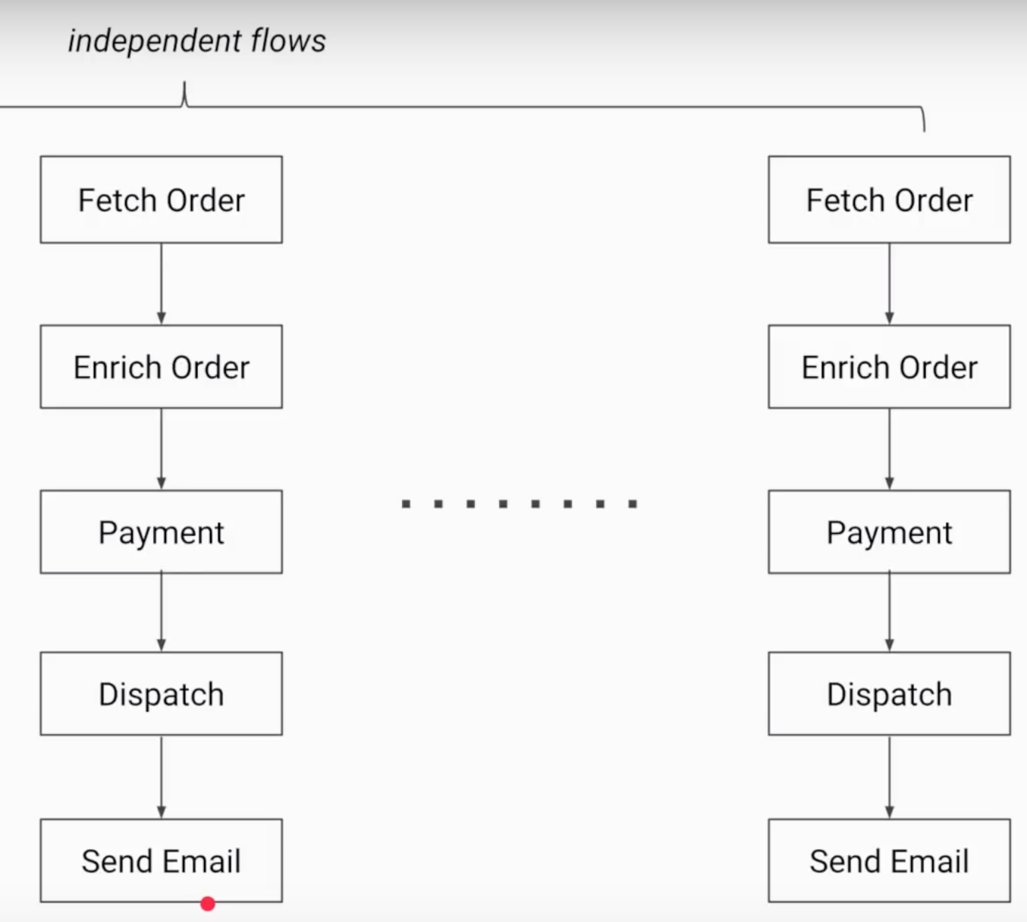
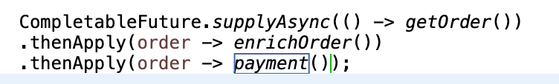
JAVA FUTURE
COMPLETABLE FUTURE

