Slide 1
COMPLETABLE FUTURE
JAVA8+

Slide 2
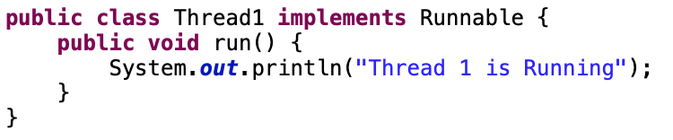
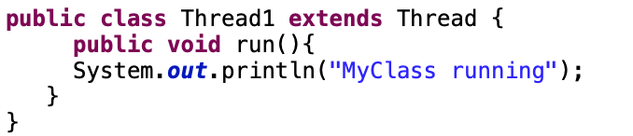
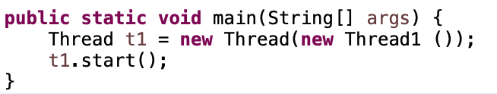
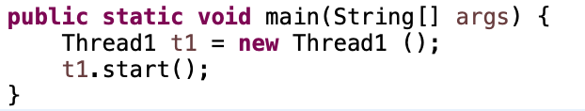
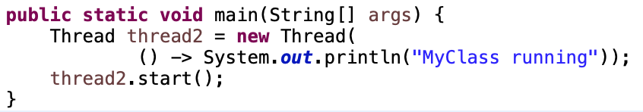
TRADITIONAL ASYNCHRONOUS BEST PRACTICE
Implement Runnable
Extend Thread
Java 8 with
Lambda Expression

Slide 3
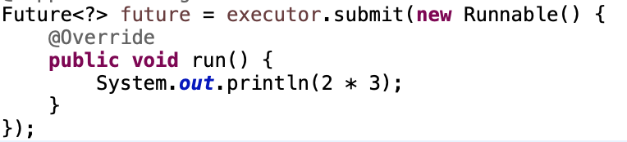
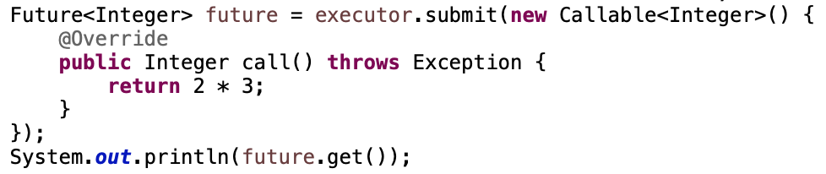
WHAT IS FUTURE INTERFACE?
JAVA5
Callable
MainThread
Separate Thread
MainThread
Separate Thread
Task
Task
Callable
Runnable
Return Value with get()

Slide 4

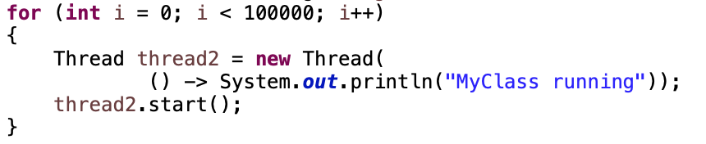
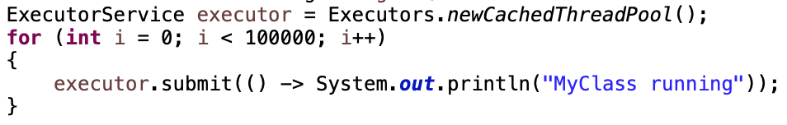
EXECUTOR SERVICE FOR BETTER PERFORMANCE
EXECUTOR SERVICE
Thread Pool
Submit Tasks
ThreadPool 1
Task
1
Task
2
Task
3
…
Task 100000
ThreadPool 2
Java Executor Service
…
ThreadPool 10
Notes:
Advantage;
Thread Creation, Thread Management, Task submission and execution
shutdown()
shutdownNow()

Slide 5
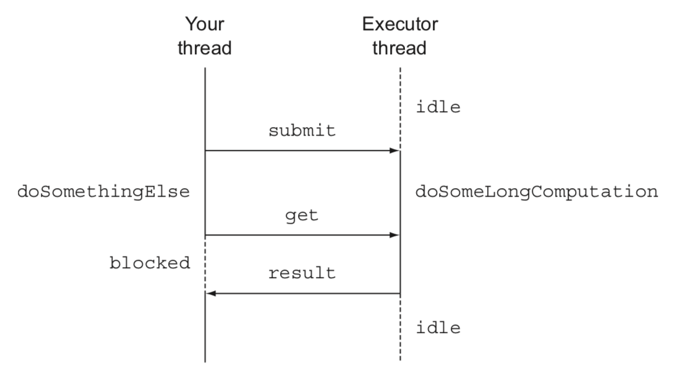
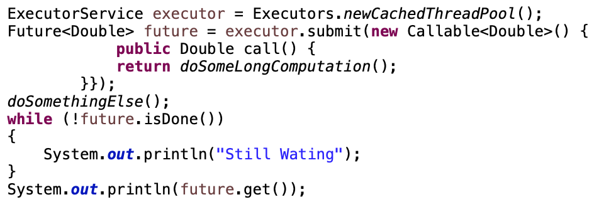
ANYTHING ELSE?
isDone()

Slide 6
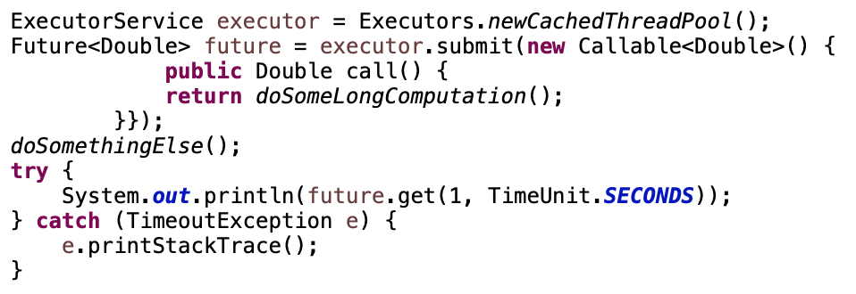
ANYTHING ELSE?
isDone()
get(timeout, unit )

Slide 7
ANYTHING ELSE?
isDone()
get(timeout, unit )
isTerminal
cancel()
isCancel()

Slide 8
WHY DEVELOPER IGNORES FUTURE?

Slide 9

findPrice()
iphone11
iphone11
COMPLEX BUSINESS
getNonDiscountPrice()
getNonDiscountPrice()
Amazon|20$|Gold
Ebay/22$|Silver
Amazon|20$|Gold
Ebay/22$|Silver
extractData()
extractData()
Price: 20|Discount: Gold
Price: 22|Discount: Silver
Gold
Gold
getDiscountPercent()
getDiscountPercent()
20%
10%
From:$ To:VND
From:$ To:VND
getExchangeCurrency()
getExchangeCurrency()
23000
22500
calculate()
calculate()

Slide 10
Thread1
Thread2
Thread3
findPrice()
Asynchronous
getNonDiscountPrice()
getExchangeCurrency()
getNonDiscountPrice()
getExchangeCurrency()
extractData()
extractData()
Synchronous
getDiscountPercent()
getDiscountPercent()
Display
calculate()
Display
calculate()
join()

Slide 11
DISADVANTAGE OF FUTURE
findPrice()
iphone11
iphone11
getPrice
getPrice
getNonDiscountPrice()
extractData()
getDiscountPercent()
getExchangeCurrency()
getNonDiscountPrice()
extractData()
getDiscountPercent()
getExchangeCurrency()
Amazon|20$|Gold
Ebay|20$|Silver
Price: 20|Discount: Gold
Price: 25|Discount: Silver
20%
10%
23000
22500

Slide 12
Executor Thread
Executor Thread
findPrice()
iphone11
iphone11
getPrice
getPrice
getNonDiscountPrice()
extractData()
getDiscountPercent()
getExchangeCurrency()
getNonDiscountPrice()
extractData()
getDiscountPercent()
getExchangeCurrency()
Amazon|20$|Gold
Ebay|20$|Silver
Price: 20|Discount: Gold
Price: 25|Discount: Silver
20%
10%
23000
22500
1. Blocking
Blocking time
MainThread
Submit()
Get()
Separate
Thread 1
Task
Separate
Thread 2
Task

Slide 13
Executor Thread
Executor Thread
findPrice()
iphone11
iphone11
getPrice
getPrice
getNonDiscountPrice()
extractData()
getDiscountPercent()
getExchangeCurrency()
getNonDiscountPrice()
extractData()
getDiscountPercent()
getExchangeCurrency()
Amazon|20$|Gold
Ebay|20$|Silver
Price: 20|Discount: Gold
Price: 25|Discount: Silver
20%
10%
23000
22500
MainThread
Submit()
Callback
1. Blocking
2. Manually Completed
Separate
Thread 1
Task
Separate
Thread 2
Task

Slide 14
Executor Thread
Executor Thread
findPrice()
iphone11
iphone11
getPrice
getPrice
getNonDiscountPrice()
extractData()
getDiscountPercent()
getExchangeCurrency()
getNonDiscountPrice()
extractData()
getDiscountPercent()
getExchangeCurrency()
Amazon|20$|Gold
Ebay|20$|Silver
Price: 20|Discount: Gold
Price: 25|Discount: Silver
20%
10%
23000
22500
1. Blocking
Separate
Thread 1
Separate
Thread 2
Asynchronous
2. Manually Completed
3. Multiple Futures chain(Synchronous)
getNonDiscountPrice()
getExchangeCurrency()
4. Multiple Futures combine (Asynchronous)
Synchronous
extractData()

Slide 15
Thread1
Thread2
findPrice()
iphone11
iphone11
getPrice
getPrice
getNonDiscountPrice()
extractData()
getDiscountPercent()
getExchangeCurrency()
getNonDiscountPrice()
extractData()
getDiscountPercent()
getExchangeCurrency()
Amazon|20$|Gold
Ebay|20$|Silver
Price: 20|Discount: Gold
Price: 25|Discount: Silver
20%
10%
23000
22500
1. Blocking
getNonDiscountPrice()
2. Manually Completed
3. Multiple Futures chain(Synchronous)
extractData()
4. Multiple Futures combine (Asynchronous)
5. Exception Handling
getDiscountPercent()
0%

Slide 16
Executor Thread
Executor Thread
findPrice()
getNonDiscountPrice()
getExchangeCurrency()
COMPLETABLE FUTURE
extractData()
JAVA8
getDiscountPercent()
calculate()

Slide 17
Executor Thread
SUPPLYASYNC
findPrice()
getNonDiscountPrice()
Amazon|20$|Gold
private final static Executor executor = Executors.newFixedThreadPool(100);
public static CompletableFuture<String> findPrice(String product) {
Shop amazon = new Shop(”Amazon");
return CompletableFuture.supplyAsync(() -> amazon.getPrice("iphone11”), executor);
}
<U> CompletableFuture<U> supplyAsync(Supplier<U> supplier)
<U> CompletableFuture<U> supplyAsync(Supplier<U> supplier, Executor executor)

Slide 18
Executor Thread
Executor Thread
SUPPLYASYNC
findPrice()
getNonDiscountPrice()
getNonDiscountPrice()
Amazon|20$|Gold
private final static Executor executor = Executors.newFixedThreadPool(100);
static List<Shop> shops = List.of(new Shop("Amazon"), new Shop("Ebay"), new Shop("Shopee"));
public static Stream<CompletableFuture<String>> findPrice(String product) {
return shops.stream().map(
shop -> CompletableFuture.supplyAsync(() -> shop.getPrice("iphone11")));
}
<U> CompletableFuture<U> supplyAsync(Supplier<U> supplier)
<U> CompletableFuture<U> supplyAsync(Supplier<U> supplier, Executor executor)

Slide 19
Executor Thread
findPrice()
THENAPPLY
getNonDiscountPrice()
public static Stream<CompletableFuture<Quote>> findPrice(String product) {
return shops.stream()
.map(shop -> CompletableFuture.supplyAsync(() -> shop.getPrice("iphone11")))
.map(future -> future.thenApply(Quote::parse));
}
Amazon|20$|Gold
extractData()
Price: 20|Discount: Gold
<U> CompletableFuture<U> thenApply (Function<? super T,? extends U> fn)
<U> CompletableFuture<U> thenApplyAsync(Function<? super T,? extends U> fn)
<U> CompletableFuture<U> thenApplyAsync(Function<? super T,? extends U> fn, Executor executor)

Slide 20
Executor Thread
findPrice()
THENCOMPOSE
getNonDiscountPrice()
public static Stream<Object> findPrice(String product) {
return shops.stream()
.map(shop -> CompletableFuture.supplyAsync(
() -> shop.getPrice("iphone11"), executor))
.map(future -> future.thenApply(Quote::parse))
.map(future -> future.thenCompose(
quote -> CompletableFuture.supplyAsync(
() -> Discount.applyDiscount(quote), executor)));
}
extractData()
Gold
getDiscountPercent()
20%

Slide 21
Executor Thread
Executor Thread
findPrice()
THENCOMBINE
From:$ To:VND
getNonDiscountPrice()
getExchangeCurrency()
22500
extractData()
getDiscountPercent()
public static Stream<Object> findPrice(String product) {
return shops.stream()
.map(shop -> CompletableFuture.supplyAsync(
() -> shop.getPrice("iphone11"), executor))
.map(future -> future.thenApply(Quote::parse))
.map(future -> future.thenCompose(
quote -> CompletableFuture.supplyAsync(
() -> Discount.applyDiscount(quote), executor)))
.map(future -> future.thenCombine(
CompletableFuture.supplyAsync(() -> ExchangeService.getRate("USD", "VND")),
(quote, rate) -> quote.getShopName() + " " + quote.getDiscount() * rate));
}
Quote
calculate()

Slide 22
THENACCEPT
CompletableFuture[] futures = findPrice(”iphone11")
.map(f -> f.thenAccept(
s -> System.out.println(s)))
.toArray(size -> new CompletableFuture[size]);
findPrice()
thenAccept()
Executor Thread
Executor Thread
thenAccept()
findPrice()
ALLOF/ANYOF
join()
CompletableFuture.allOf(futures).join();

Slide 23
HANDLE EXCEPTION
public static Stream<CompletableFuture<String>> findPrice(String product) {
return shops.stream()
.map(shop -> CompletableFuture.supplyAsync(() -> shop.getPrice("iphone11"), executor))
.map(future -> future.exceptionally(ex -> {return ”Unknow";}
));
}

Slide 24
Executor Thread
Executor Thread
findPrice()
THINGS TO DO
supplyAsync
supplyAsync
getNonDiscountPrice()
getExchangeCurrency()
thenApply
extractData()
thenCompose
supplyAsync
thenCombine
getDiscountPercent()
thenCombine
Edit the source code in DefaultSearchingService.java
Generate URL in new thread
Execute API in the same previos thread
Process convert to BookDTO in separate threads
Throw Exception with timeout 10 seconds and apply exceptionally
Log processing time using thenAccept
calculate()
thenAccpet

